Slide 1
Do we need a separate discussion about impact for social science and the humanities?
Magnus Gulbrandsen, Professor
Oslo Institute for Research on the Impact of Science (OSIRIS), TIK Centre for Technology, Innovation and Culture, University of Oslo
Nordic workshop on impact of social science and humanities research
Oslo, House of Literature, 27 March 2017

Slide 2
Main themes
What do we know about impact from research?
What is special about social science and humanities (SSH)?
How do Norwegian researchers engage with actors outside of academia?
Is impact different for SSH than for other disciplines?

Slide 3

Impact – what do we know?

Slide 4

Impact takes time

Slide 5
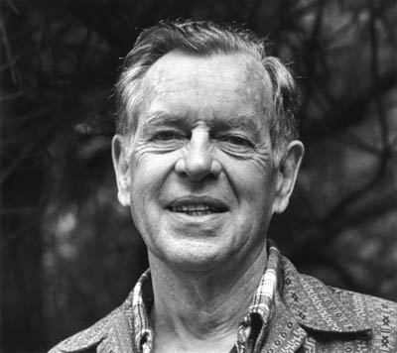
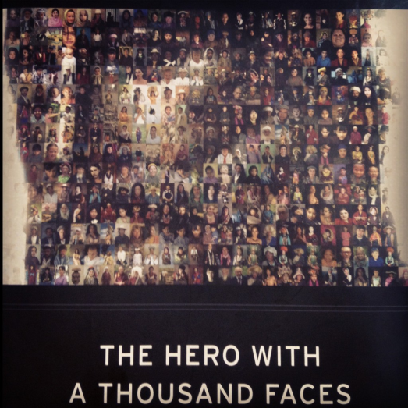



George Lucas strongly inspired by Joseph Campbell’s book “The hero with a thousand faces” (a study in comparative religion, 1949) when he created the Star Wars universe (first movie 1977)
  The monomyth
  The hero’s journey
  Metamorphosis
“Campbell was my Yoda”

Slide 6


Strong econometric evidence
Studies of agriculture show that the average time from research to (main) impact can be 25-50 years
Some research is clearly useful in a much shorter time frame, but this is not the general rule

Slide 7
Preconditions for impact
Research often makes a difference not because of special actions of researchers, but because of the actions and characteristics of various users of research based knowledge
Productive interaction between researchers and users also essential, i.e. the “academic engagement” that individuals carry out
In many cases there might be little that the researchers – and the organisations that fund them – can do to increase, accelerate or influence the impact process

Slide 8

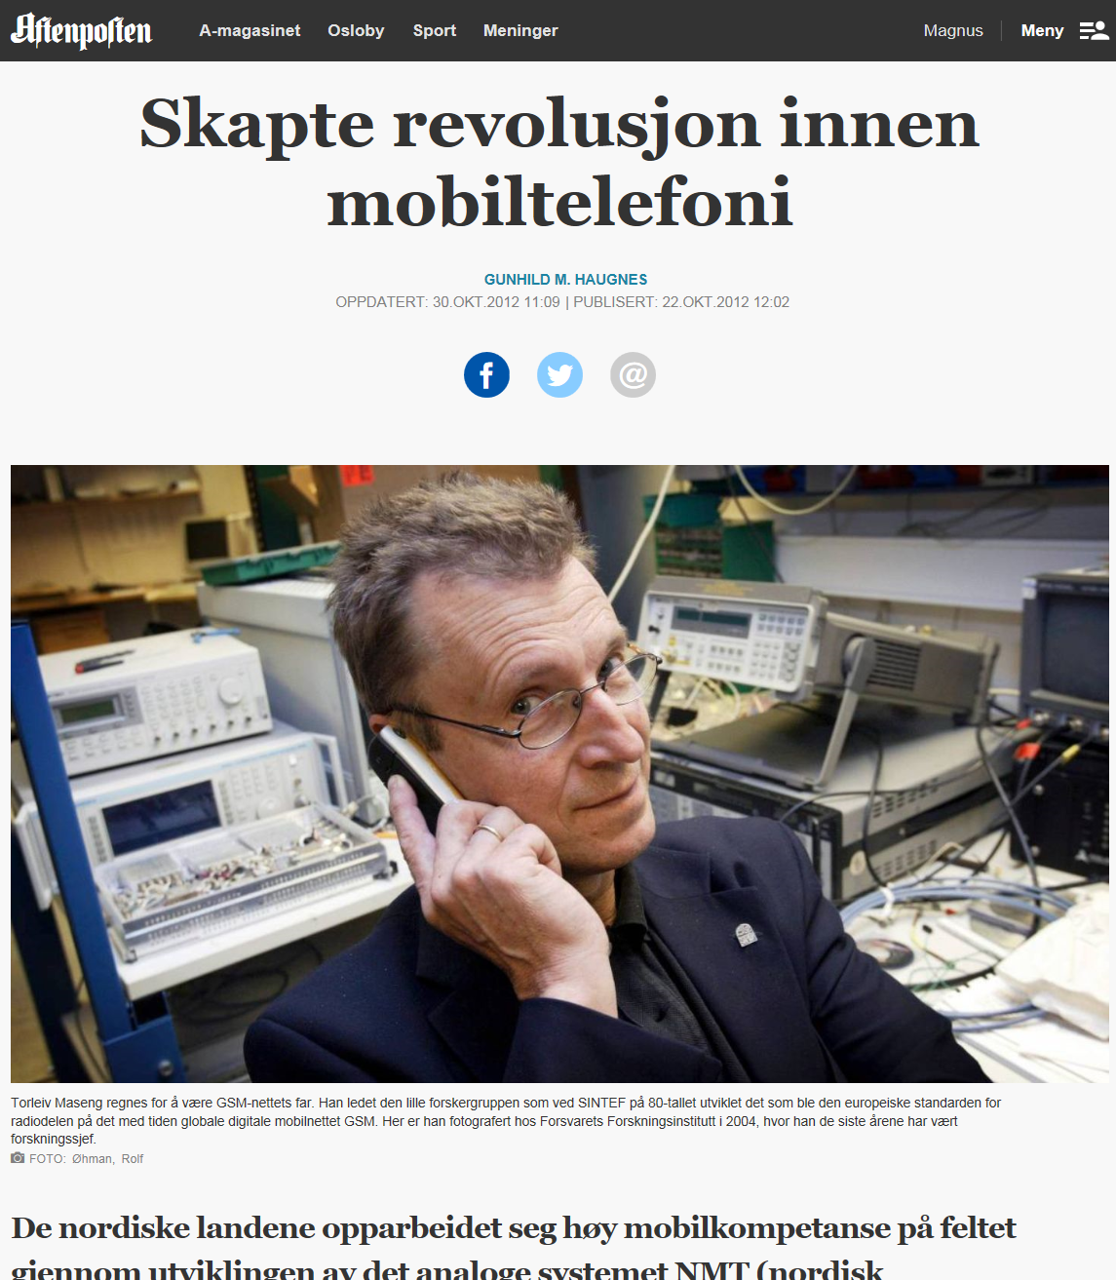
GSM technology
One of the most important research-based innovations coming from Norway (and elsewhere) the last 50 years
Main actors: the state phone company’s research institute and the technological institute SINTEF
Strong interaction gave a digital system well suited Norwegian geography
Weak impact in Norway, strong elsewhere (Nokia, Ericson and more)

Slide 9
Types of impact
Relevant impacts from research are not just economic but also related to health, environmental issues, policymaking and more
Impacts can be instrumental and problem-solving but just as often conceptual, symbolic, political and more
This is a central backdrop for modern impact measurement methods
My earlier examples – Star Wars, agriculture, GSM – are all useful for understanding the heterogeneity of impact

Slide 10
Differences between fields

Slide 11
Are SSH different?
Time: does it take more (or less) time for impact from social science and humanities research?
Preconditions: are there different external conditions that need to be met for social science and humanities to make a difference?
Types of impact: does social science and humanities research lead to distinct types of impact? Does this warrant special methods for measuring impact?
Different from what? From STEM? From something else?

Slide 12


Slide 13


Slide 14


Slide 15
Differences
Depend upon perspective and level of analysis
We often exaggerate the similarities between social sciences and humanities – and their differences from other fields
Compared to social science, humanities researchers define their activities to a much greater extent as “basic research”, they are more international and have less external funding
At another level, there are major differences within these two fields but also transformations going on

Slide 16
Academic engagement in Norway

Slide 17
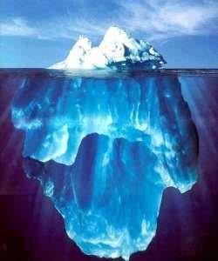
4400 Norwegian researchers
In the last three years I have…:

Slide 18
Five main engagement types
Dissemination to users/the general public
Training in/for non-academic organisations
Individual consultancy, professional practice and adjunct positions
Formal research collaboration
Commercialisation

Slide 19
Differences between fields

Slide 20
Two distinct stories
Similarities
Differences
Dissemination is the most common activity and commercialisation the least common in all fields
Some researchers from all fields found in all activities
The same factors influence the tendency to get involved in these activities regardless of field
Humanities overrepresented in dissemination, underrepresented in formal research collaboration and commercialisation
Social science overrepresented in training and consultancy, underrepresented in commercialisation
Fewer institutional differences than expected

Slide 21
Positive for engagement
Non-academic work experience lasting more than one year
  Very common (48% in humanities, 59% in social science, 53% average)
A research profile defined to a greater extent as “applied” or “problem-oriented”
  Much more common in social science than humanities
Seniority
  Impact may be related to a certain level of expertise and experience
External funding
  Less common in humanities than other disciplines

Slide 22
Wider collaboration partners

Slide 23
Are SSH special fields?
So far: yes and no
Time: few indications that impact has a different time dimension in SSH
Preconditions: the non-academic partners are somewhat different, and humanities has fewer externally funded projects
Types of impact: an indirect form of impact based on dissemination and training is central across fields
Impact measurement: should not use patents and spin-offs to measure the use of social science and humanities – or of any other field

Slide 24
Conclusions
We need a better discussion about impact and more knowledge about how the impact process unfolds
Although social science and humanities research may be less “special” or “exclusive” than is often assumed, this also means that these fields are good starting points for fresh perspectives on and discussions of impact
This is what we want to contribute to in the OSIRIS project

Slide 25
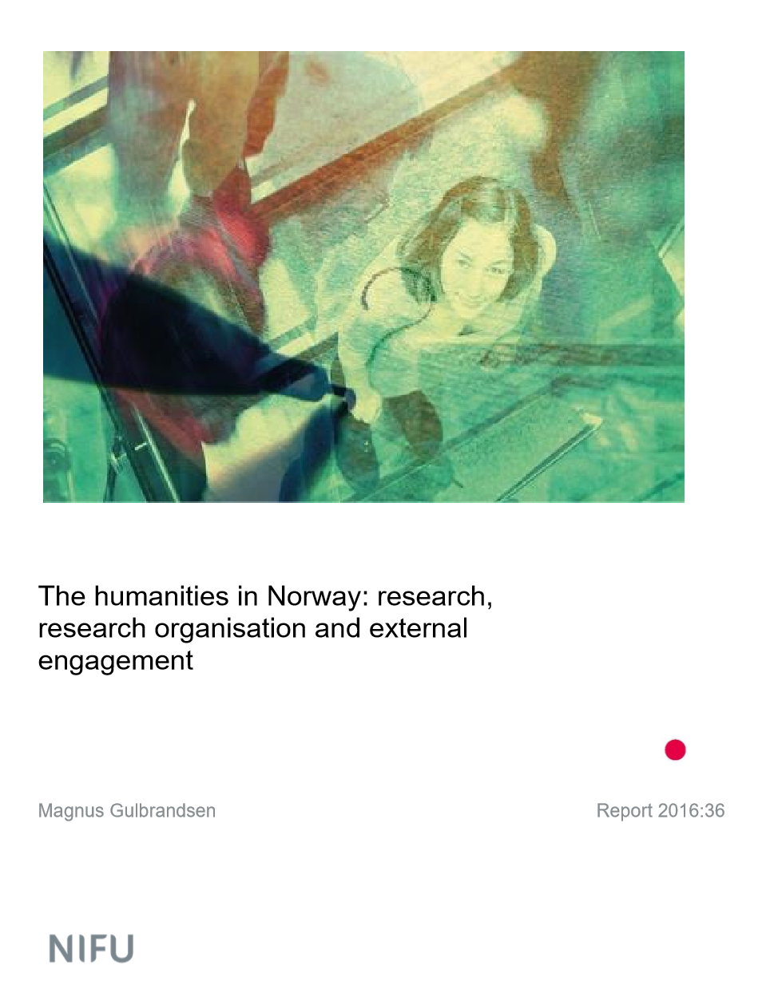

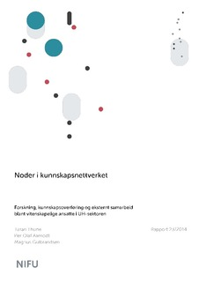
Thank you
For more information, contact magnus.gulbrandsen@tik.uio.no or see http://www.sv.uio.no/tik/english/research/projects/osiris/

