Slide 1
Impact & public values: how can funders usefully support impact?
Paul Benneworth, Center for Higher Education Policy Studies (CHEPS), University of Twente, the Netherlands
With Reetta Muhonen, TaSTI, Tampere, Finland &
Julia Olmos Peñuela, University of Valencia, Valencia, Spain

Slide 2
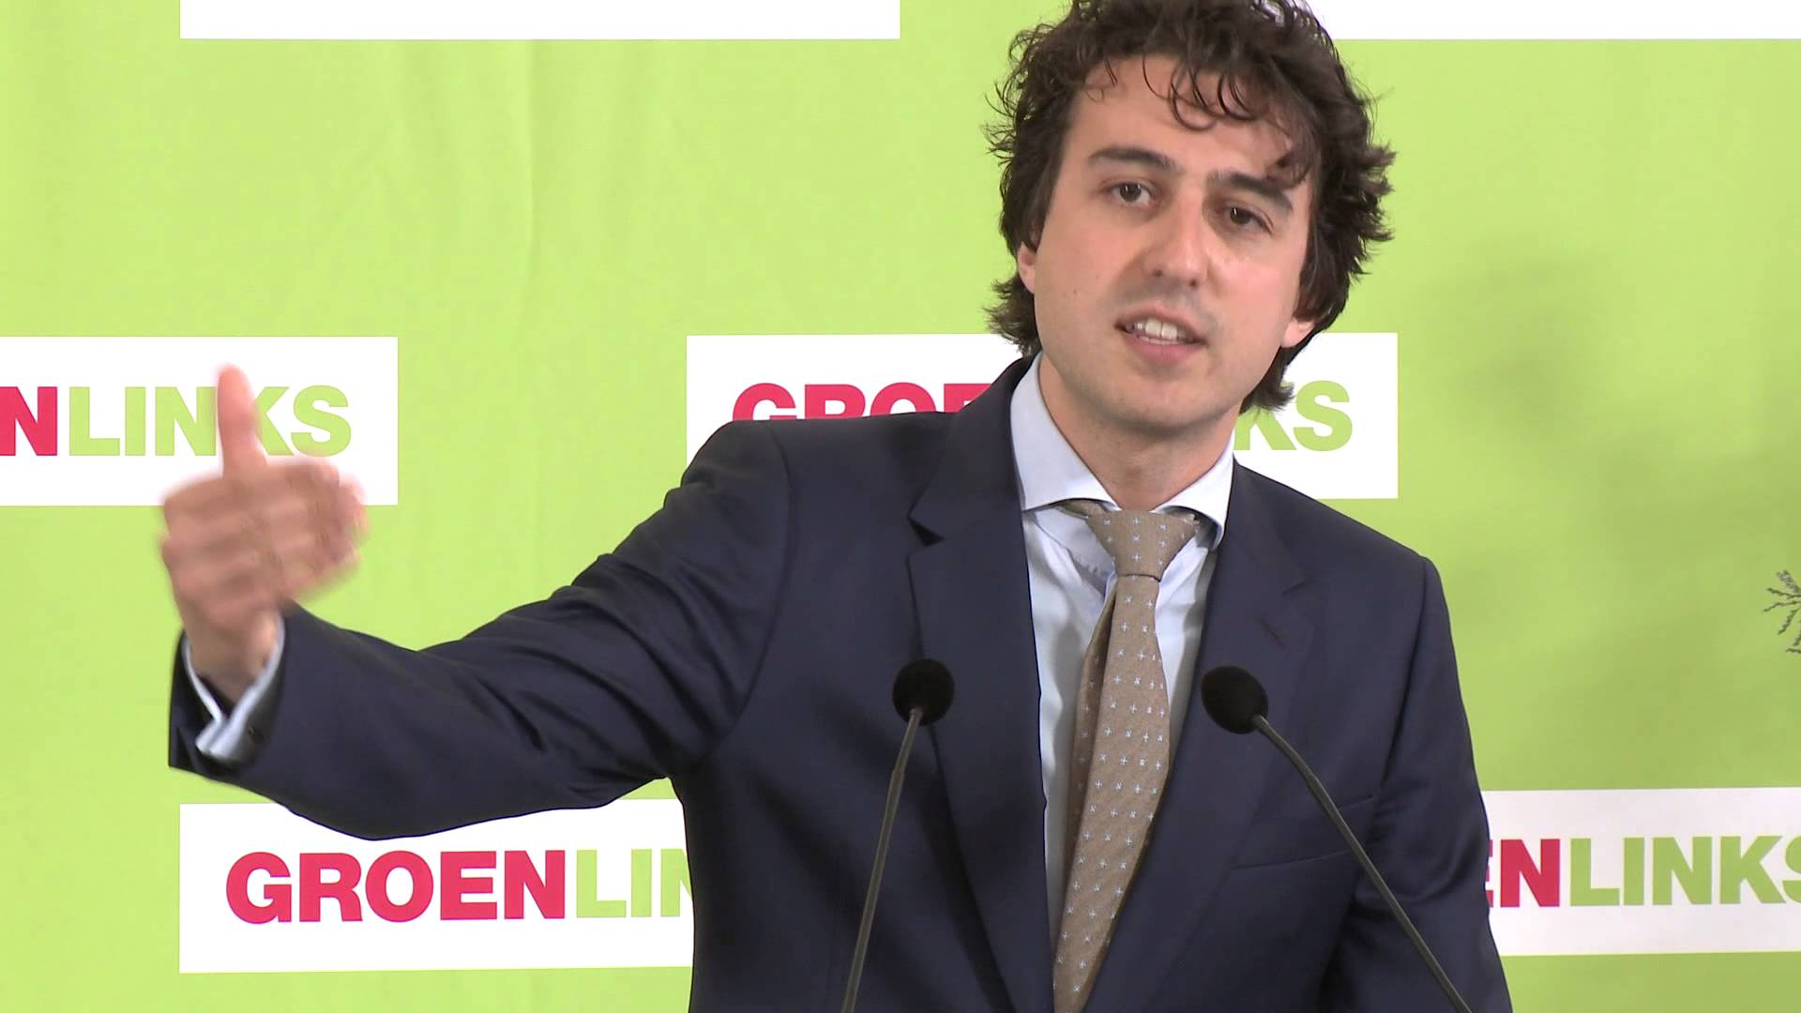
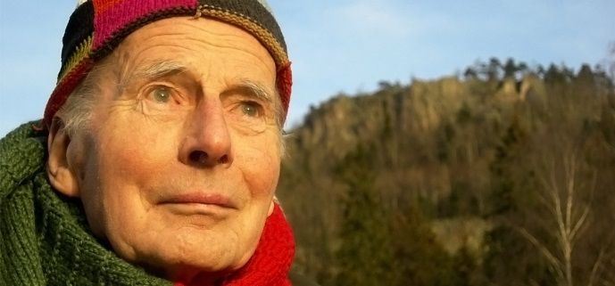
Why are we still even talking about the impact of humanities and social sciences?
We found a fortnight ago that 10% of Dutch Voters chose a 1970s Norwegian philosopher’s approach to express their views

Slide 3

Overview
Introduction – the policy problematic of accidental agreements
The misfocusing – the disappearance of publics from research impact
Towards understanding societal development journeys
Developing a typology of how society uses research
Developing measures, incentives, policies to promote impact pathways

Slide 4
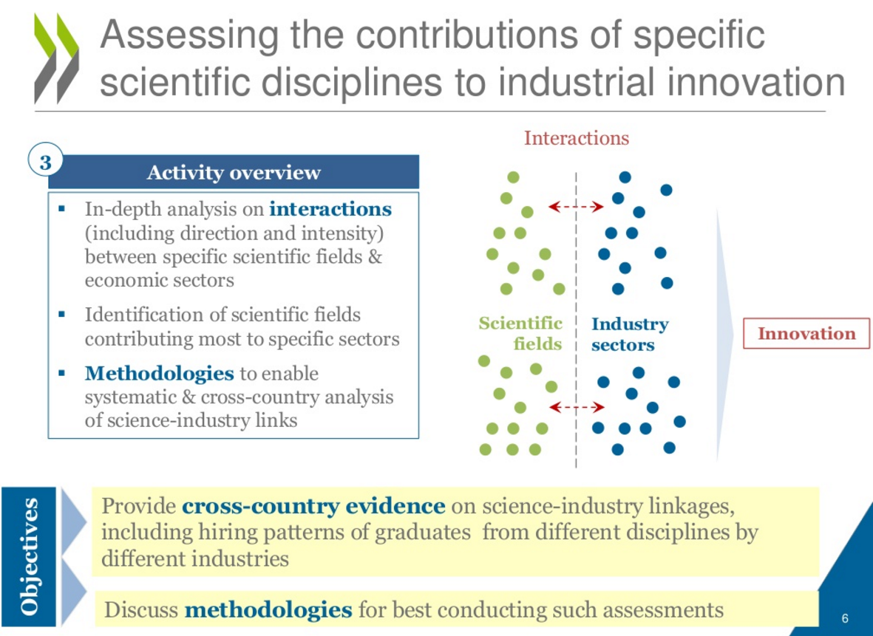


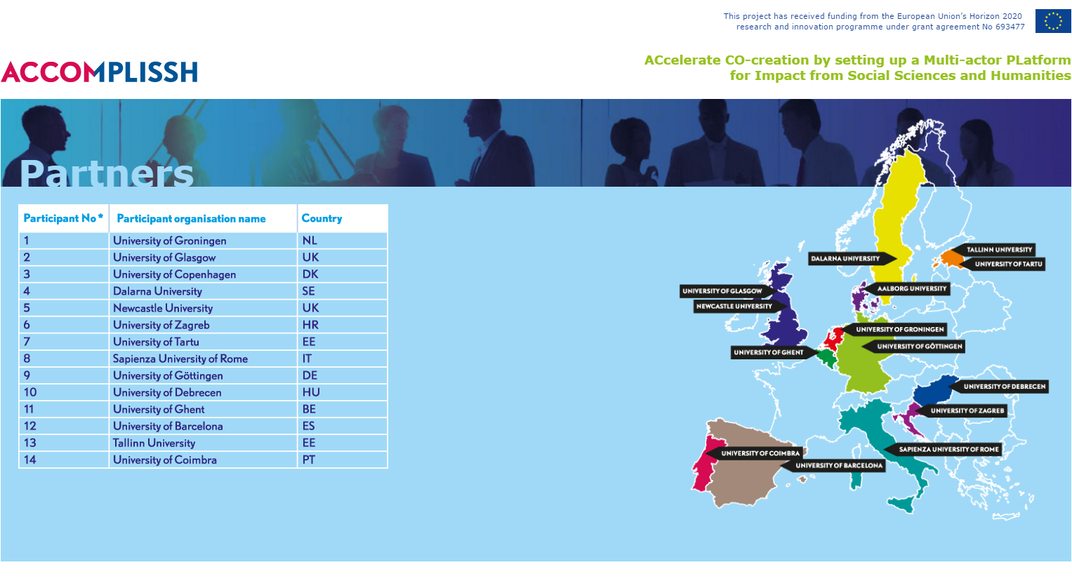

A hot topic in research evaluation

Slide 5
The policy problematic of impact ‘evaluation’
3 lemmas of modern research
We invest in research because of the benefits it brings for our societies
We evaluate our research to ensure that it delivers efficiently and to drive up quality
We need to evaluate the impact of research to maximise societal benefits
But how can we evaluate our research to improve the production of society benefits?
What are the appropriate
  Units of evaluation?
  Scales of measurement?
  Expectations of outcomes?
  Importance vis-à-vis scientific quality?

Slide 6
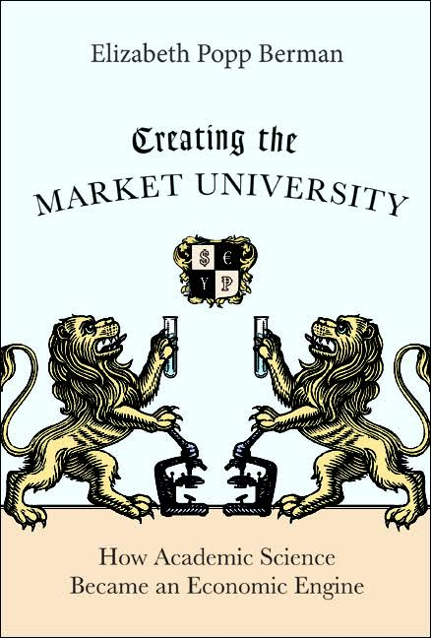

The accidental agreement on AUTM indicators
Donovan today:
“Practice of assessing impacts have raced ahead of its theory, current events mean it is useful to stop and think about the implications of the different elements of assessing research impact;

Slide 7
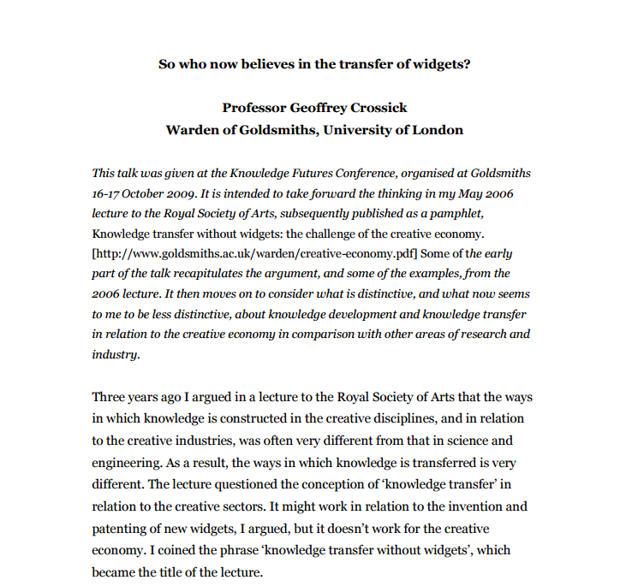
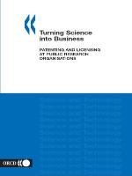
The usual suspects of impact evaluation
The emergence of a standard set of measures of research impact
  Contract research income
  Commercial income
  License income
  Patents/ patent income
  Spin-off company formation

Slide 8
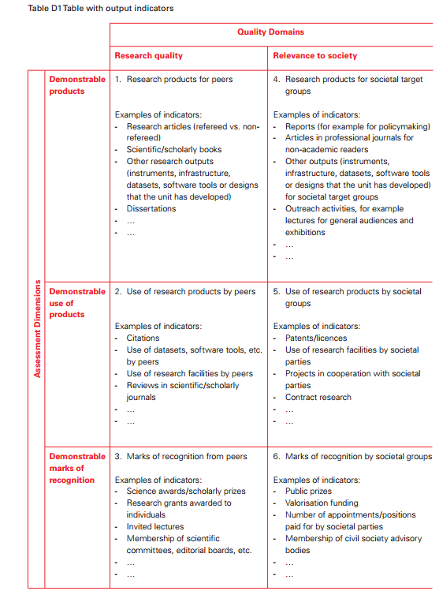
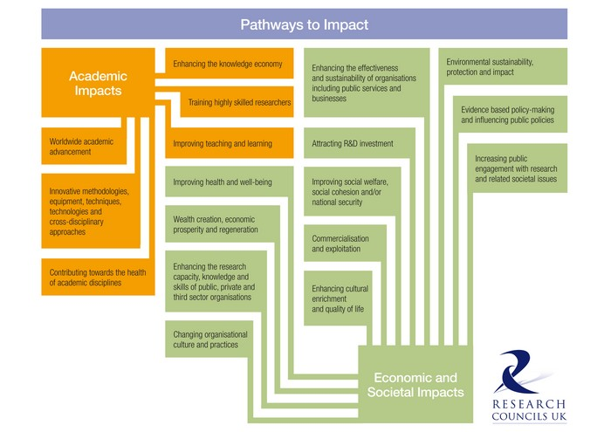
Research Councils & “Impact Grailquesting”
Widespread understanding that need to capture more

Slide 9
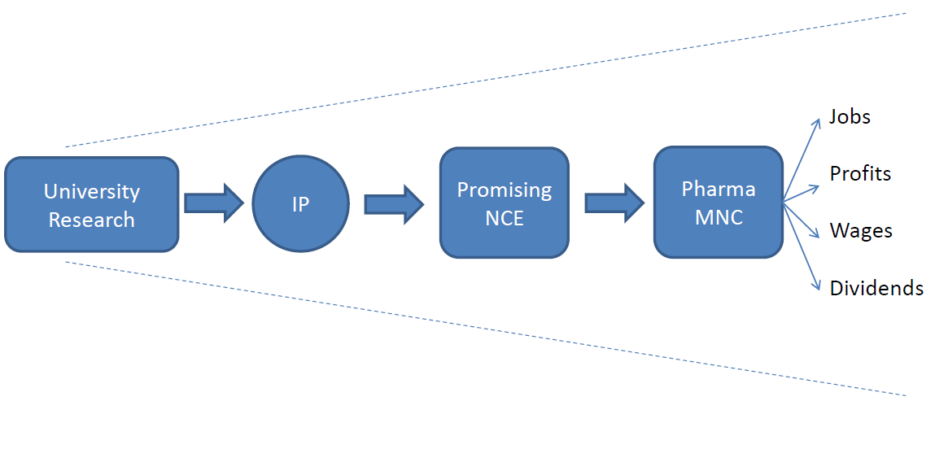
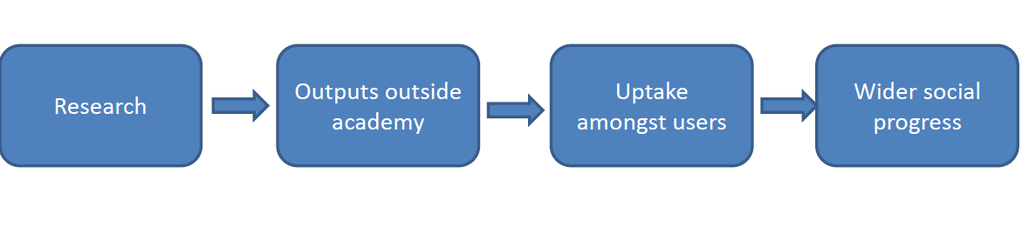
The long shadow of the linear model
From technology transfer meta-theory
To a popular policy concept
“We must measure this”
“We can measure this”
Notes:
Now what has happened – I contend – is that there has been an elision between a linked set of processes in which research is intermediated into innovative businesses, and an unsophisticated neo-linear model.
So the top diagram shows a version of the model by which knowledge drives growth under very particular circumstances.
But, in a process that I don’t have time to chart here, there has been the development of a linear, stage gate model that loses all the sophistication of the feedback loops and the mediating nature of ‘knowledge’ in the innovation process, and simply sees that research drives progress.
The top model highlights clear and identifiable benefits that can be measured, and with a degree of ingenuity, ascribed to particular research projects, whicb can be measured. (CLICK)
The problem is that this model is generalised from particular research projects to all scientific research, and clear and identifiable benefits that might apply are transformed into nebulous benefits that must apply. (CLICK)

Slide 10
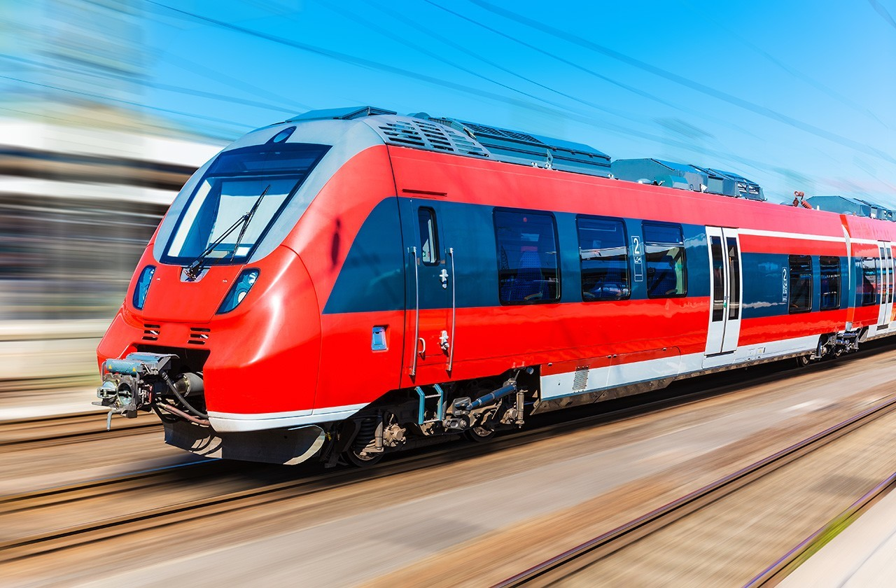
Research impact as a train metaphor
With a discussion over what the contribution of the research is to the train
Line 1: Impact
Social benefit
Research
Outputs
User uptake
Publication
Citations
Line 2: Excellence
Excellence

Slide 11
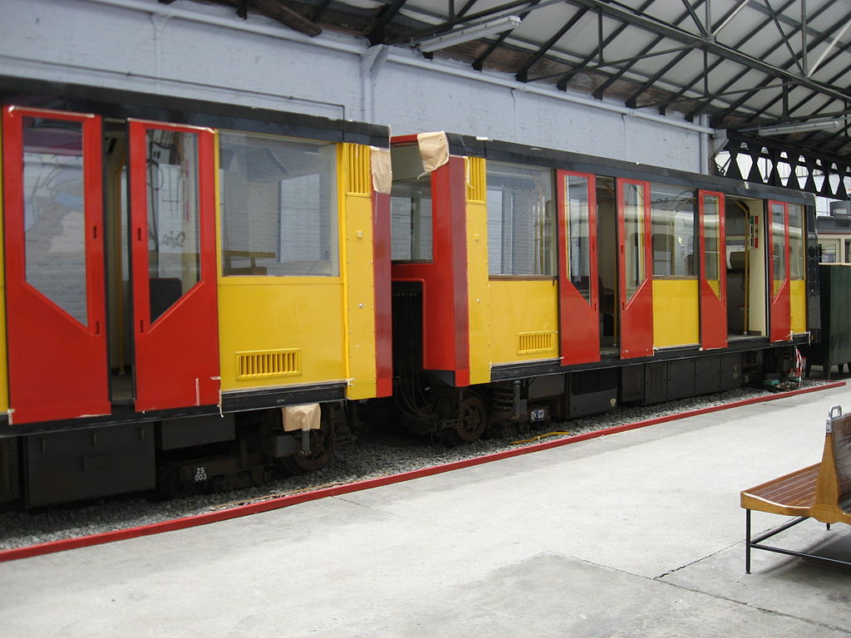
The loss of the ‘passengers’ from the picture
The point of a transit system is not to run trains…
  But to create value for passengers
A transit system becomes taken-for-granted in allowing people to live good lives
  Gulbrandsen “Research often makes a difference not because of special actions of researchers, but because of the actions and charatcierstics of various users”
What the people do with the system more important than what the train allows
Thinking about ‘social journeys’ rather than train rides

Slide 12
ENRESSH Project – working group 2
European Network for Research Evaluation in Social Sciences & the Humanities
4 year COST Network with 31 participating countries
Apr 2016-2020
Seeking to better understand SSH evaluation of science excellence and scientific impact
WG 2 Understanding societal impact
Step 1 Creating an impact of typologies
Fiches gathered – 65 fiches from 17 countries (including 4 from Norway)
Developed typology of research impact pathways

Slide 13
SSH pathways to societal impact
pipeline model
dissemination
cocreation
public engagement
driving societal change
research engagement as therapy
cocreation
interactive dissemination
media dissemination
expertise & evaluation
building new epistemic communities
seize the day
reacting to societal change
anticipating anniversaries
engagement activities/ "creep"

Slide 14
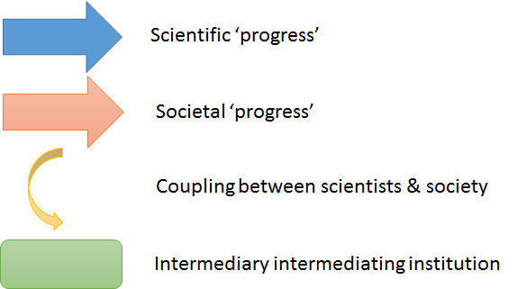
The key to the typology
Proxied by citations
Giving society more capacities to do ‘good things’
Visible (non-)transactions
Second order effects – transactions → networks→ Institutions

Slide 15
The Classical Pipeline Model
The Interactive Dissemination Model
The Media Dissemination Model
The Public Engagement Model
Public Vote

Slide 16
The Expertise & Evaluation Model
The ‘Anticipating Anniversaries’ Model
The ‘Seize the Day’ Model
The “Research Engagement as Therapy” Model

Slide 17
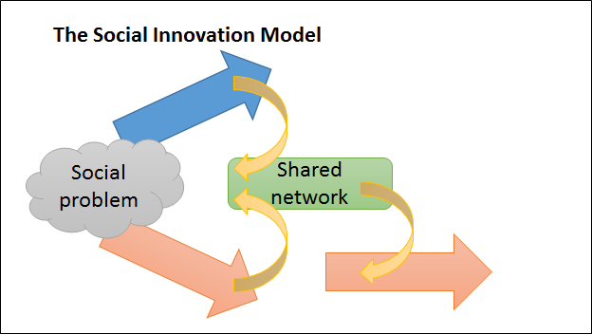
Knowledge “creeps” into society model
The ‘Building New Epistemic Communities ‘ Model
Training new cohorts of researchers
Societal discourse
Producing new cohorts of students
Producing new cohorts of workers
The Co-creation Model

Slide 18
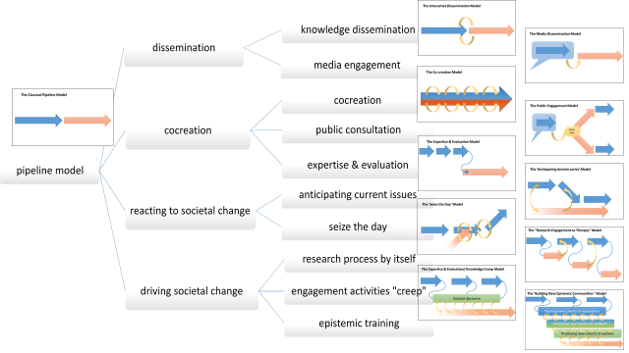

Slide 19
Next steps in using this for evaluation
Three more years to run in the project → evaluation framework
Finalising the typology/ architecture/ elements/ dynamics
Understanding the experiences of researchers on these pathways (incentives/ barriers)
Understanding the role of evaluation systems on these incentisve
Identifying appropriate measures, mechanisms, techniques for making publics more visible in impact.

