Slide 1
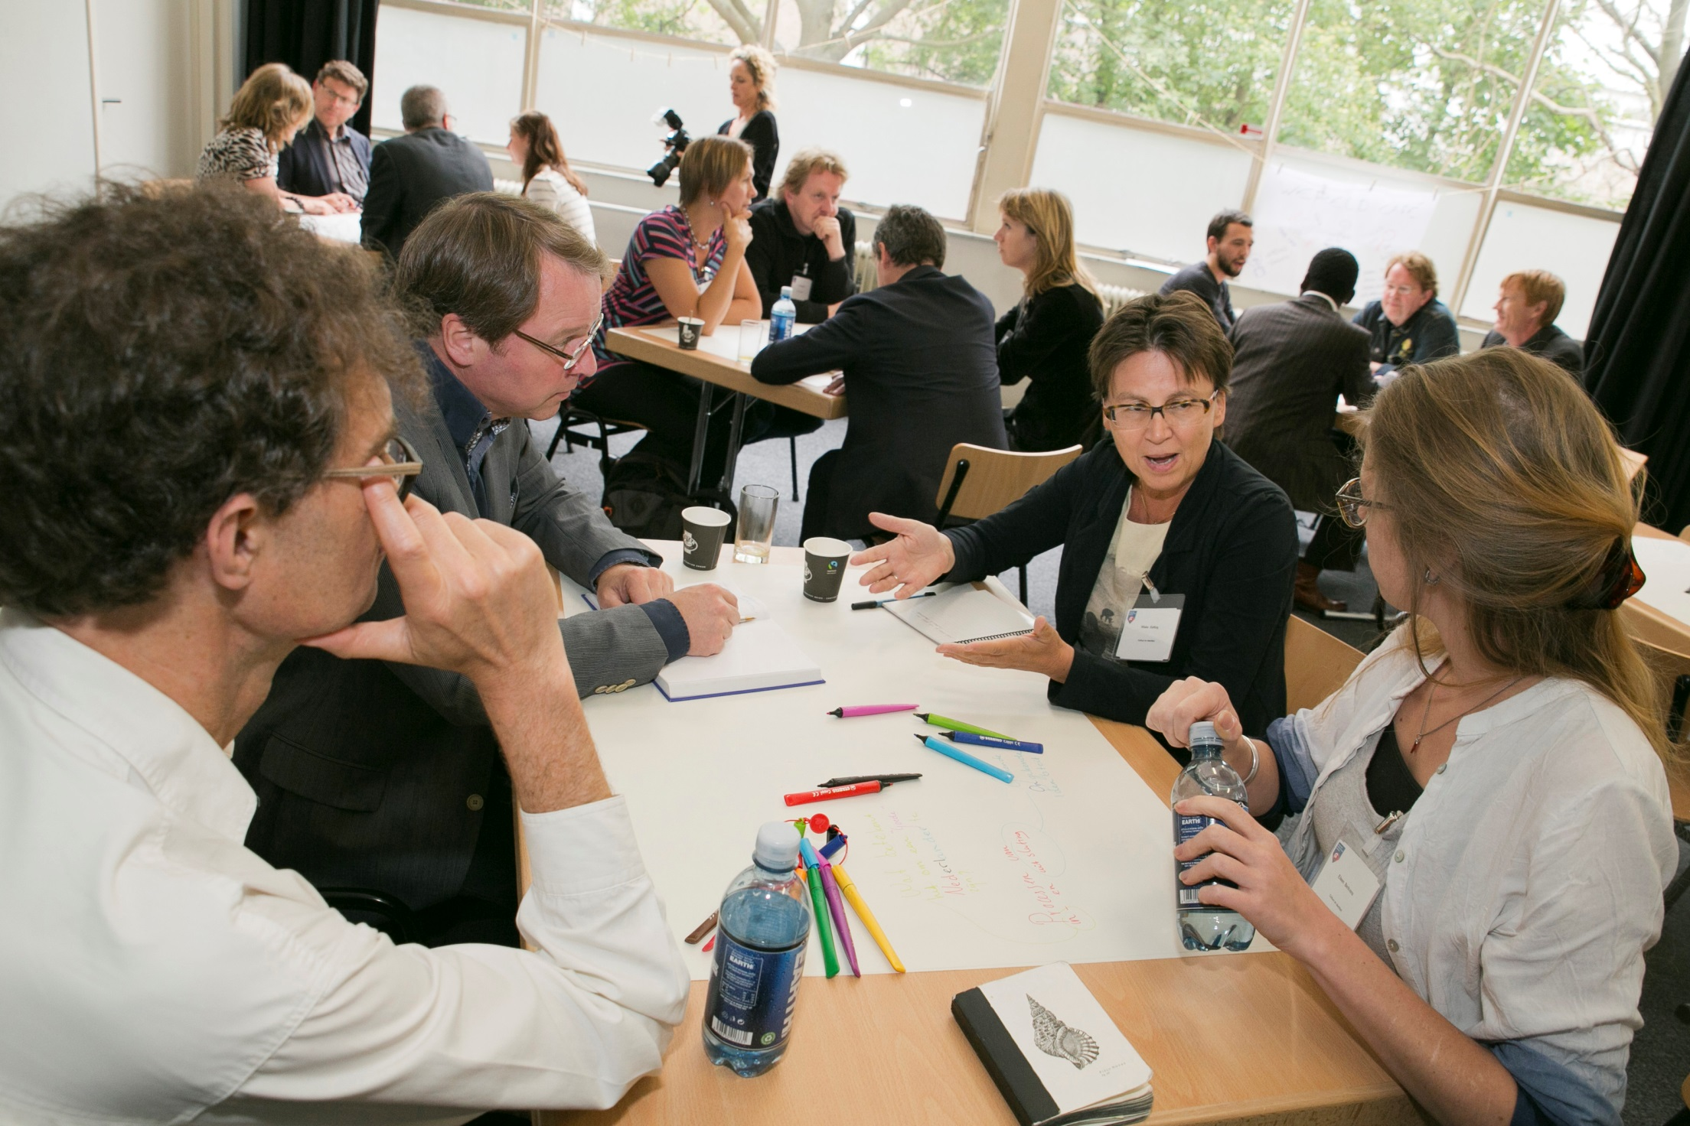
Assessing the impact of SSH: The Dutch approach
Leonie van Drooge

Slide 2
Two tales of one city
A positive story about intentions and initiatives:
  National habits
  National policies
    Research council NWO
    Standard Evaluation Protocol for academic groups
  National initiatives dedicated to SS and H
A realist story of perceptions and practices :
  Commonly shared interpretations
  Unease
    that leads to even more sophisticated evaluation

Slide 3
The Dutch approach to…
Trust
Financial decisions
Evidence
Measurement
Impact

Slide 4
Dutch approach to impact
Impact or:
  Valorisation – ministries
  Knowledge utilization – research council NWO
  Relevance to society – ex post evaluation protocol SEP
  Impact – locally used
Formal definitions are similar; it
  is a process
  aims at enhancing societal impact in the widest sense of the term
  is possible in all different disciplines
  can occur in many different forms

Slide 5
NWO – Innovational Research Incentives Scheme
Veni, Vidi, Vici
Three criteria:
quality of the researcher
quality, innovative character and academic impact of the research proposal
knowledge utilisation
The ex ante assessment of the latter regards:
Potential: a realistic representation of the knowledge utilisation possibilities (or the lack of possibilities)
Implementation: the extent to which the action plan is made tangible with respect to knowledge utilisation.

Slide 6
NWO – Knowledge Utilization
A process promoting the use of the outcomes of scientific research both outside academia and by other academic disciplines.
This process frequently requires interaction between the researcher and the potential knowledge user and such interaction may occur at any stage of the research, from the formulation of the research question right through to the dissemination of the results.

Slide 7
NWO - Evidence
Publication culture
Track record regarding knowledge utilization

Slide 8
SEP: Standard Evaluation Protocol
Assessment once every 6 years, ex post
Board of university / research organisation is responsible
Assessment takes place at research unit level
The four three assessment criteria are:
  academic quality
  academic productivity
  relevance to society (criterion since 1994)
  feasibility
Review committee forms a judgment, based on self-evaluation by the unit (including metrics) and site visit
No predefined consequences

Slide 9
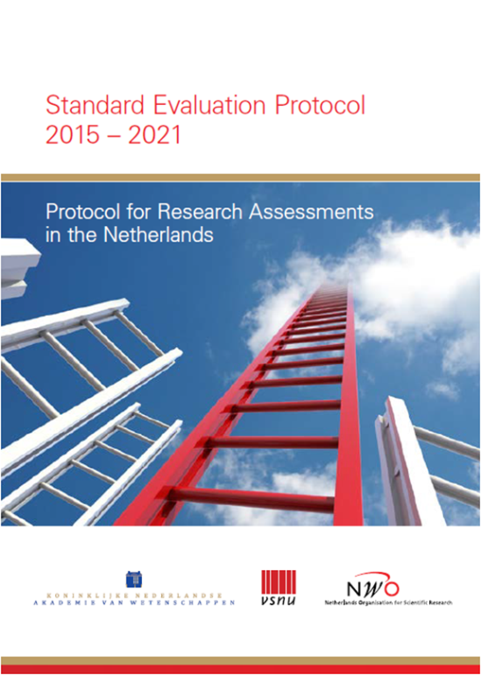
SEP 2015-2021 – Relevance to society
The committee assesses the quality, scale and relevance of contributions targeting specific economic, social or cultural target groups, of advisory reports for policy, of contributions to public debates, and so on.
The point is to assess contributions in areas
that the research unit has itself designated
as target areas.

Slide 10
SEP 2015-2021 – A narrative + a table
A narrative indicates what relevance to, impact on or added value for society the research unit’s work has (had) at regional, national or international level….
The narrative describes:
the precise work or research projects involved;
the individuals involved and their roles;
the nature of the research unit’s relevance to or impact on society and the scope of that relevance or impact;
how the unit achieved this;
whether revenue has been generated.

Slide 11
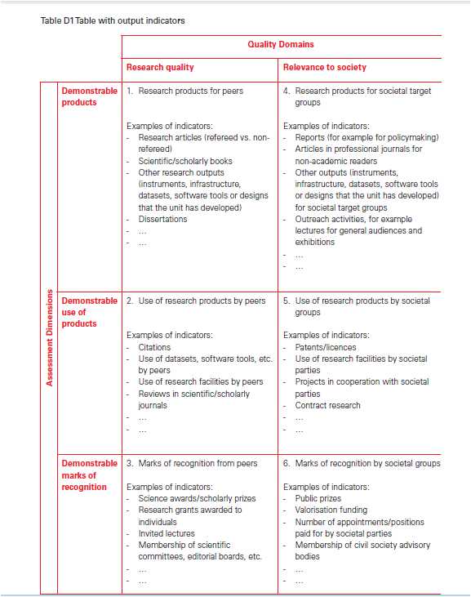

Slide 12
Series of reports “Quality indicators”
Social sciences
Humanities
Design and engineering disciplines
Dimensions | Scientific quality | Societal quality
Demonstrable output
Demonstrable utilisation
Demonstrable recognition

Slide 13
QRiH: Quality and Relevance in the Humanities
Related to SEP
Introduces a narrative for the entire unit: mission, academic as well as societal perspective
Evidence: case studies as well as quantitative indicators
“Hybrid products:”
  Books and articles intended for multiple audiences
  Exhibition catalogs
  Serious games

Slide 14
Unease, or (impact) policies in practice
Trust
Finance
Evidence
Measurement
Impact

Slide 15
Unease with the sociologists
Nederlandse Sociologische Vereniging: Naar een evenwichtige kwaliteitsbeoordeling van sociologisch onderzoek
Dutch Sociology Association: Towards a well-balanced evaluation of quality of sociological research
Focus on international peer reviewed publications; neglect of engagement with society

Slide 16
More unease: Science in Transition
“Science is in need of fundamental reform. That is the belief of the initiators of Science in Transition. Science has become a self-referential system where quality is measured mostly in bibliometric parameters and where societal relevance is undervalued.”
New evaluation approach (SEP + job appraisal) in University Medical Center Utrecht
Mission of academic hospital is central

Slide 17
University Medical Center Utrecht
Structure
  Leadership&culture
  Collaboration with stakeholders
  Continuity & infrastucture
Process
  Setting research priorities
  Posing the right questions
  Incorporation of next steps
  Design, conduct, analysis
  Regulation and management
Outcomes
  As defined in SEP

Slide 18
Thank you!
Leonie van Drooge
l.vandrooge@rathenau.nl

Slide 19
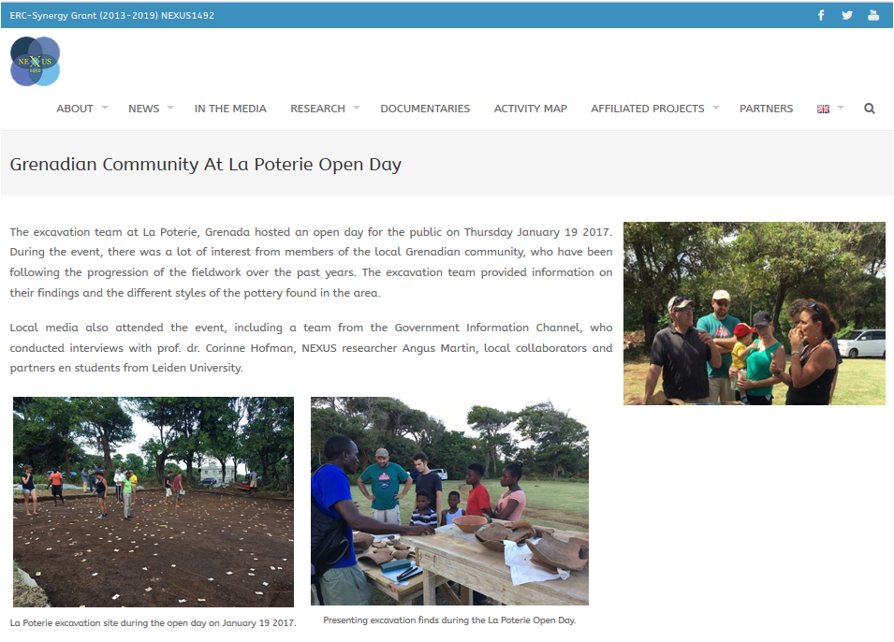

Slide 20
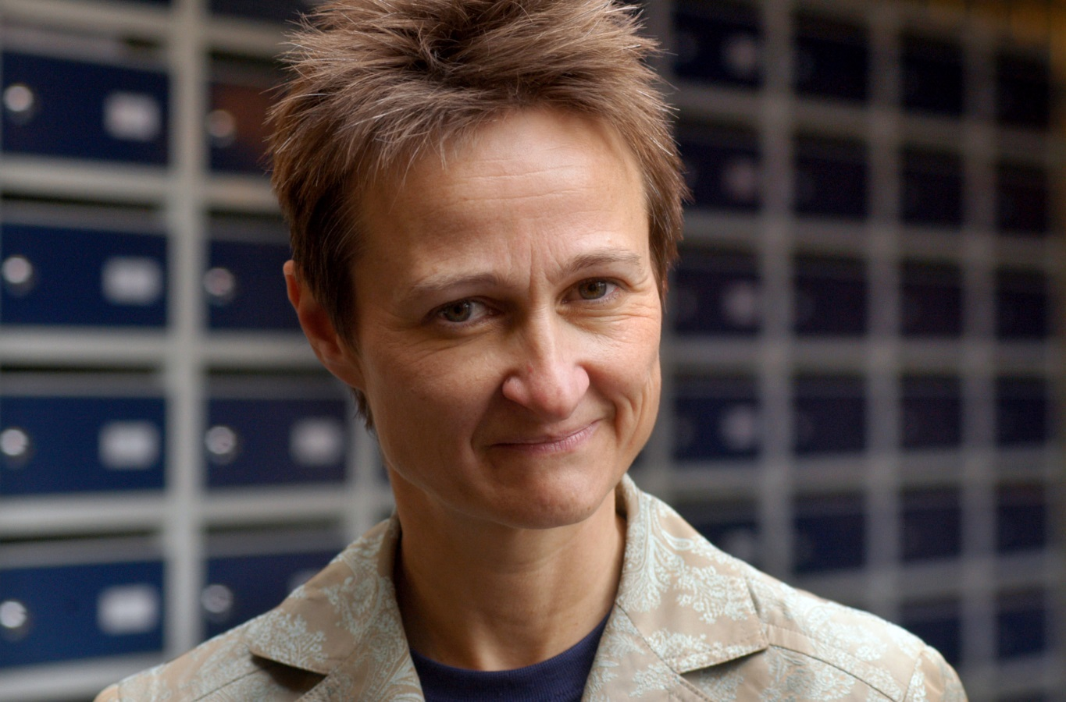
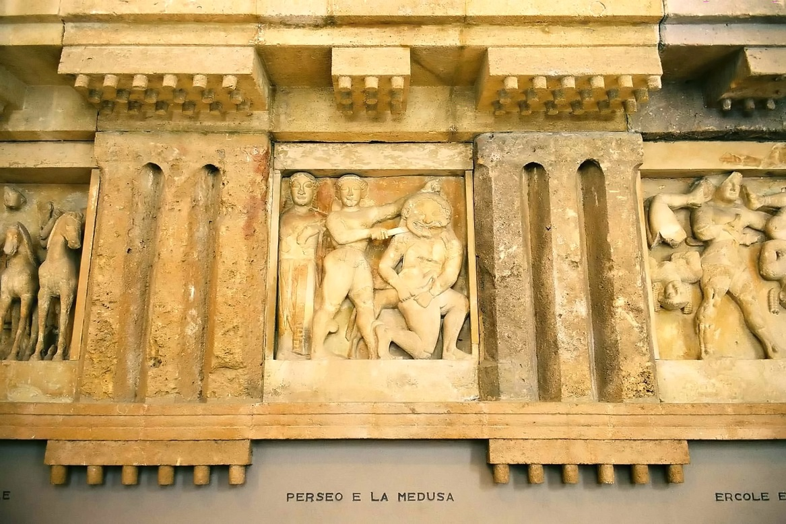


Slide 21
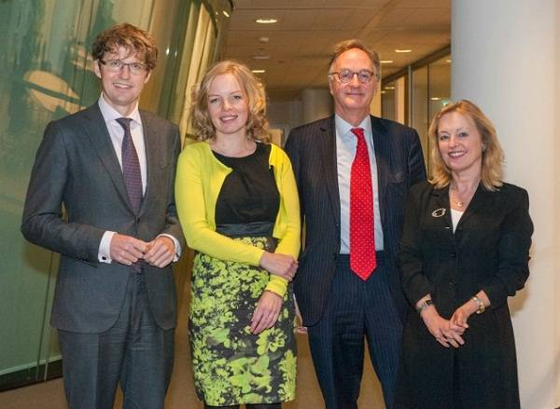


Slide 22
Impact of SSH
2007 report on impact in SSH:
  Economic
  Societal
  Cultural
  Democratic

