Slide 1
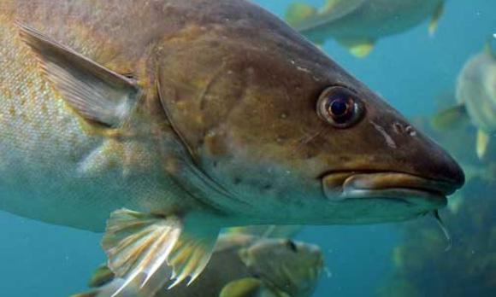
Case: marine biodiversity
Magnus Gulbrandsen
OSIRIS Workshop Valencia 10-11 Oct 2018
Presentation based on desktop research, six initial interviews, three days of observation with extra interviews, Madrid workshop contribution

Slide 2
Problem area
Biodiversity: the variety of plant and animal life in the world or in a particular habitat, including genetic variety, species variety and wider ecosystem variety
Seen as important, desirable and threatened
EEA argues that it is a more severe and immediate challenge than climate change because of path dependencies and irreversibilities
Problem: how to regulate human activities (and alien organisms etc.) so that they do not threaten biodiversity

Slide 3
Problem with problem area
It might be too big for an OSIRIS case!
Biodiversity defined within a species, within a geographical area or within a larger ecosystem – and regulation of it related to many different human activities and other phenomena
From interviews: very large differences between e.g. saltwater and freshwater areas and between species like moose (wild) and reindeer (partly domesticated)
Suggestion: limit the case to marine biodiversity, possibly even only to saltwater/ocean biodiversity (and a specific region?)

Slide 4
Main scientific knowledge base
Biology/ecology in a wide sense and more specialised fields like biodemographics and systems biology
Models of ecosystems also draw heavily upon statistics and other more generic fields (mathematics, computer simulation) – a drive towards big data, better data and more sophisticated models
Applied areas related to mapping/counting of species/individual fish/animals, their genes and so on
To some extent also knowledge about human activities (pollution, fish farming, reindeer farming etc.) and about the effects of various types of regulation (including non-biological effects e.g. related to aboriginal culture)

Slide 5
Pathway
This is more or less a pure policy pathway – the problem area is a policy area
In a wider sense, regulation affects economic activity and the challenge of reduced biodiversity may in a wider sense be tied to health aspects – similar to many of the ASIRPA cases

Slide 6
Maturity of the pathway
Very mature – mapping of ecosystems and regulation of fishing quotas, hunting quotas, pollution and more goes back a century, including using research-based advice (but emergent areas with decentralisation)
The Fishery Board (1900) one of the country’s first HEIs; the Norwegian Fisheries Investigations (1864, now Institute for Marine Research), early applied research institute; Johan Hjort, “the father of ocean research”
Biodiversity is formalised in White Papers (e.g. no. 42/2000-01); regulated as an interplay between mapping and surveillance, coordination of legal and economic mechanisms, and research-based knowledge and competence
New scientific methods, new knowledge and new problems (like plastic in the sea) challenge traditional “one species policies”

Slide 7
Users
Multiple users on the policy side in Norway
Ministry of the Environment with an overall responsibility, but with sectorial responsibilities for other ministries and several underlying and large agencies such as the Norwegian Environment Agency in a complex division of labour
Also international dimension; co-governance of specific regions (e.g. Barents region with Russia) and influence of EU and international semi-public organisations (like ICES) and NGOs
Each of these users have contacts with many different research organisations and they often have high formal competences themselves (and a strong experience base)

Slide 8
Users cont.
Basic funding to research institutes, funding of research council programmes, consultancy etc. quite common
Many informal meeting places and institutionalised and regular updates on new developments in science (but conservative uptake)
Also through organisations like ICES data about organisms in the oceans are gathered and shared with research organisations
Data gathering often involves a large number of people and organisations including hunters, indigenous people, fishery vessels

Slide 9
Research organisations
All the major Norwegian universities have research units that deal with marine biodiversity, which is also the theme of several courses at bachelor, master and PhD level in the four largest university cities
Also several large research institutes like the Institute for Marine Research and the Norwegian Institute for Water Research
Many of the most important units have come together in the SUSTAIN network funded as a centre of excellence with a Nordic grant (this is our first contact into the case)
In other words, the case involves multiple user sites which all have links with multiple research sites which tackle wider issues than just marine biodiversity

Slide 10
Other dimensions
Great international potential in the case: the issue is global and high on the EU agenda, research community very international (all empirical work in Norway done in English), famous UK impact case, large country differences in success rates in the regulation of biodiversity
The case is institutionalised and mature, but the empirical work so far also indicates a number of problems in policy-research interaction and many gaps between the communities
Also a certain “activism” among researchers

Slide 11
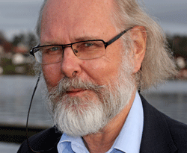
Access/risk
Good contacts with researchers who want to be studied and want to understand how they can engage in a better way with policymakers
These people seem open, reflexive and interested in various ethnographic approaches including electronic diaries etc.
Many of them work with other issues than marine biodiversity, so that could be a risk if the case is defined too narrowly
We need similar contact with one or several policy sites, need to develop this independently of the research network
The case challenges the idea of one user site

Slide 12
The linear model of impact
Traditional impact measurement: relation between inputs and outputs
Process measurement: create a better understanding and indicators for the various parts of the pathway
Research
Inputs
Basic research
Applied research
Development
Market/user
Society
Outputs
Production/ implementation
Sales/use/ effect
Impact

Slide 13
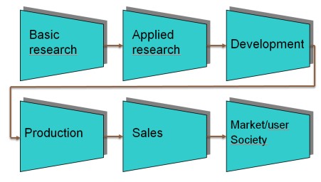
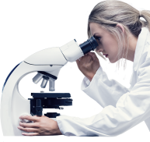

The chain-linked model of impact
The research process
Research
Knowledge
D
S
I
Potential market, need or problem/ problem area
Invent or create an analytical design
Detailed design and test
Redesign and produce or move to practice
Distribute and market, monitor and follow-up
The impact process
Multiple contexts and stakeholders
c
c
c
c
Based on Kline & Rosenberg (1986)

Slide 14
Impact seen from the user side
May not directly involve research at all or only a particular selection of it – impact processes run independently (more or less or most of the time) of the processes of research
As such a pure user perspective may be problematic if the aim is to evaluate research
We need some additional perspectives to understand the relationship between impact and research – I will sketch some ideas that I have called organisational, cognitive, cultural-political and dynamics

Slide 15
Some perspectives for analysing users 1
Organisational
  Organisations need certain capabilities in order to use research (e.g. Cohen & Levinthal 1989, 1990) – important to look also at capabilities to influence research
Cognitive
  To achieve coordination (and reduce cognitive distance), users need to align research results and perspectives with the prevailing perceptions, meanings, values etc. of their context (Nooteboom 2006)
  A large psychological distance (Trope & Liberman 2010) may limit the ability to imagine that research could be used or complicate coordination

Slide 16
Some perspectives for analysing users 2
Cultural and political
  Transilience: the degree to which a new idea makes old competences and ways of working obsolete (cf. Abernathy & Clark 1985)
  Impact resilience: how impact may be limited over time due to the resilience of the receiving organisation or problem area
Dynamics
  Movement of ideas: proliferation (research meets other ideas), reinvention (old research gets rediscovered), reimplementation (new uses of research are discovered), termination (research ideas get discarded)
  Movement of people and material movements
  Divergence and convergence

Slide 17
Example: biodiversity
How should biodiversity in Norwegian nature be protected? Use of biological/ecological research
Organisational: absorptive capacity varies from extremely high to very low; users essential for gathering and distributing data to research
Cognitive: researchers want to be useful but struggle with many of the user contexts
Cultural-political: high degree of resilience which may be good for the impact process (possibly also for research)
Dynamics: high movement of people between users and research, infrastructure for data sharing

Slide 18
Example from the Norwegian Work and Welfare Directorate
How should people who have been ill be reintroduced to work? Use of “individual placement theory” from research
Organisational: absorptive capacity is centralised, attempts at creating intermediary organisational units
Cognitive: huge distance between some research units and the users, some research from different national contexts
Cultural-political: high degree of transilience
Dynamics: limited involvement of researchers (reinvention), emphasis on internal personnel movement and on material translation of research

