Slide 1
Me and myself
Lars Wenaas, master in Philosophy back in the days.
One year (of four) into my PhD-project about Open Access
A part of Research Council of Norway’s public PhD scheme
  Employed at Unit/Cristin as a national coordinator for Open Access-affairs in Norway
  since 2011
  RCN and Unit has obvious interests in my subject of Open Access

Slide 2

Topic
Title: “Open Access: a change in academic publishing with limited reach?”
Hot political topic
  National guidelines for Open Access
  Plan S
  EU being the main driving force
The project has naturally drifted a bit towards Open Science
Open Science can be interpreted in (at least) two different
contexts: one “external” and one “internal”.

Slide 3
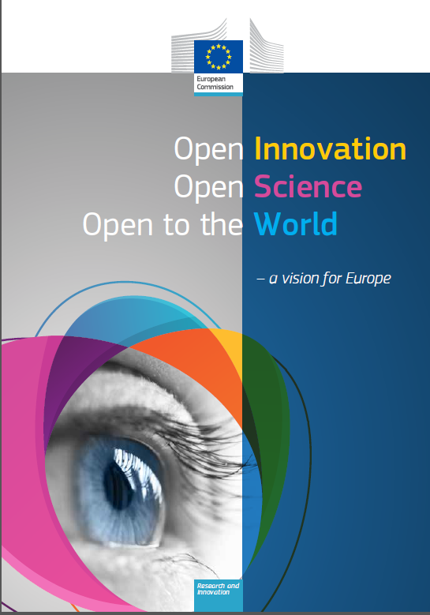
1. Open Science as an innovation-enabler
“Most of the political priorities set for my mandate as
President of the European Commission depend to a
greater or lesser extent on research and innovation”
President Junker

Slide 4
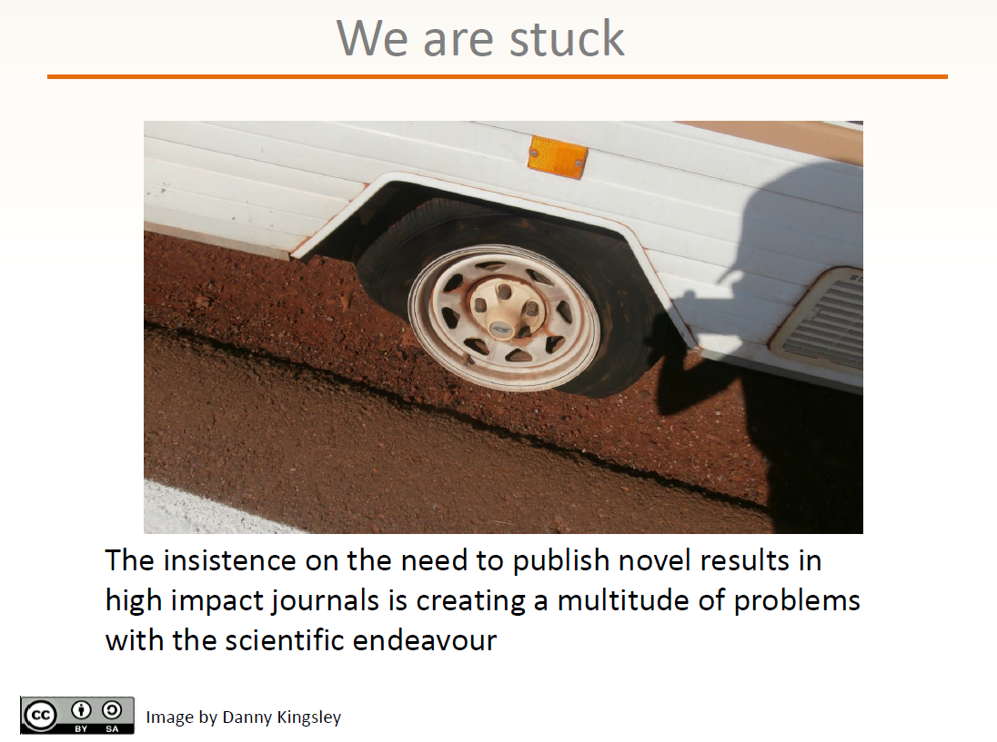
2. Open Science as a remedy
Dr Danny Kingsley
Head of Scholarly Communication
University of Cambridge

Slide 5
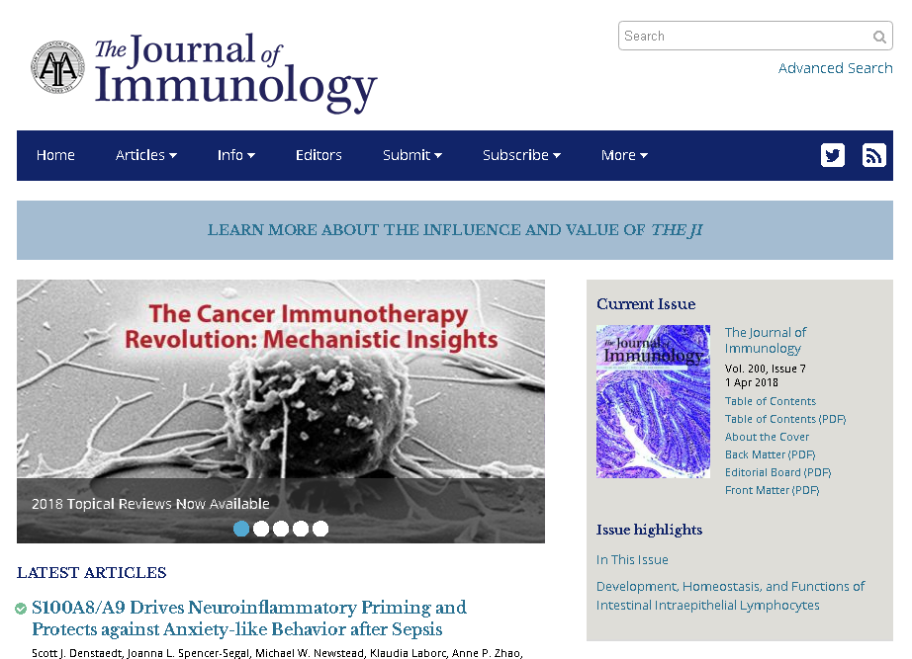
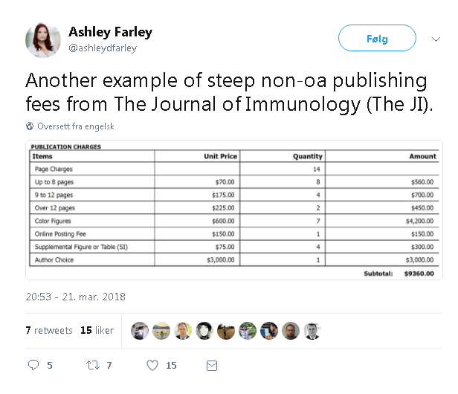

Slide 6
A heavy burden
On open science to fix
A system not conforming to the high standards of science
We must revert to the Mertonian norms
Enhance innovation
..and save Europe
(There are other threads to follow
  We need to restore the cultural authority of science, since trust in science is decreasing
  Open Science as a consequence of the new digital age and networked science)

Slide 7

Outline of research questions
If Open Access and Open Science is the cure, what is the disease in the research-system?
What does Open Access aim to fix and enhance? Are there side-effects that comes with
the cure?
Is the patient taking the medicine? If not, why? What is the general status of
Open Access-publishing in Norway? (And does hybrid-articles have a citation-advantage?)
Does Open Access increase usage outside academia?
A case-study of flipped journals
To what extent is Open Access and Third mission-activities seen as complementary
on the policy-level at Norwegian universities?

Slide 8
Data
A national CRIS, all publications in Norway 2011-2017 (RQ no.1 and 2)
  Enhanced by many sources, primarily Open Access-info
  But also WOS/SCOPUS/Crossref-citations
  And journal-metrics (SCIMAGO) just in case
Further enhance the data-set with visiting and download-logs from one important Norwegian publisher (Universitetsforlaget). Parts of their portfolio was flipped from subscription to Open Access. (RQ no. 3)
Official strategy/policy-documents from a selection of Norwegian Universities, for revealing bridges between 3M and OA (RQ no. 4)

Slide 9
Connecting to OSIRIS
The four research questions in OSIRIS:
How can we identify research impacts, their magnitude and the processes that lead to them? (Perhaps RQ no.1 and no.2?)
How can we characterize the absorptive capacity and processes of cogeneration, transfer, engagement, uptake and utilization of knowledge through which investment in research lead to social and economic impacts over time? (RQ no.3)
How do impacts differ by field and sector of science and by area of application? (Maybe RQ no.2)
What is the role of policies and framework conditions for research impact and how can policy and framework conditions be designed to stimulate impact? (RQ no.1, no3. and no.4)

Slide 11
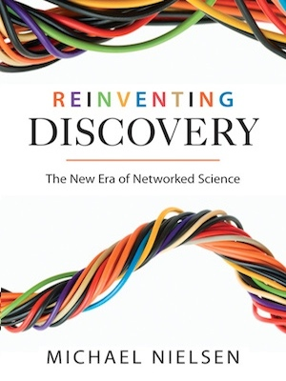
Open Science also represents a more positive side
Internet and the networked (researcher)-society
creates new possibilities and a new potential.

Slide 12
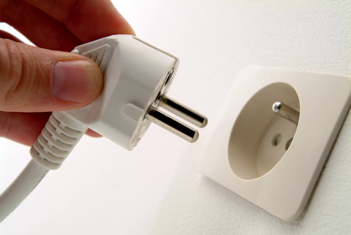

Slide 13
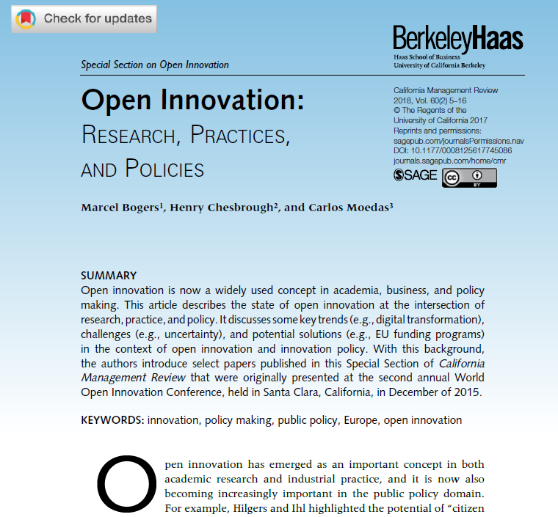




Slide 14
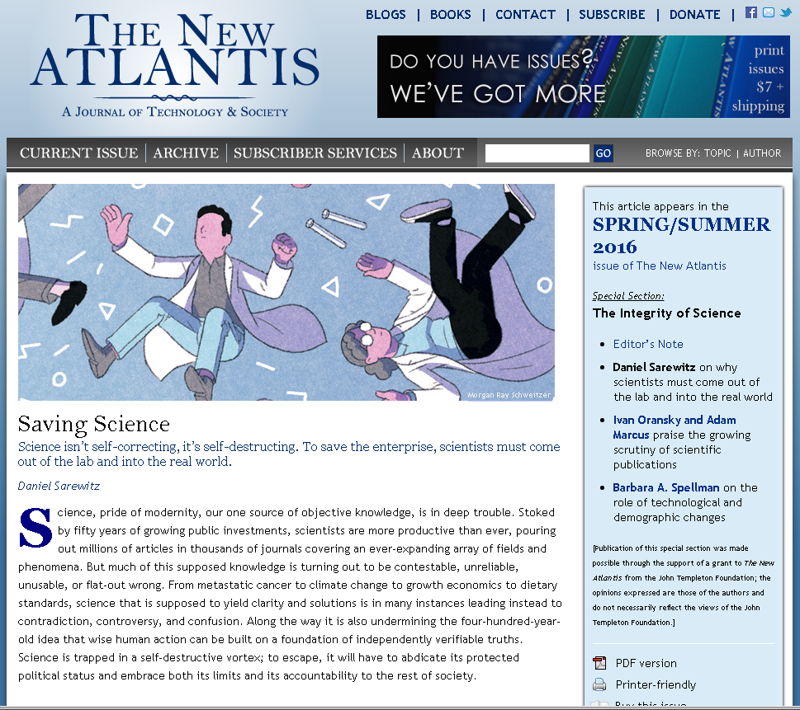
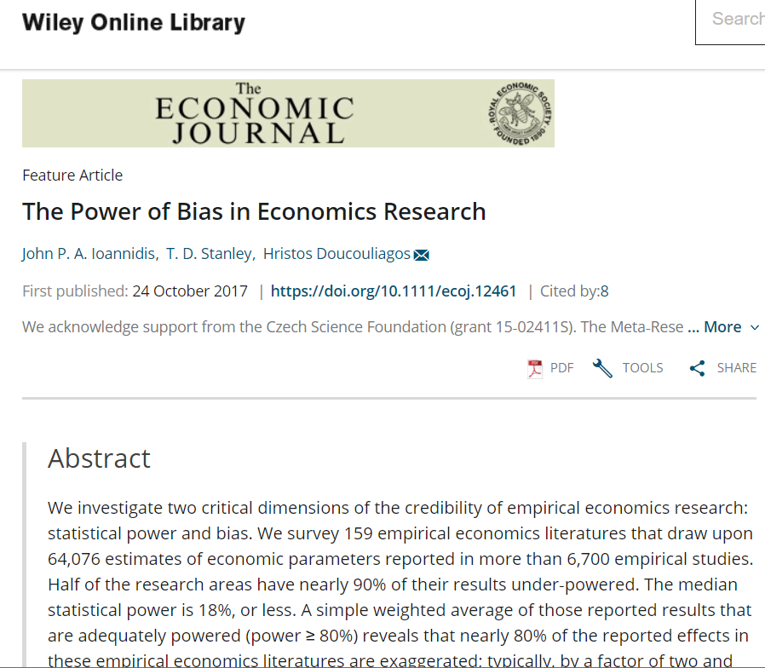
Hyperauthorship
Replicability crisis
Increase in retractions
P-hacking
Journal Impact Factor
Peer review not scaling

Slide 15
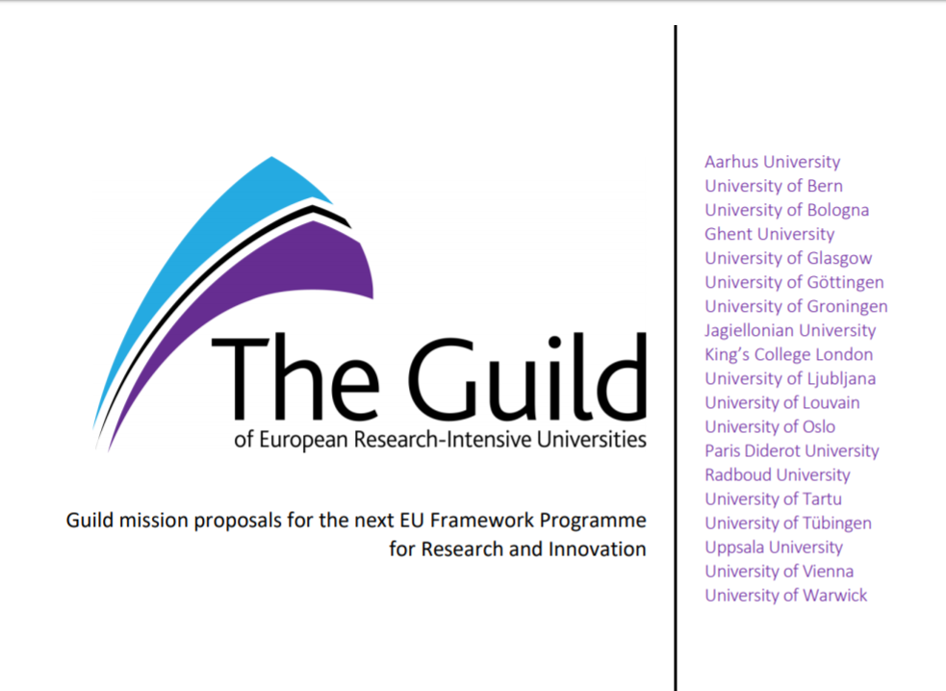
3. Open Science: restoring the cultural authority of science (Mission 1)
“What is at stake is the overall status of knowledge – including its continuous contestation – in society.”

Slide 16

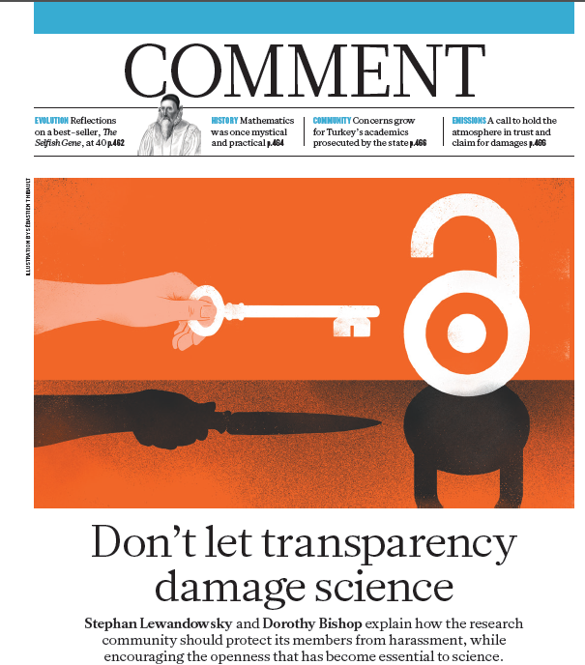
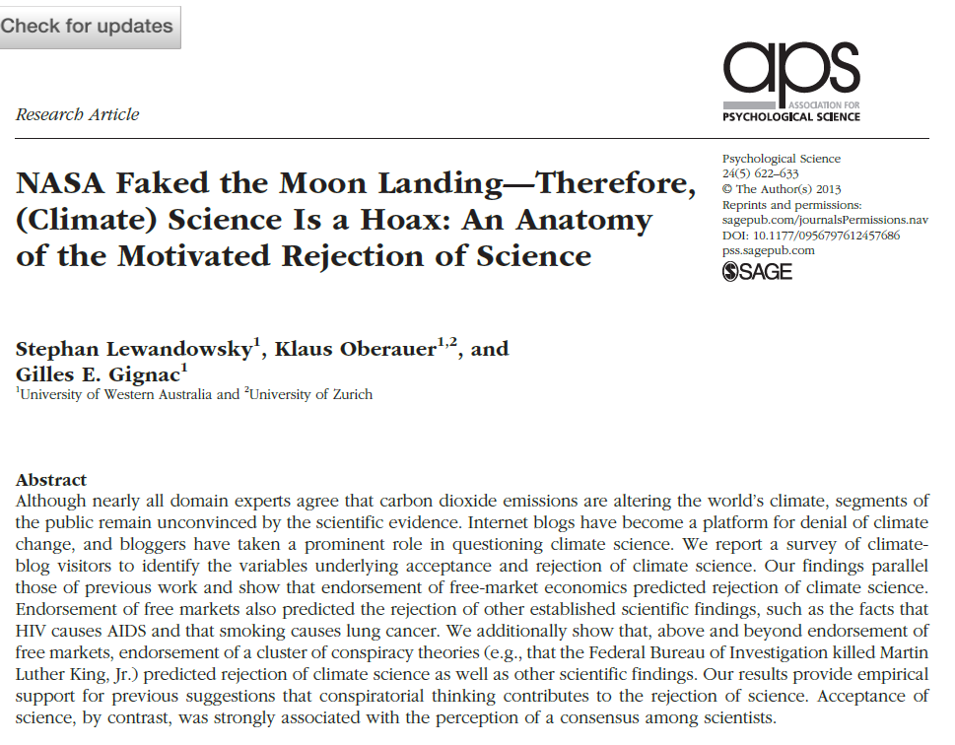
The dark side of Open Science
(at least of Open Data)
Stephan Lewandowsky commenting on U.S. data access act 1998 (and 2000)
Initiated by the tobacco-industry
privately funded research is exempt from disclosure

Slide 17
Innovation
Remedy
Rebuild trust
Open Science

Slide 18
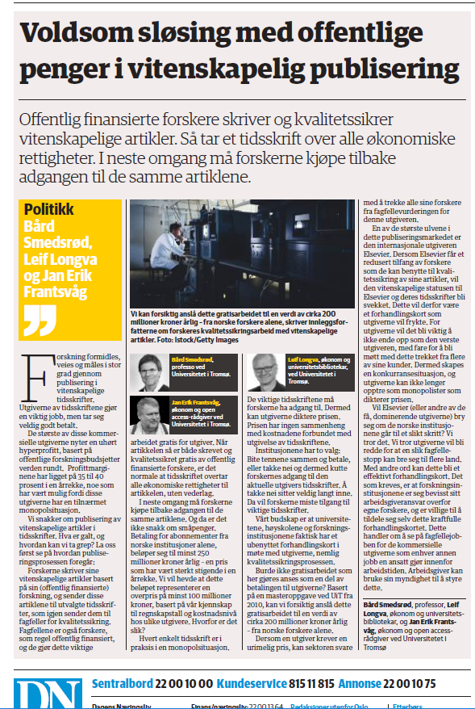
Peer reviewing for free,
estimated worth 200 mill kr
in Norway alone

Slide 19
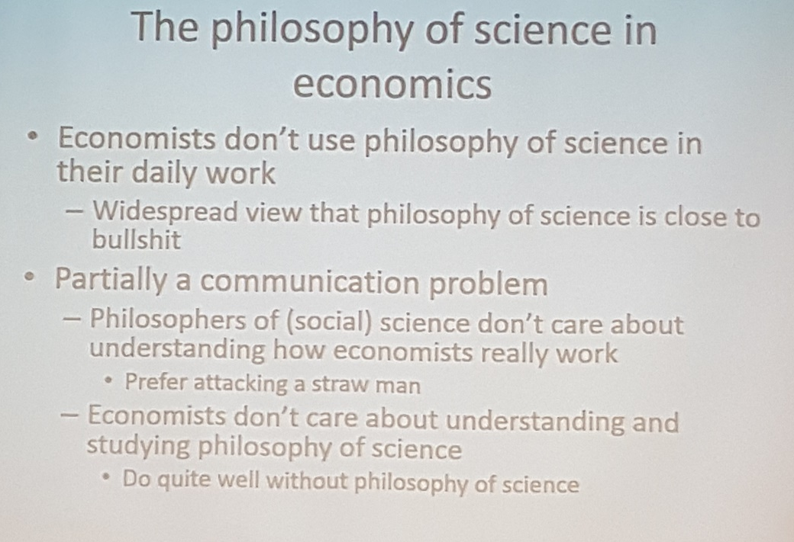
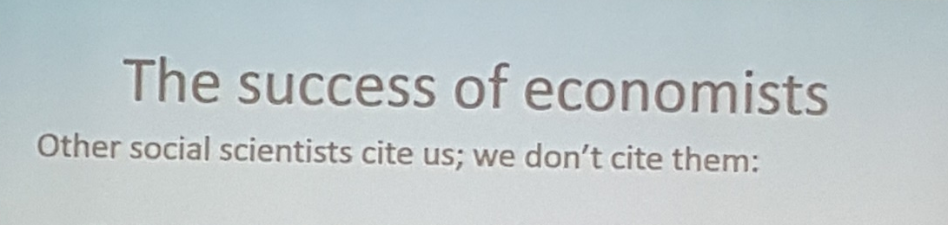

Slide 20
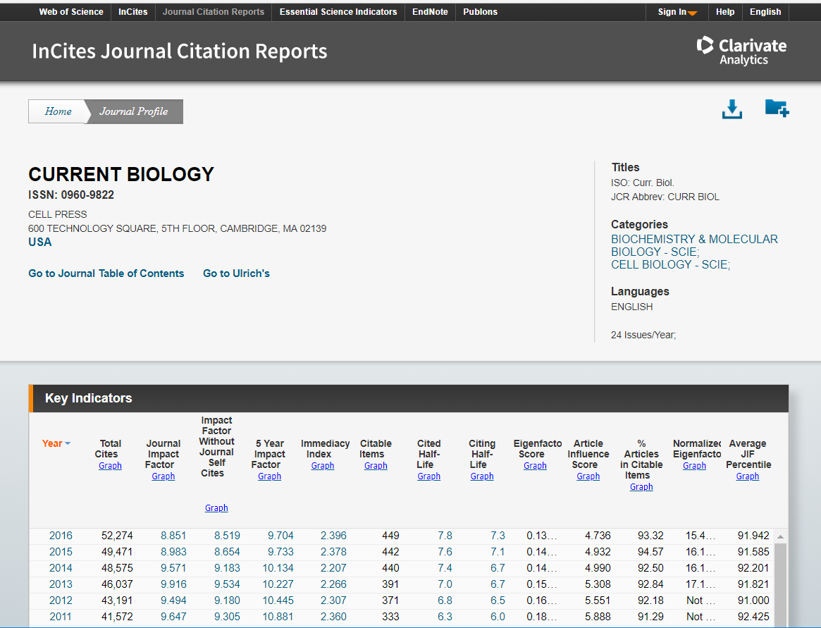
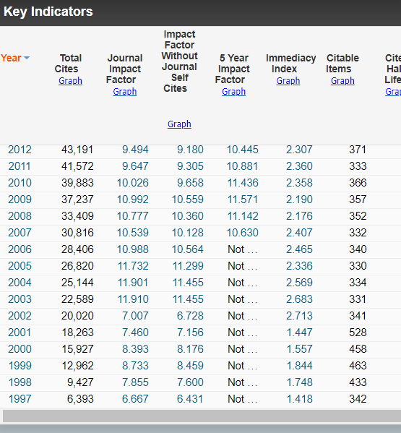
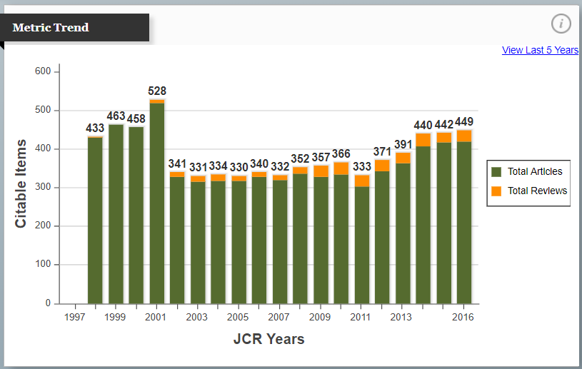
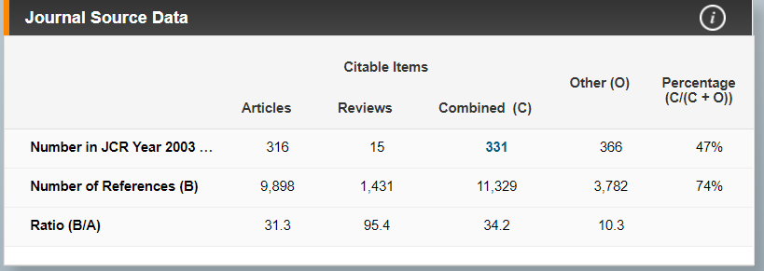
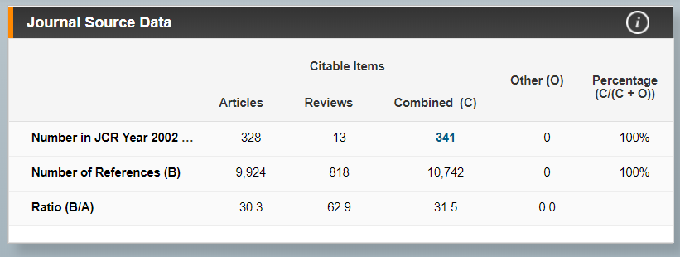

Slide 21
