Slide 1
R&D in Europe – The CORDIS dataset
R&D Networks Seminar
Oslo, 29th November 2018
Maria Tsouri

Slide 2
Structure of R&D Projects
A complete dataset of collaborative projects is difficult to retrieve but when it is retrieved it can give a complete idea of knowledge transfer in the level of organizations.
Project | Duration of the Project | Funding Scheme | Coordinator of the Project | List of Participants | Attributes of Participants
Name of the project (usually includes a full name and an acronym) | Start and End date of the project | Funding entity or entities (includes attributes like location) | Coordinating actor (includes attributes like location) | Name of Participant 01 | Attribute of Participant 01
 |  |  |  | Name of Participant 02 | Attribute of Participant 02
 |  |  |  | Name of Participant 03 | Attribute of Participant 03

Slide 3
The CORDIS dataset
FP1 (1984-1987)
FP7 (2007-2013)
Horizon 2020 (2014-2020)
FP6 (2002-2006)
FP2 (1987-1991)
FP3 (1990-1994)
FP4 (1994-1998)
FP5 (1998-2002)

Slide 4
Labels in Projects
MBI | Medical biotechnology
FIS | Nuclear Fission
EAR | Earth Sciences
ENV | Environmental Protection
SPA | Space and satellite research
AER | Aerospace Technology
FOR | Forecasting
MAT | Materials Technology
ROB | Robotics
RWA | Radioactive Waste
FOO | Food
MST | Mathematics and Statistics
IND | Industrial Manufacture
ETH | Research ethics
SEC | Security
RSE | Renewable Sources of Energy
EDU | Education and Training
WAS | Waste Management
CLC | Clean coal technologies
WAT | Water resources and management
SAF | Safety
COO | Coordination and Cooperation
RAD | Radiation Protection
CON | Construction Technology
STA | Standards
POL | Policies
NNT | Nanotechnology and Nanosciences
SDT | Sustainable development
ESV | Energy Saving
SEA | Resources of the Sea and Fisheries
AUT | Automation
VAS | Veterinary and animal sciences
EST | Energy Storage and Energy Transport
FUS | Nuclear Fusion
ECO | Economic Aspects
BIF | Biofuels
TRA | Transport
ELM | Electronics and Microelectronics
OTH | Other
HFC | Hydrogen and fuel cells
CCC | Climate change and Carbon cycle research
LIF | Life Sciences
IBI | Industrial biotech
BUS | Business aspects
AGR | Agriculture
PMM | Project management methodologies
TEL | Telecommunications
REG | Regional Development
INF | Information and Media
OET | Other Energy Topics
REF | Reference Materials
TEC | Other Technology
EVA | Evaluation
FFU | Fossil Fuels
NET | Network technologies
IPR | Intellectual property rights
IPS | Information Processing and Information Systems
SOC | Social Aspects
MET | Meteorology
ITT | Innovation and Technology Transfer
LEG | Legislation and Regulations
EMP | Employment issues
SCI | Scientific Research
HCS | Healthcare delivery/services
MEA | Measurement Methods
FPR | Funding Programmes
BIO | Biotechnology
MED | Medicine and Health
ICT | Information and communication technology applications
ABI | Agricultural biotechnology

Slide 5
More on the data
Other project and actor attributes
Norway in CORDIS
Project attributes: funding program, topics (broad), funding
Actor attributes:
  Location
  Activity
    HES - Higher or Secondary Education Establishments
    REC - Research Organizations
    PRC - Private for-profit entities (excluding Higher or Secondary Education Establishments)
    PUB - Public bodies (excluding Research Organizations and Secondary or Higher Education Establishments)
    OTH - Other
All frameworks/All topics:
  4147 projects
  1279 single actors based in Norway
FP5: 1122 projects, 570 actors
FP6: 836 projects, 631 actors
FP7: 1503 projects, 538 actors
H2020: 686 projects, 318 actors

Slide 6
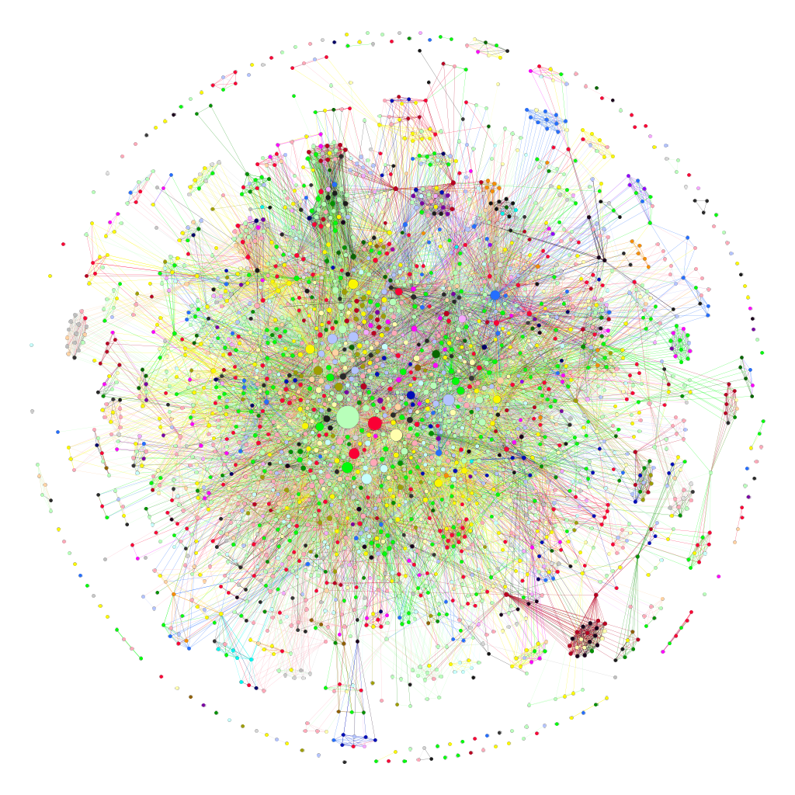
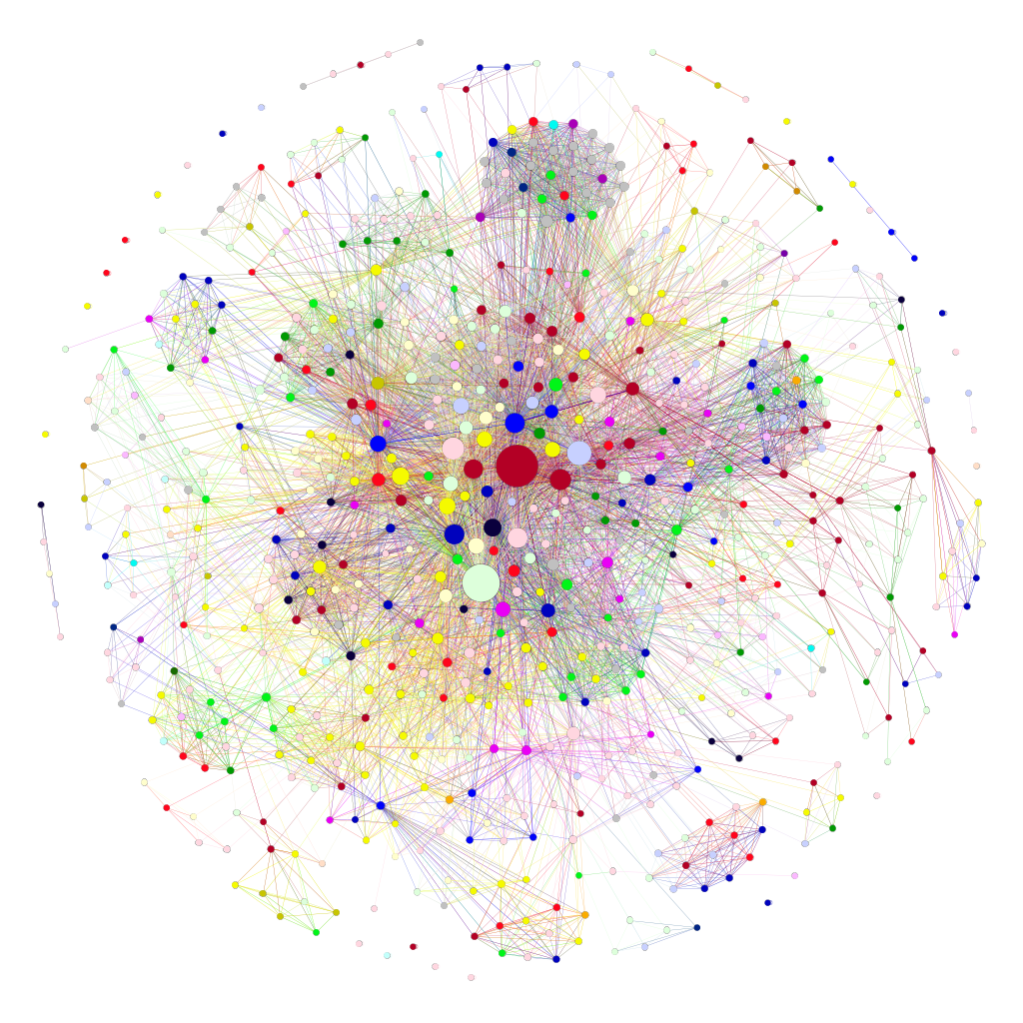
Example: Photovoltaics and Offshore Wind in CORDIS
PV: 2632 nodes, 27374 ties
OW: 690 nodes, 9419 ties

Slide 7
Key Actors inside PV network
Organization | Activity | Country | City | Degree | Closeness | Betweeness | Eigenvector
FRAUNHOFER GESELLSCHAFT ZUR FOERDERUNG DER ANGEWANDTEN FORSCHUNG E.V. | REC | DE | MUNCHEN | 754 | 0.569 | 710841 | 1
COMMISSARIAT A L ENERGIE ATOMIQUE ET AUX ENERGIES ALTERNATIVES | REC | FR | PARIS 15 | 391 | 0.510 | 193413 | 0.646
INTERUNIVERSITAIR MICRO-ELECTRONICA CENTRUM | REC | BE | LEUVEN | 338 | 0.501 | 150796 | 0.564
STICHTING ENERGIEONDERZOEK CENTRUM NEDERLAND | REC | NL | PETTEN | 307 | 0.502 | 139974 | 0.533
CONSIGLIO NAZIONALE DELLE RICERCHE | REC | IT | ROMA | 290 | 0.491 | 133799 | 0.466
CENTRE NATIONAL DE LA RECHERCHE SCIENTIFIQUE CNRS | REC | FR | PARIS | 271 | 0.483 | 99478 | 0.453
ECOLE POLYTECHNIQUE FEDERALE DE LAUSANNE | HES | CH | LAUSANNE | 270 | 0.489 | 122665 | 0.477
NEDERLANDSE ORGANISATIE VOOR TOEGEPAST NATUURWETENSCHAPPELIJK ONDERZOEK TNO | OTH | NL | DEN HAAG | 247 | 0.482 | 116722 | 0.366
ACCIONA CONSTRUCCION SA | PRC | ES | ALCOBENDAS | 246 | 0.470 | 83496 | 0.428
TECHNISCHE UNIVERSITEIT EINDHOVEN | HES | NL | EINDHOVEN | 243 | 0.474 | 92148 | 0.433
CENTRE FOR RENEWABLE ENERGY SOURCES AND SAVING FONDATION | REC | EL | PIKERMI | 233 | 0.479 | 182272 | 0.337
FUNDACION TECNALIA RESEARCH & INNOVATION | REC | ES | DONOSTIA SAN SEBASTIAN | 222 | 0.482 | 124468 | 0.395
TEKNOLOGIAN TUTKIMUSKESKUS VTT | OTH | FI | ESPOO | 205 | 0.477 | 72318 | 0.419
STIFTELSEN SINTEF | REC | NO | TRONDHEIM | 182 | 0.474 | 54492 | 0.399
SIEMENS AKTIENGESELLSCHAFT | OTH | DE | MUNCHEN | 182 | 0.462 | 57764 | 0.369
UNIVERZA V LJUBLJANI | HES | SI | LJUBLJANA | 178 | 0.464 | 44644 | 0.324
UNIVERSIDAD POLITECNICA DE MADRID | HES | ES | MADRID | 177 | 0.470 | 81884 | 0.336
CENTRO RICERCHE FIAT SCPA | REC | IT | ORBASSANO | 176 | 0.457 | 35111 | 0.352
Teknologian tutkimuskeskus VTT Oy | PUB | FI | Espoo | 172 | 0.473 | 30498 | 0.418
CENTRO DE INVESTIGACIONES ENERGETICAS, MEDIOAMBIENTALES Y TECNOLOGICAS-CIEMAT | REC | ES | MADRID | 169 | 0.476 | 65502 | 0.330

Slide 8
Key Actors inside OW network
Organization | Activity | Country | City | Degree | Closeness | Betweeness | Eigenvector
DANMARKS TEKNISKE UNIVERSITET | HES | DK | KGS LYNGBY | 483 | 0.642 | 51179 | 1
FRAUNHOFER GESELLSCHAFT ZUR FOERDERUNG DER ANGEWANDTEN FORSCHUNG E.V. | REC | DE | MUNCHEN | 423 | 0.626 | 48341 | 0.925
STICHTING ENERGIEONDERZOEK CENTRUM NEDERLAND | REC | NL | PETTEN | 249 | 0.559 | 12133 | 0.612
UNIVERSITY OF STRATHCLYDE | HES | UK | GLASGOW | 218 | 0.536 | 6662 | 0.559
DONG ENERGY WIND POWER AS | PRC | DK | FREDERICIA | 200 | 0.541 | 7663 | 0.451
SINTEF ENERGI AS | REC | NO | TRONDHEIM | 190 | 0.523 | 3129 | 0.541
THE UNIVERSITY OF EDINBURGH | HES | UK | EDINBURGH | 188 | 0.532 | 4531 | 0.494
CENTRE FOR RENEWABLE ENERGY SOURCES AND SAVING FONDATION | REC | EL | PIKERMI | 184 | 0.525 | 9978 | 0.459
AALBORG UNIVERSITET | HES | DK | AALBORG | 177 | 0.518 | 5275 | 0.476
UNIVERSITY COLLEGE CORK - NATIONAL UNIVERSITY OF IRELAND, CORK | HES | IE | Cork | 158 | 0.518 | 6951 | 0.385
IBERDROLA RENOVABLES ENERGIA SA | PRC | ES | VALENCIA | 154 | 0.497 | 2959 | 0.347
FUNDACION TECNALIA RESEARCH & INNOVATION | REC | ES | DONOSTIA SAN SEBASTIAN | 142 | 0.518 | 3959 | 0.365
GARRAD HASSAN & PARTNERS LTD | PRC | UK | BRISTOL | 141 | 0.519 | 9814 | 0.327
TECHNISCHE UNIVERSITEIT DELFT | HES | NL | DELFT | 136 | 0.519 | 2012 | 0.361
NATIONAL TECHNICAL UNIVERSITY OF ATHENS - NTUA | HES | EL | ATHINA | 136 | 0.517 | 10373 | 0.306
WIND EUROPE | OTH | BE | BRUXELLES | 136 | 0.499 | 1087 | 0.375
GAMESA INNOVATION AND TECHNOLOGY S.L. | PRC | ES | SARRIGUREN | 128 | 0.499 | 2117 | 0.357
FUNDACION CENER-CIEMAT | REC | ES | SARRIGUREN | 125 | 0.504 | 679 | 0.417
UNIVERSITAET STUTTGART | HES | DE | STUTTGART | 122 | 0.500 | 799 | 0.362
WAVEC/OFFSHORE RENEWABLES - CENTRO DE ENERGIA OFFSHORE ASSOCIACAO | REC | PT | LISBOA | 117 | 0.484 | 2075 | 0.297

Slide 9
Change over time: Can we trace patterns?

Slide 10
Change over time: Can we trace patterns?

Slide 11
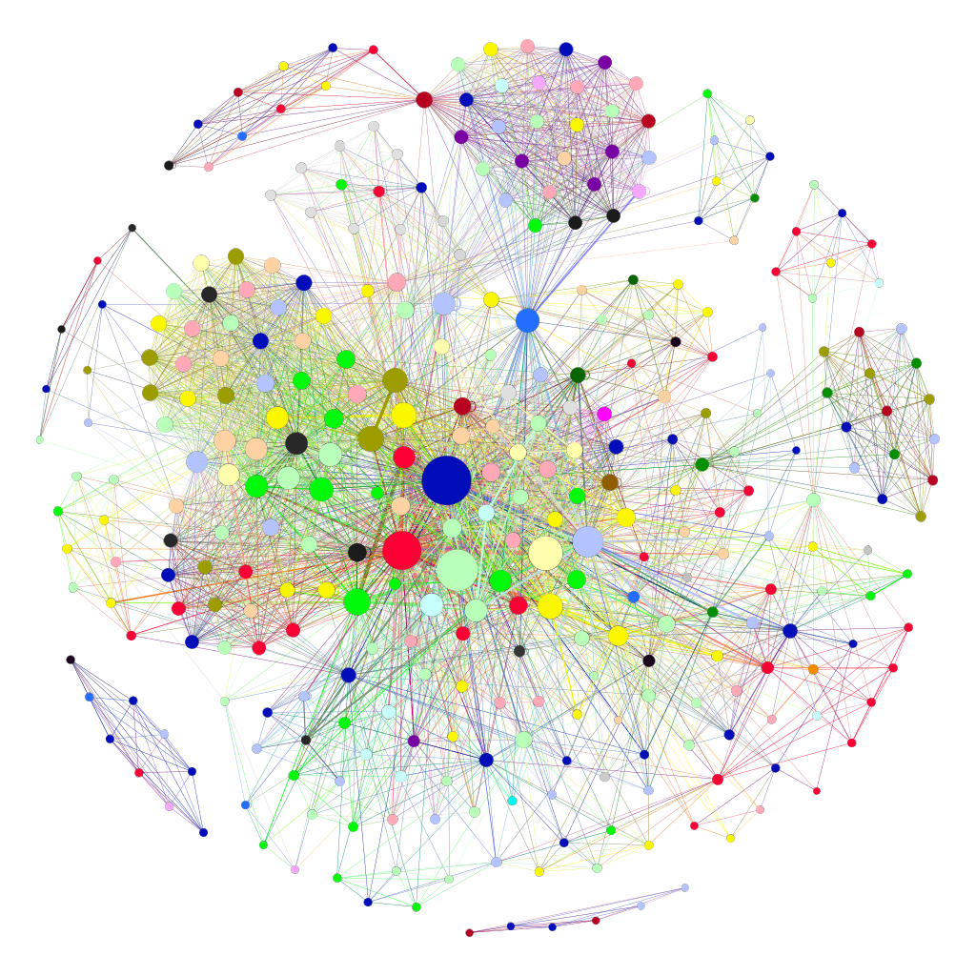
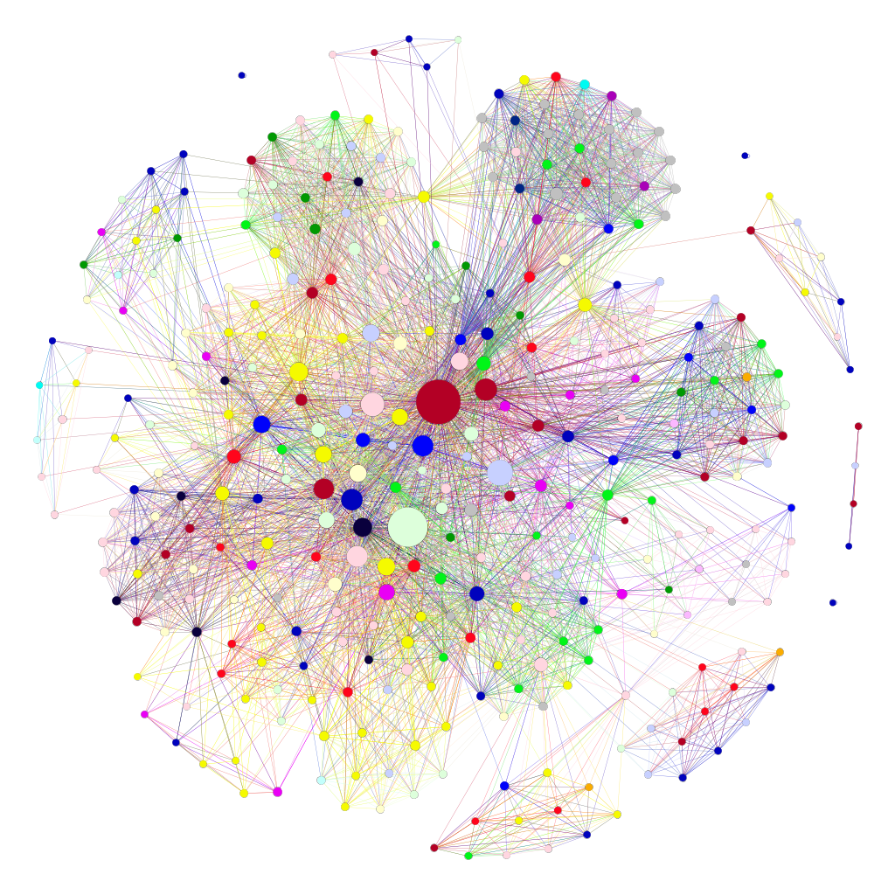
Norwegian PV and OW
All frameworks: 333 nodes, 4420 ties
All frameworks: 354 nodes, 6267 ties

Slide 12
Norwegian PV and OW
Organization | Activity | Country | City | Degree | Closeness | Betweeness | Eigenvector
STIFTELSEN SINTEF | REC | NO | TRONDHEIM | 182 | 0.674 | 10804 | 1
FRAUNHOFER GESELLSCHAFT ZUR FOERDERUNG DER ANGEWANDTEN FORSCHUNG E.V. | REC | DE | MUNCHEN | 149 | 0.618 | 5883 | 0.859
COMMISSARIAT A L ENERGIE ATOMIQUE ET AUX ENERGIES ALTERNATIVES | REC | FR | PARIS 15 | 136 | 0.597 | 3870 | 0.799
INTERUNIVERSITAIR MICRO-ELECTRONICA CENTRUM | REC | BE | LEUVEN | 118 | 0.575 | 3387 | 0.663
STICHTING ENERGIEONDERZOEK CENTRUM NEDERLAND | REC | NL | PETTEN | 103 | 0.575 | 3096 | 0.583
CONSIGLIO NAZIONALE DELLE RICERCHE | REC | IT | ROMA | 84 | 0.530 | 1352 | 0.566
FUNDACION TECNALIA RESEARCH & INNOVATION | REC | ES | DONOSTIA SAN SEBASTIAN | 80 | 0.535 | 570 | 0.695
TEKNOLOGIAN TUTKIMUSKESKUS VTT | OTH | FI | ESPOO | 80 | 0.535 | 545 | 0.693
UNIVERSIDAD POLITECNICA DE MADRID | HES | ES | MADRID | 79 | 0.537 | 1856 | 0.492
Teknologian tutkimuskeskus VTT Oy | PUB | FI | Espoo | 77 | 0.533 | 555 | 0.686
Organization | Activity | Country | City | Degree | Closeness | Betweeness | Eigenvector
DANMARKS TEKNISKE UNIVERSITET | HES | DK | KGS LYNGBY | 403 | 0.767 | 20283 | 1
FRAUNHOFER GESELLSCHAFT ZUR FOERDERUNG DER ANGEWANDTEN FORSCHUNG E.V. | REC | DE | MUNCHEN | 340 | 0.695 | 13177 | 0.930
UNIVERSITY OF STRATHCLYDE | HES | UK | GLASGOW | 201 | 0.607 | 2062 | 0.593
SINTEF ENERGI AS | REC | NO | TRONDHEIM | 190 | 0.597 | 1666 | 0.585
STICHTING ENERGIEONDERZOEK CENTRUM NEDERLAND | REC | NL | PETTEN | 184 | 0.597 | 1969 | 0.575
DONG ENERGY WIND POWER AS | PRC | DK | FREDERICIA | 172 | 0.604 | 3759 | 0.441
THE UNIVERSITY OF EDINBURGH | HES | UK | EDINBURGH | 148 | 0.564 | 784 | 0.482
IBERDROLA RENOVABLES ENERGIA SA | PRC | ES | VALENCIA | 147 | 0.556 | 1229 | 0.381
WIND EUROPE | OTH | BE | BRUXELLES | 136 | 0.564 | 660 | 0.408
AALBORG UNIVERSITET | HES | DK | AALBORG | 134 | 0.544 | 515 | 0.455

Slide 13
Thank you very much for your attention!

