Slide 1
Building network analyses from the R&D database
R&D networks of Norway
Erlend Osland Simensen

Slide 2
Overview of presentations
I will first give some general background on the database and how we have worked with it
I will present two analyses of the database
Then Joar Kvamsås and Maria Tsouri will present their work related to the database

Slide 3
Cleaning the data
A large database – all projects between 2000-2015
53.892 lines of data - 17.000+ projects
Received the data Spring 2016 – finished cleaning early 2018
Initial purpose oil and gas relevant research programs
In 2017: try to clean everything
Mainly carried out be Joar Kvamsås and me
Automatic cleaning, but significant parts manually

Slide 4
How we did it and challenges
Only oil related programs was about 4000 lines – a pilot project
Largest issue: name and organisational numbers of the actors. Type of actors
Changes over time and some organisations are complex (Hydro, UiO, Statoil, research centres, etc.)
Scraping Brønnøysundregisteret and other sources
Manually determine several thousands of actors – tedious, but important!

Slide 5
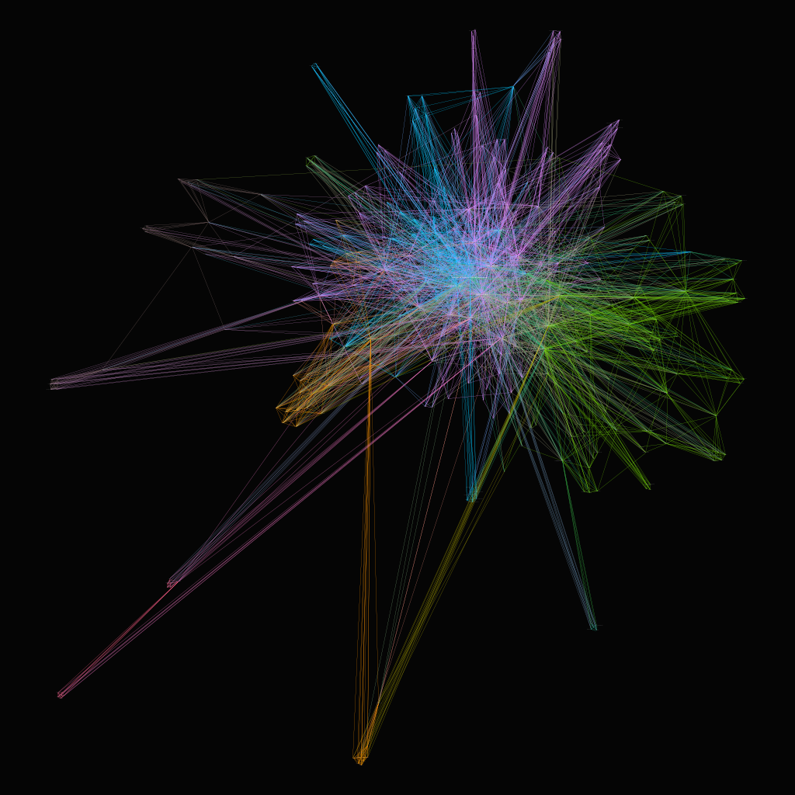
Basic principles of network analysis
Each actor will result in a dot (node) on a network graph.
Each coupling between two actors will result in line between them
More projeccts = larger nodes
More collaboration = thicker lines
Most central actors in the middle of the graph
Can make graphs of actors and collaborations →

Slide 6
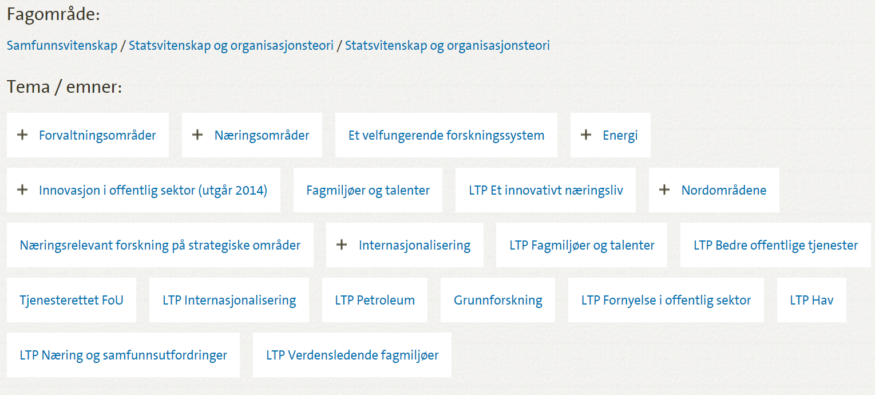
Tags of knowledge domains and subject
Additional database from NFR – coupled with the main
All projects has a tag of knowledge area and subject

Slide 7
Tags of knowledge domains and subject
Very valuable for innovation researchers, enables us to:
  Understand knowledge domains in the Norwegian system and its main actors
  Explore which actors that are involved in what type of research
  Better understand and define knowledge sectors and the interaction between them
  The evolution of knowledge networks

Slide 8
Analyses from the database
Resulted in several research papers and more to come:
Dynamic analysis on the oil and gas sector. Understanding the relevant industry and knowledge actors.
Joar Kvamsås: master assignment
Dynamic analysis of multiple sectors. Working paper by Simensen and Abbasiharofteh, 2019 (?)
In combination with EU-Cordis – Maria Tsouri
More analyses planned and discussed. OSIRIS and comparison with other countries (Germany).

Slide 9
Paper 1:
Dynamic analysis of the oil and gas research
Explorative analysis between 2005-2015.
Focussed the oil and gas related research programs only
Composition of the types of actors
  Oil companies, supplier companies, research inst., governmental actors
How has this sector evolved during this time?
  Who are the important actors?
  What are the research topics?
  How has this changed over time?

Slide 10
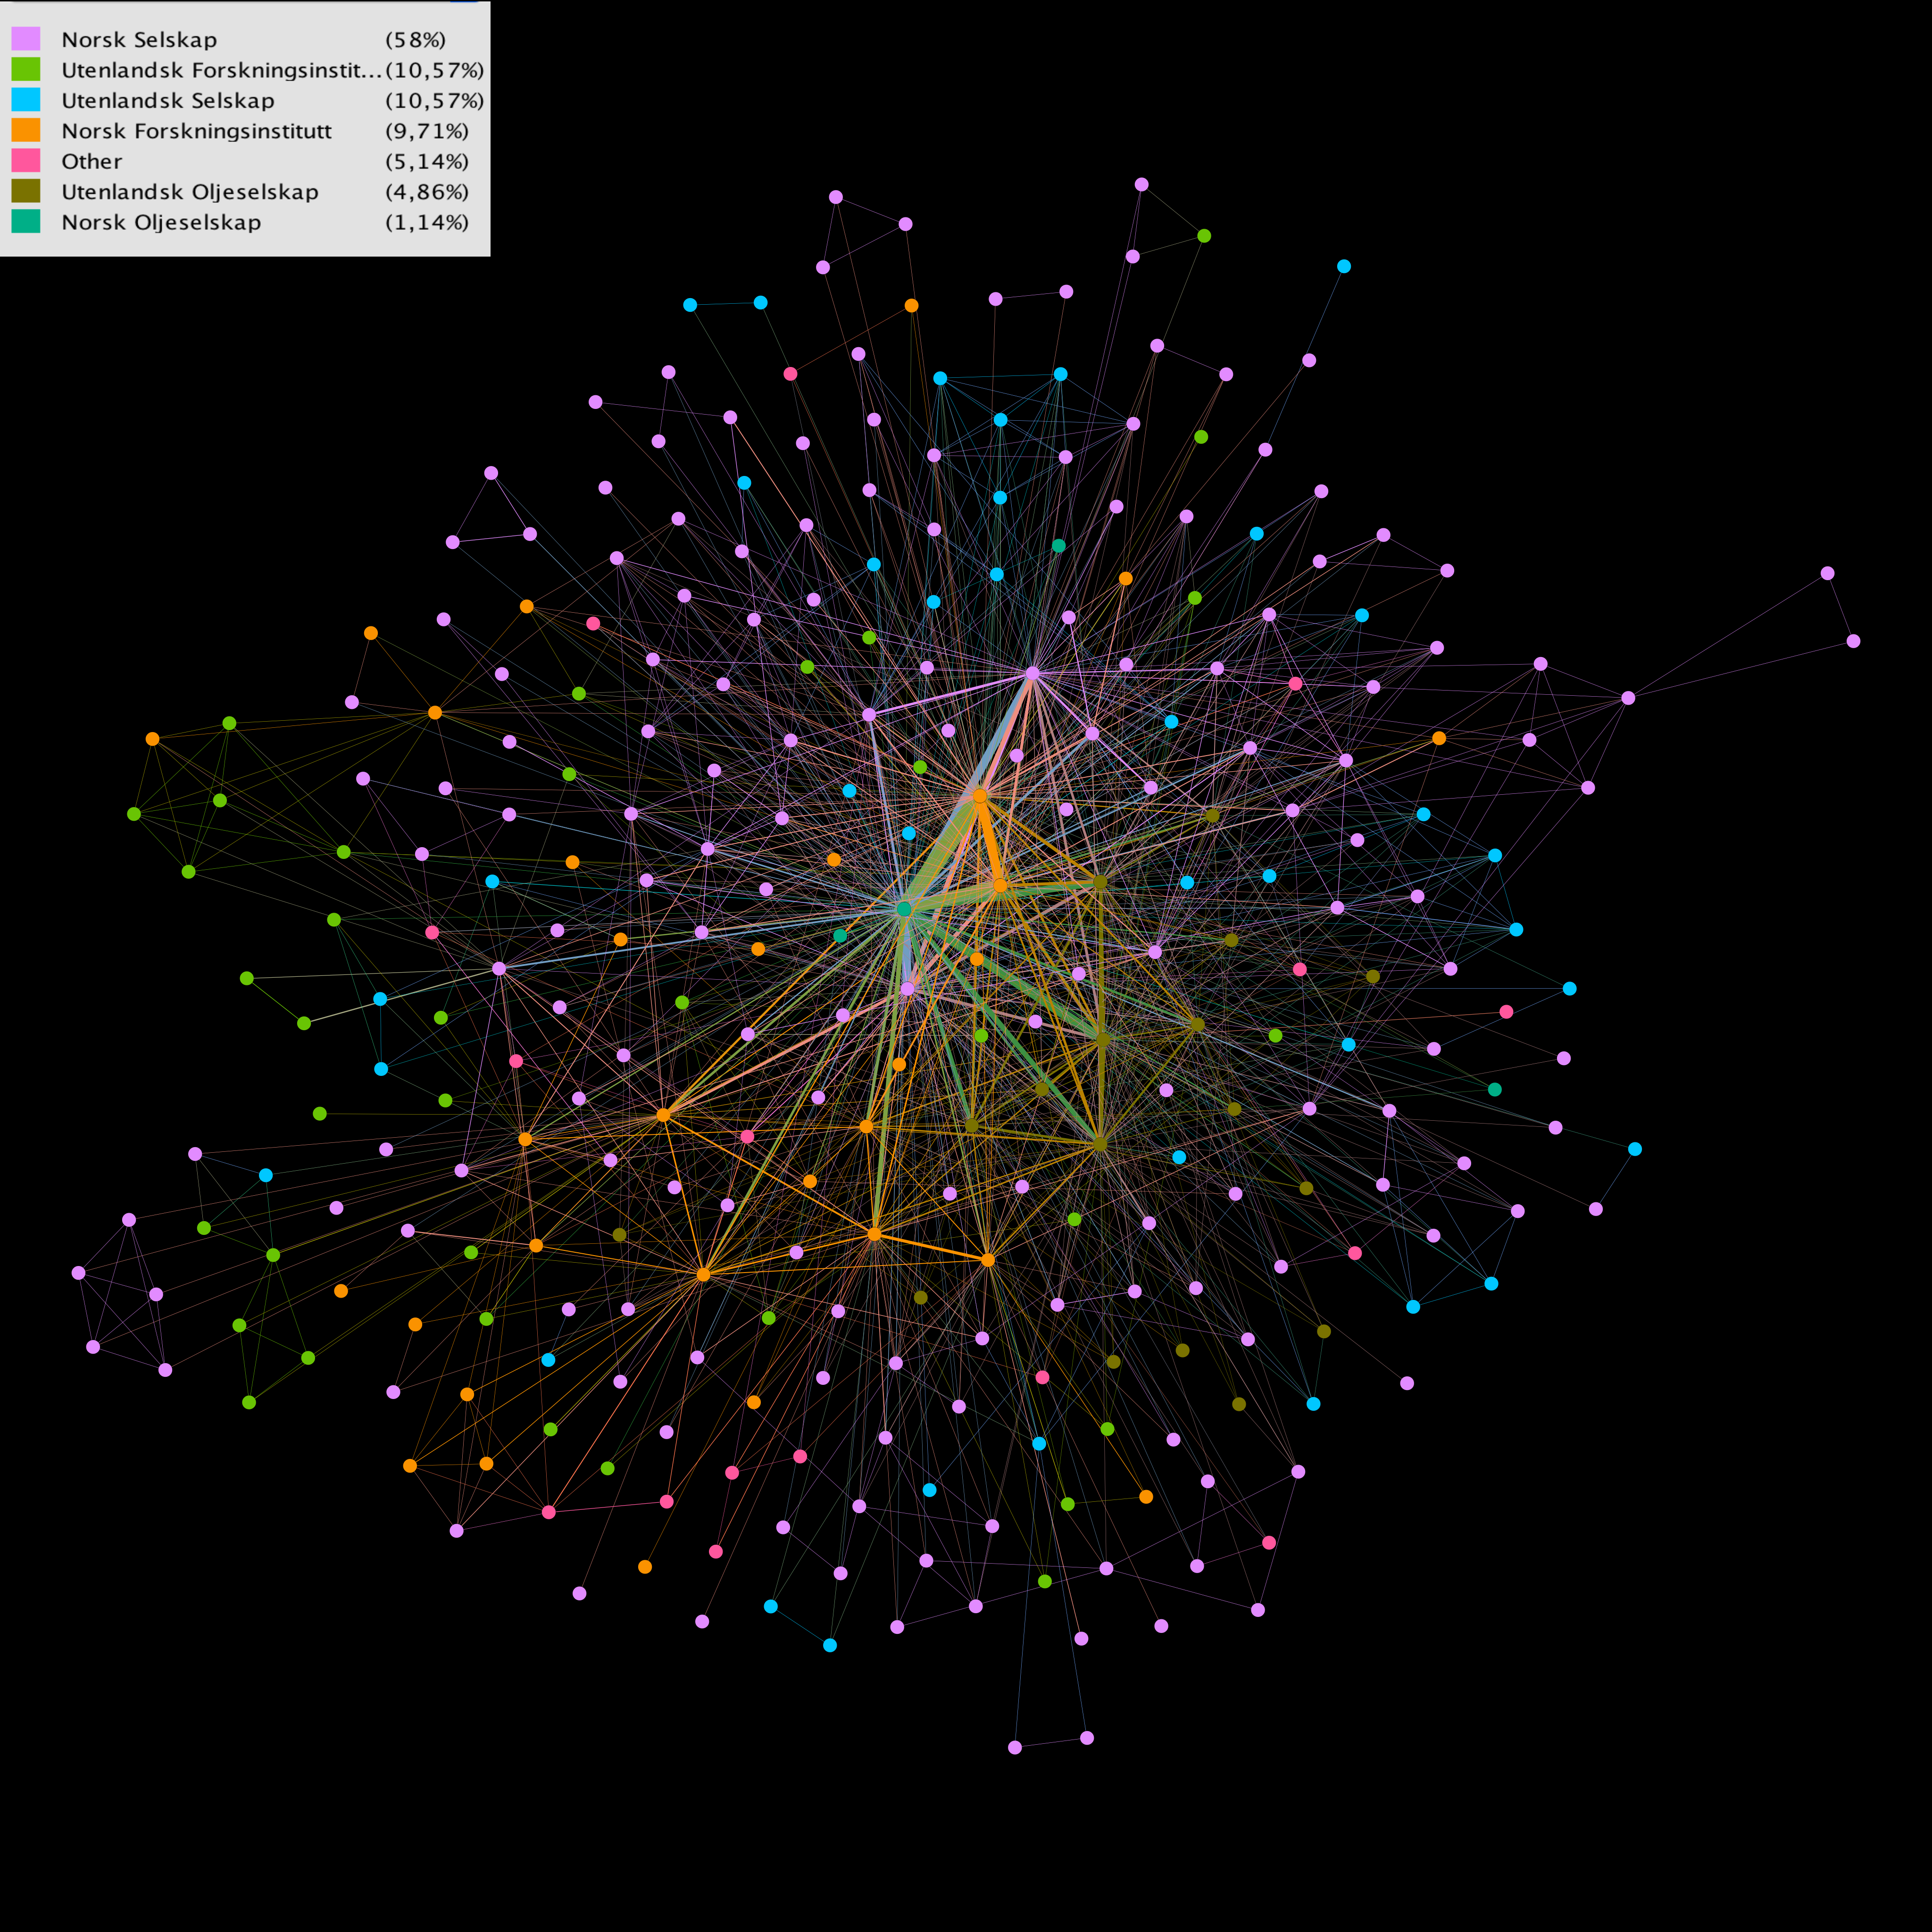
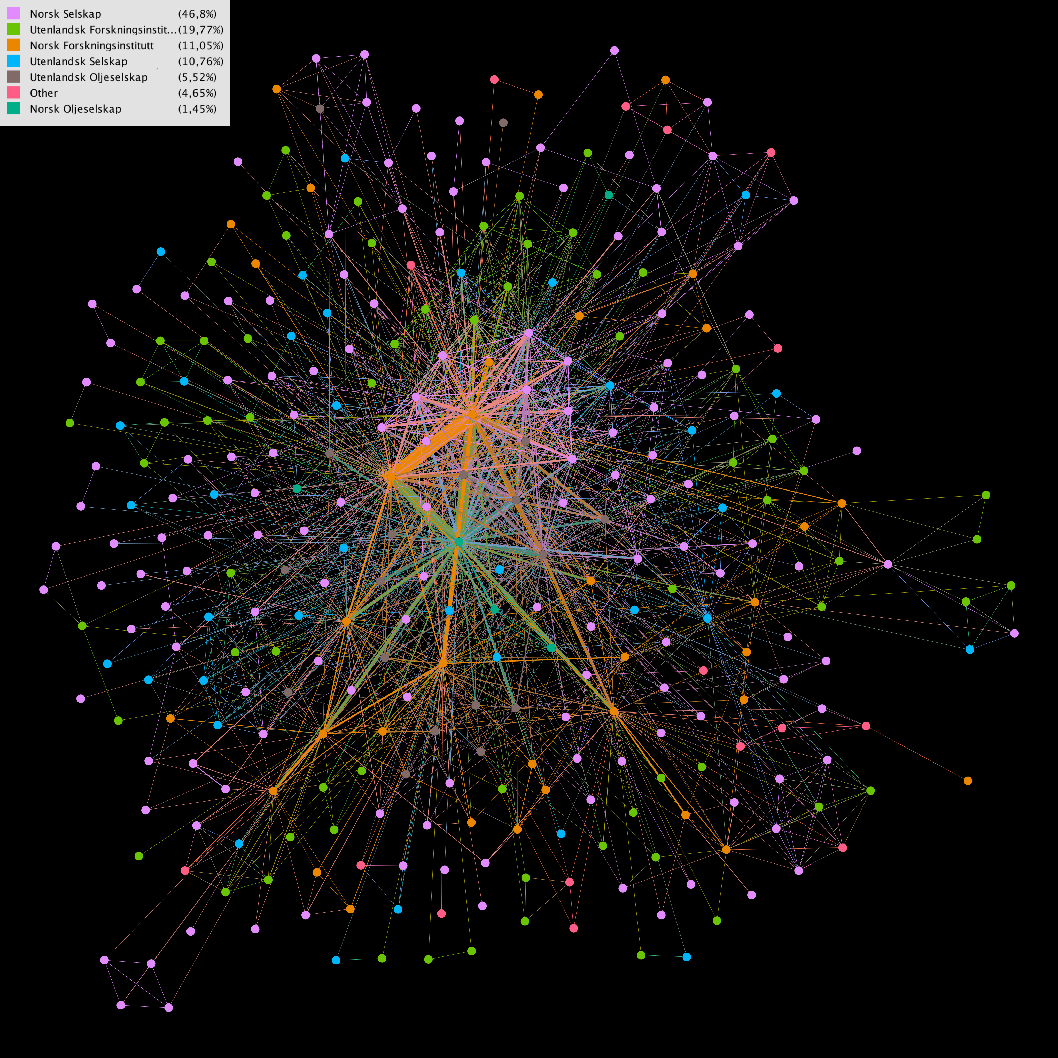
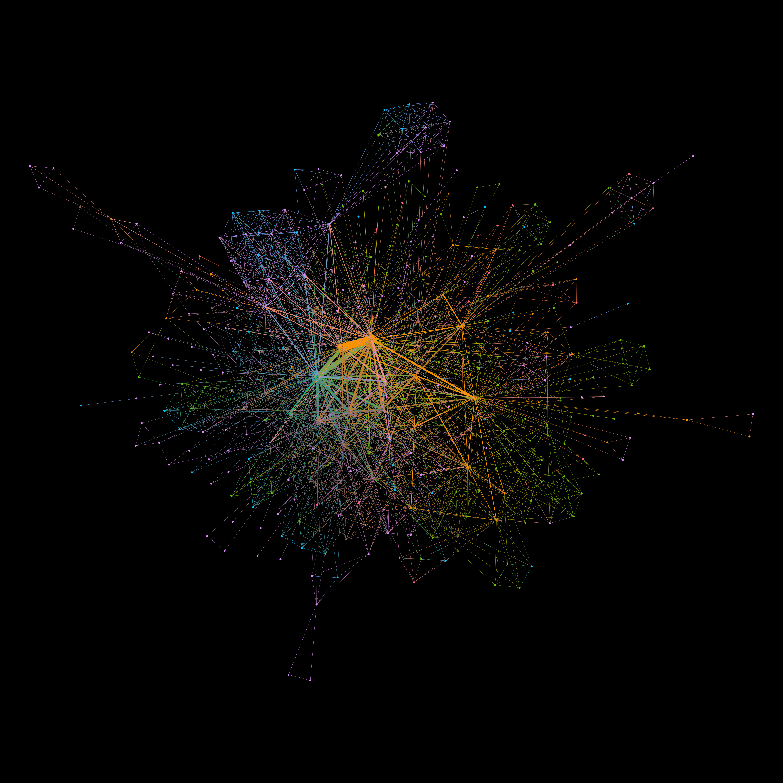
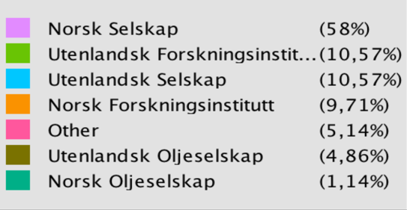
2005-2008
2009-2012
2013-2015
Results:
Dominated by a few central actors – 1 oil company and 2 research inst.
Network quite similar over time, minor increase in collaboration – more dispersed in latter
CCS emerged in two latter periods resulting in more university-related research
Will be explored further with the provided knowledge areas

Slide 11
Paper 2:
Dynamic analysis of four sectors
(Simensen and Abbasiharofteh, presented at conference last July, submission early next year)
 | Biotech | Oil and gas | Marine | Maritime
Biotech | 9520
Oil/gas | 143 | 8134
Marine | 482 | 563 | 13546
Maritime | 248 | 201 | 735 | 8889
Comparing 4 sectors:
  biotech, oil and gas, marine and maritime sector
Co-evolution of these networks. How do sectors differ?
Constructed a model that modelled probability for any two actors to collaborate in the future
Checked if any two actors had participated in projects in the same knowledge area:
  Are similar knowledge bases good for collaboration?
Theory: similar knowledge base good for understanding and collaboration, but could hamper novelty

Slide 12
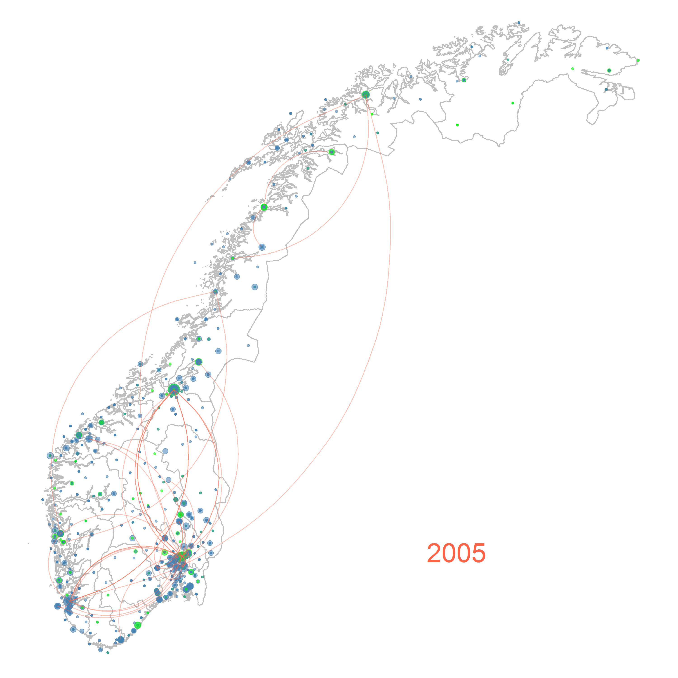
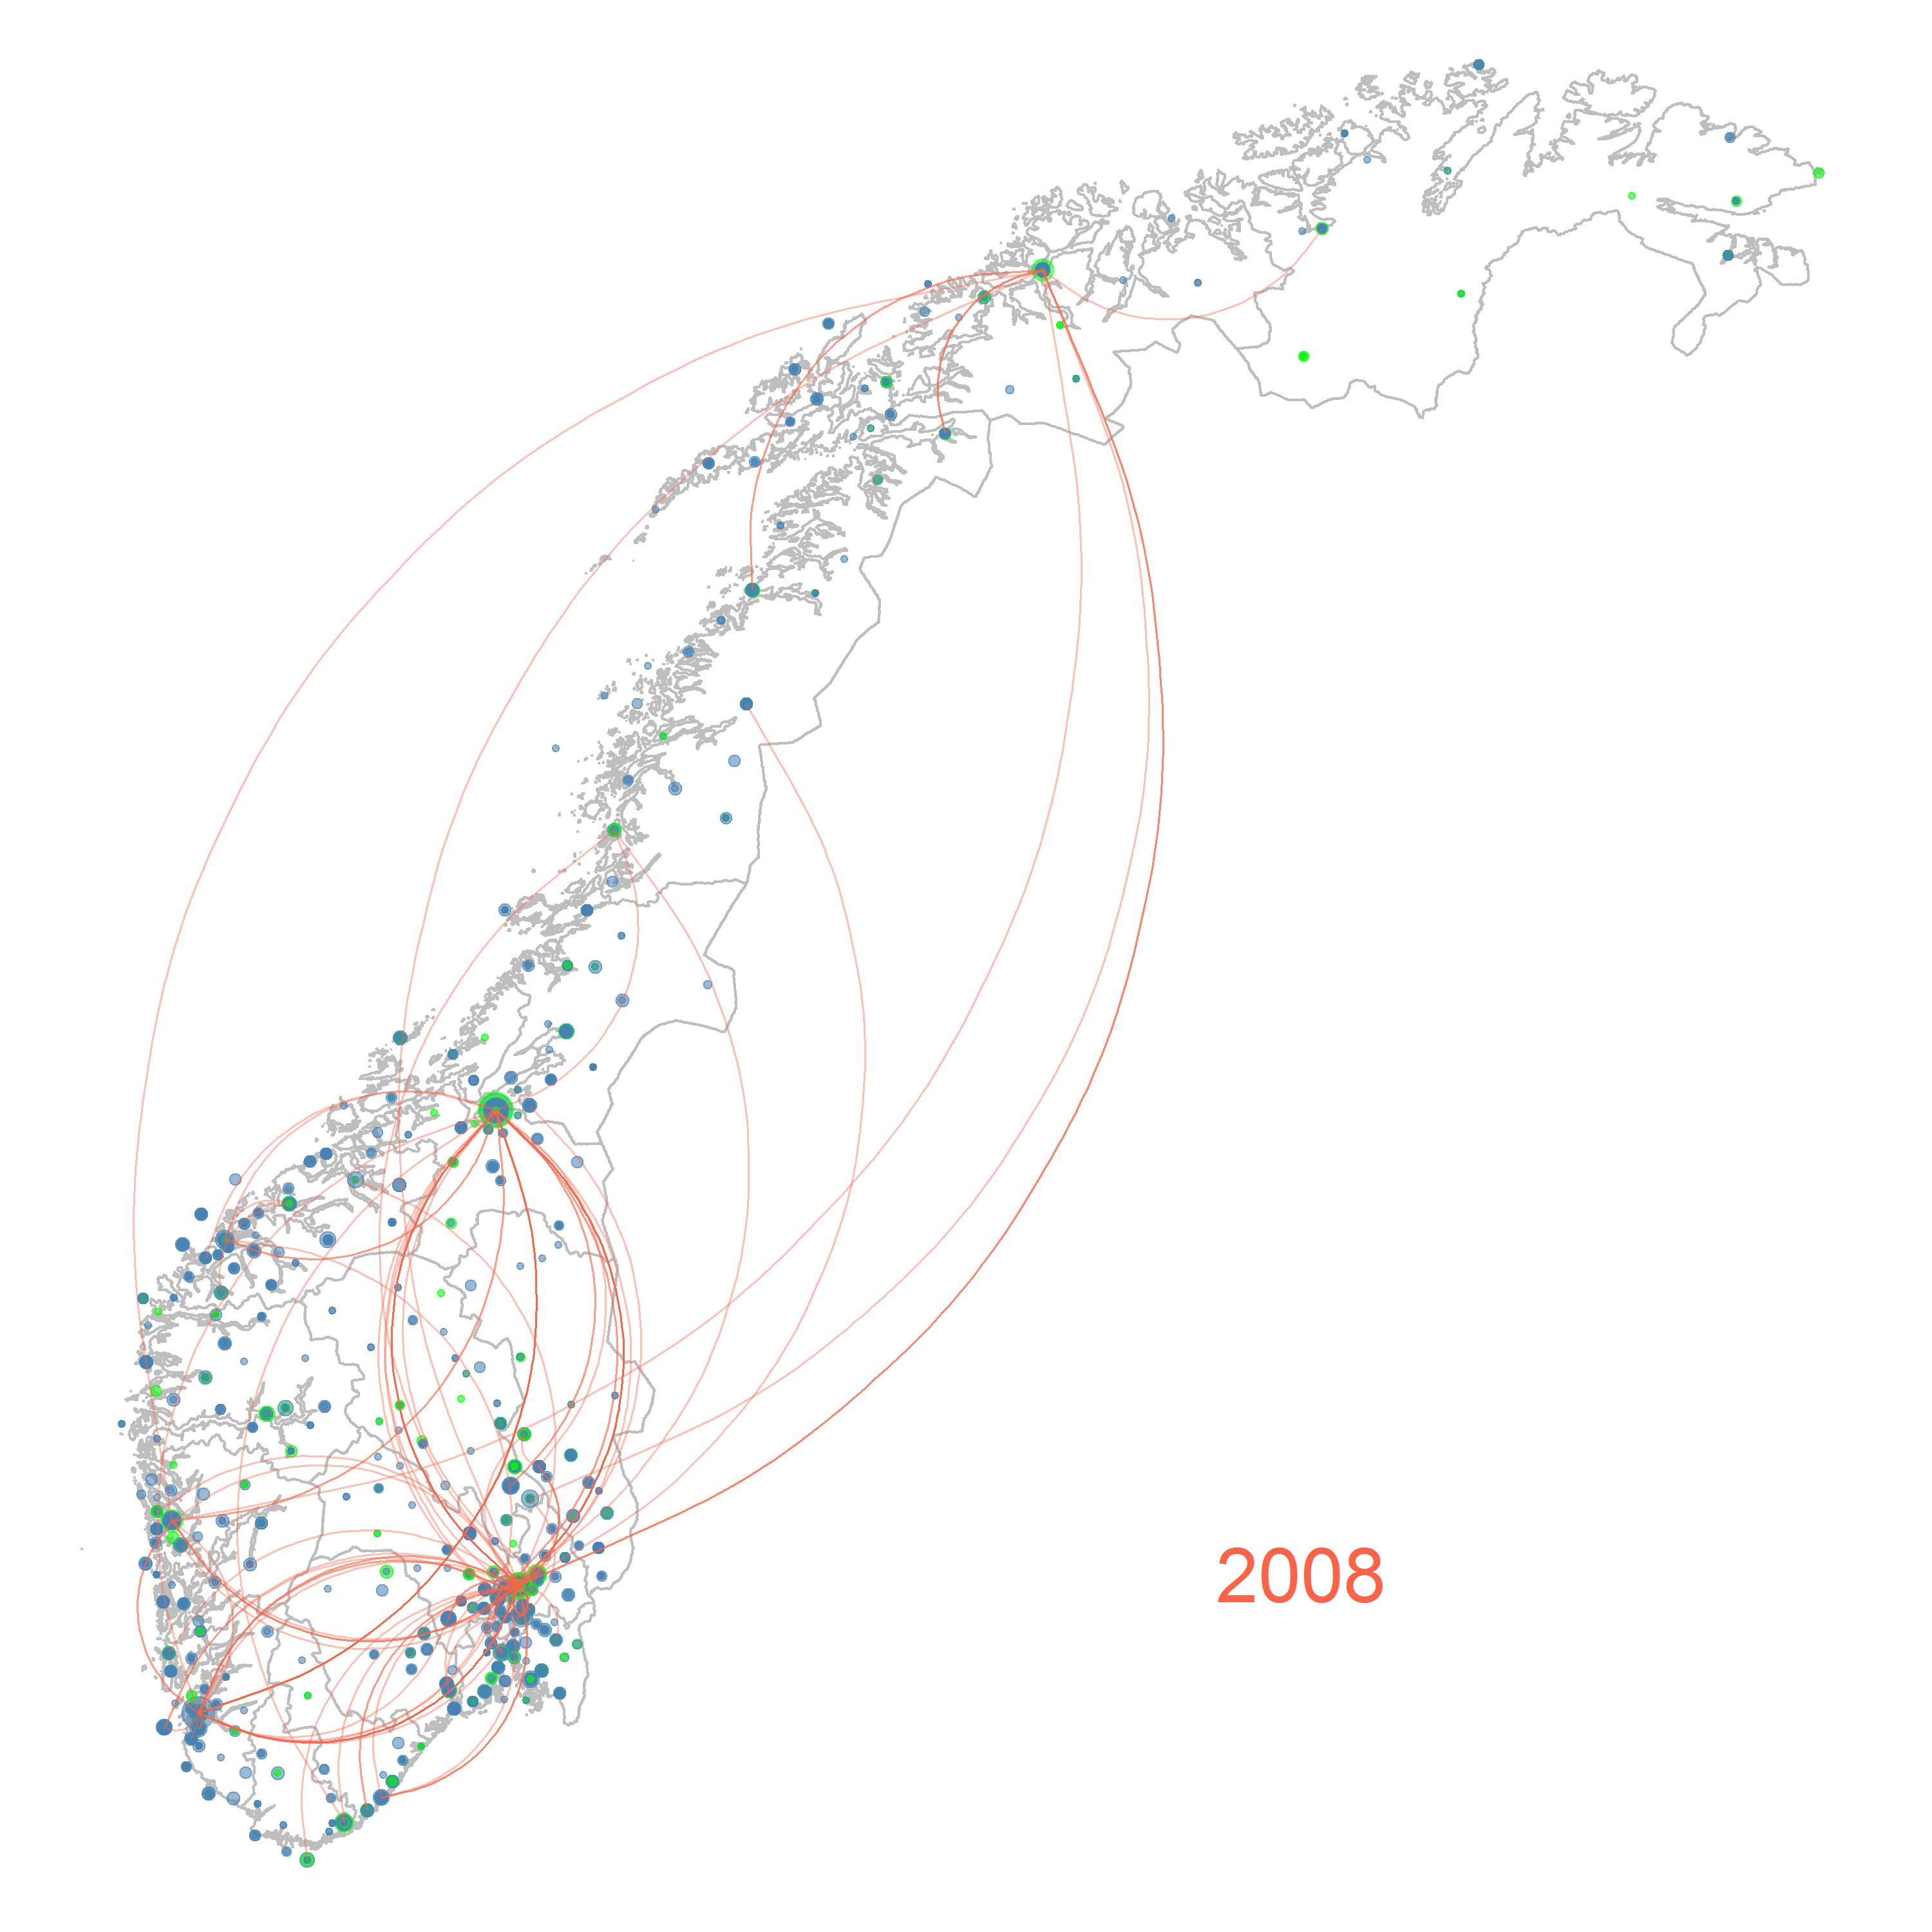
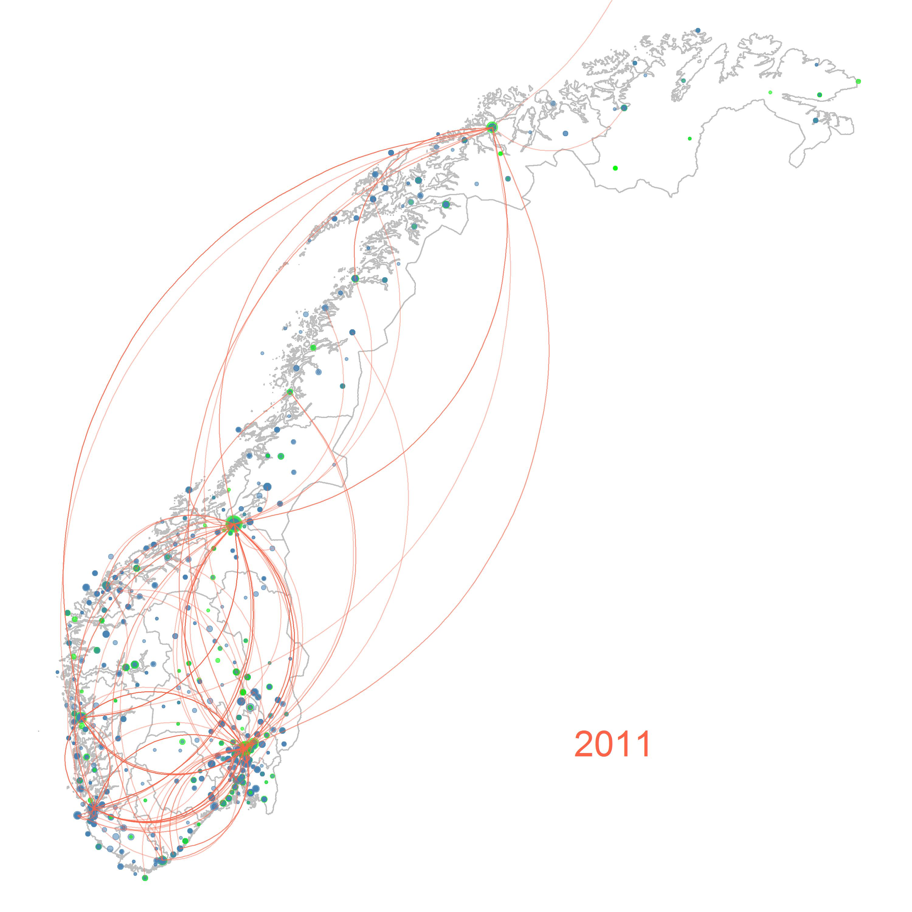
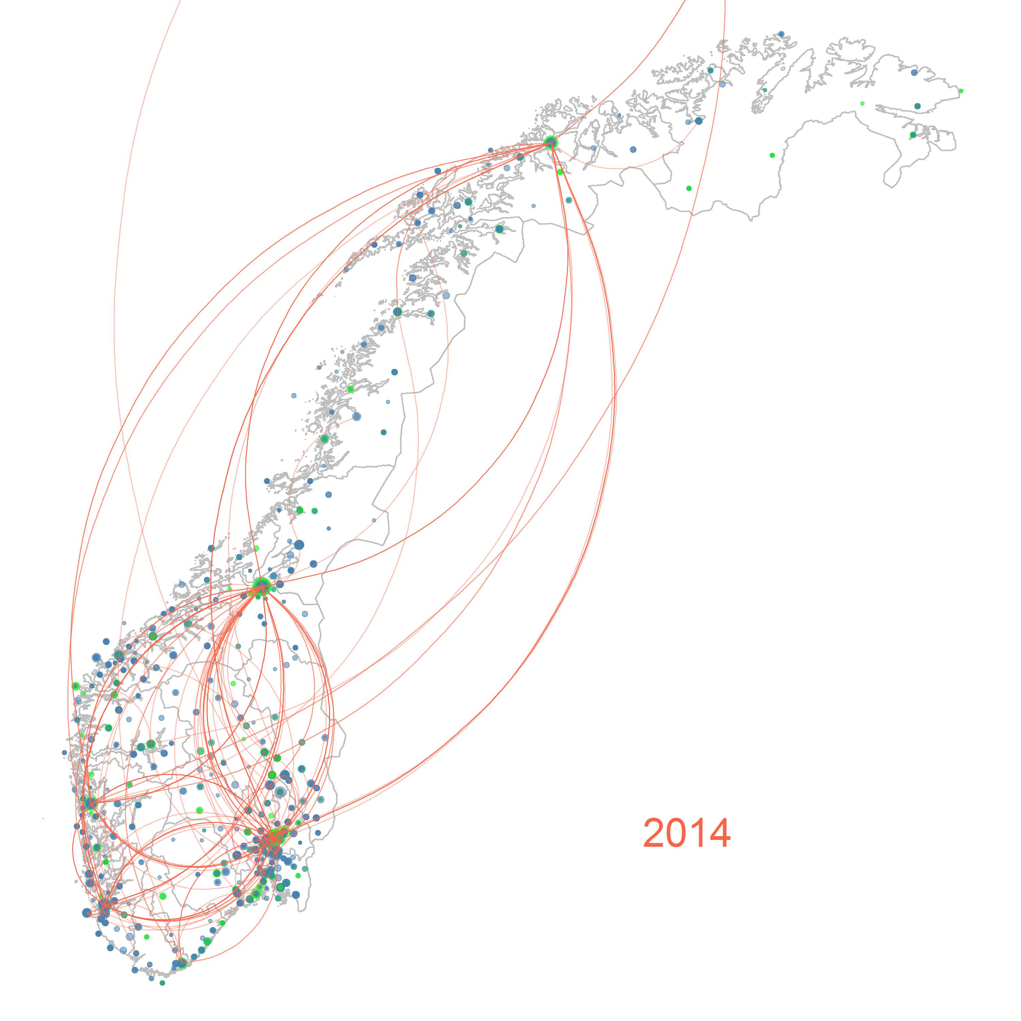
Only frequent collaborations are shown.
Main findings:
Importance of similar knowledge base changes over time and differs between sectors:
Biotech and marine: knowledge similarities important & increasing
Oil and gas and maritime: dissimilar knowledge bases positively affected collaboration
Hence, different rationale for collaboration for different sectors and time

Slide 13
Thank you!
e.o.simensen@tik.uio.no

Slide 14
Additional slides

Slide 15
About the Norway map
Figure 3 demonstrates the position of actors as well as the collaborative ties at the beginning of each moving window. As shown, most actors are located in or near four Norwegian large cities (Oslo, Bergen, Trondheim, and Stavanger). Over time, the number of collaborative ties increases and the core-periphery structure reinforces itself, implying large companies and publicly funded organizations (e.g., universities) in main cities are in the center of the knowledge network and smaller actors in distant areas occupy a peripheral position.

Slide 16
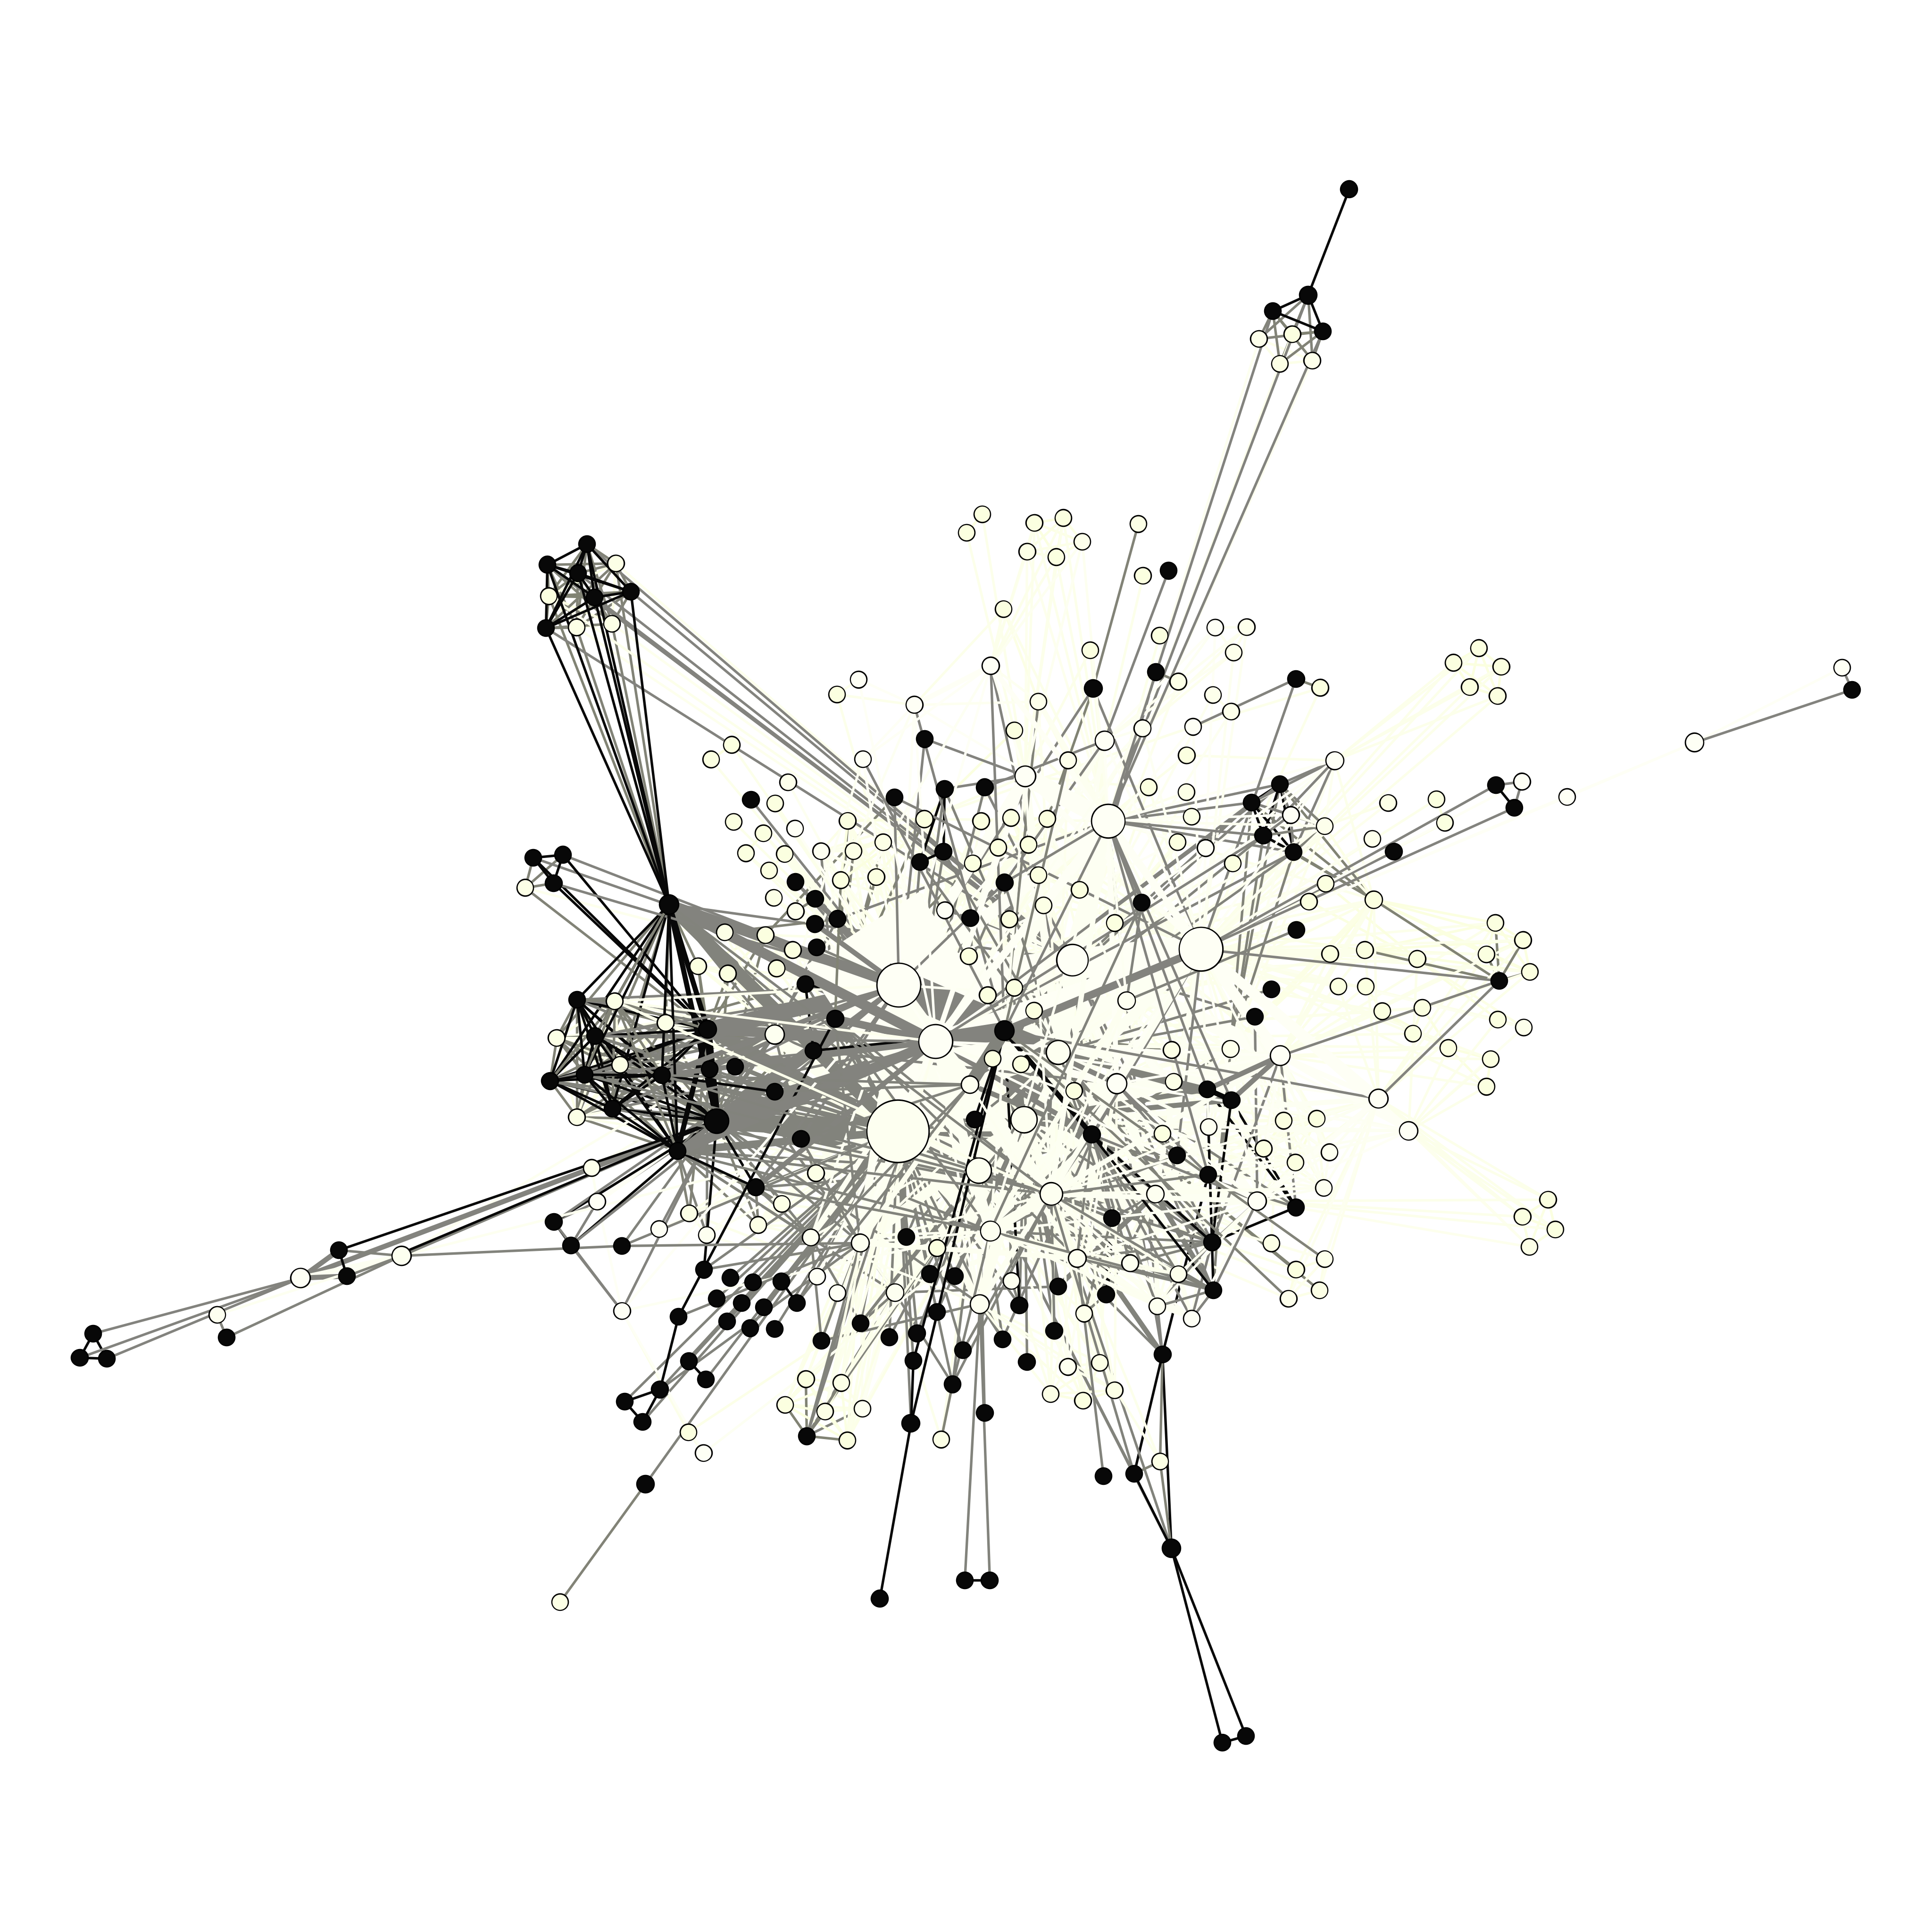
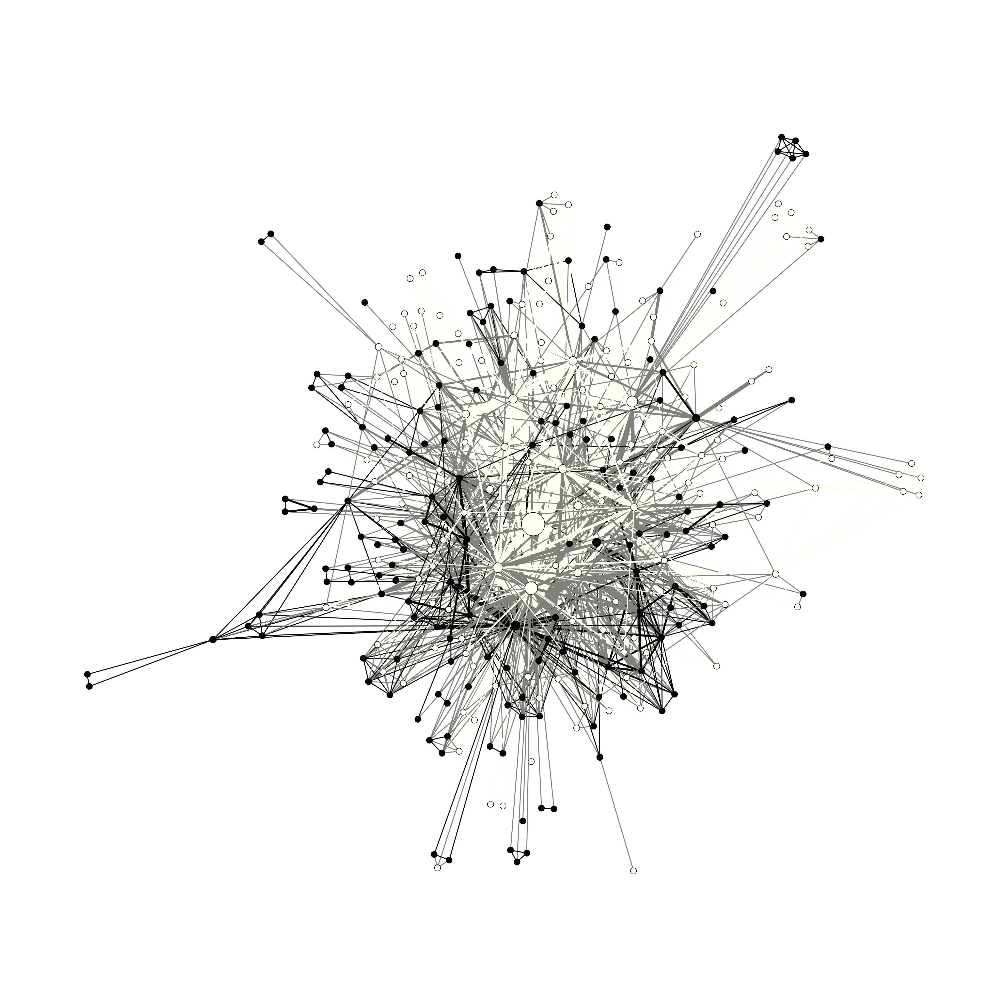
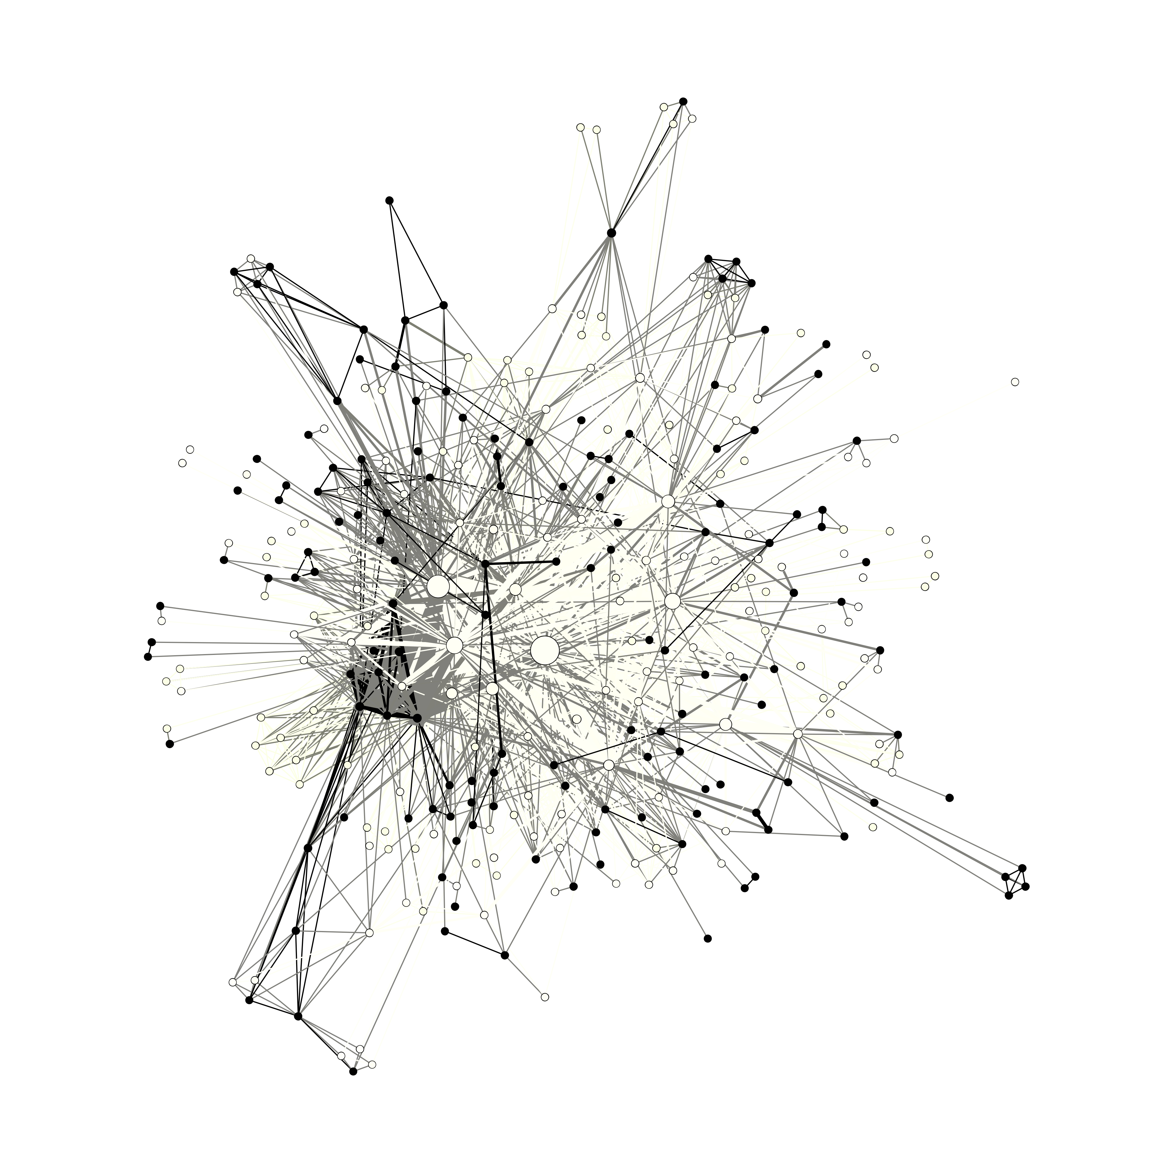
Three periods
Black nodes are supplier companies
White all other actors (oil comp, research, etc.)
2005-2008
2013-2015
2009-2012
Results:
Dominated by a few central actors – 1 oil company and 2 research inst.
Network quite similar over time, minor increase in collaboration
CCS emerged in two later periods resulting in more university-related research
Will be explored further with knowledge areas

Slide 17
2005-2008
2009-2012
2013-2015
Type of organisation | 2005-2008 |  | 2009-2012 |  | 2013-2015
 | Betweeness centrality | N | Betweeness centrality | N | Betweeness centrality | N
Norwegian oil company | 0,19447 | 2 | 0,15583 | 2 | 0,15461 | 2
Norwegian research institute | 0,01625 | 34 | 0,01934 | 38 | 0,02149 | 38
Foreign oil company | 0,01118 | 18 | 0,01278 | 20 | 0,01105 | 26
Norwegian Company | 0,00114 | 204 | 0,00051 | 162 | 0,00071 | 192
Foreign company | 0,00037 | 37 | 0,00030 | 38 | 0,00001 | 39
Other | 0,00018 | 18 | 0,00047 | 16 | 0,00022 | 21
Foreign research institute | 0,00018 | 37 | 0,00005 | 68 | 0,00017 | 98
Total average | 0,00400 | 350 | 0,00410 | 344 | 0,00377 | 416

Slide 18
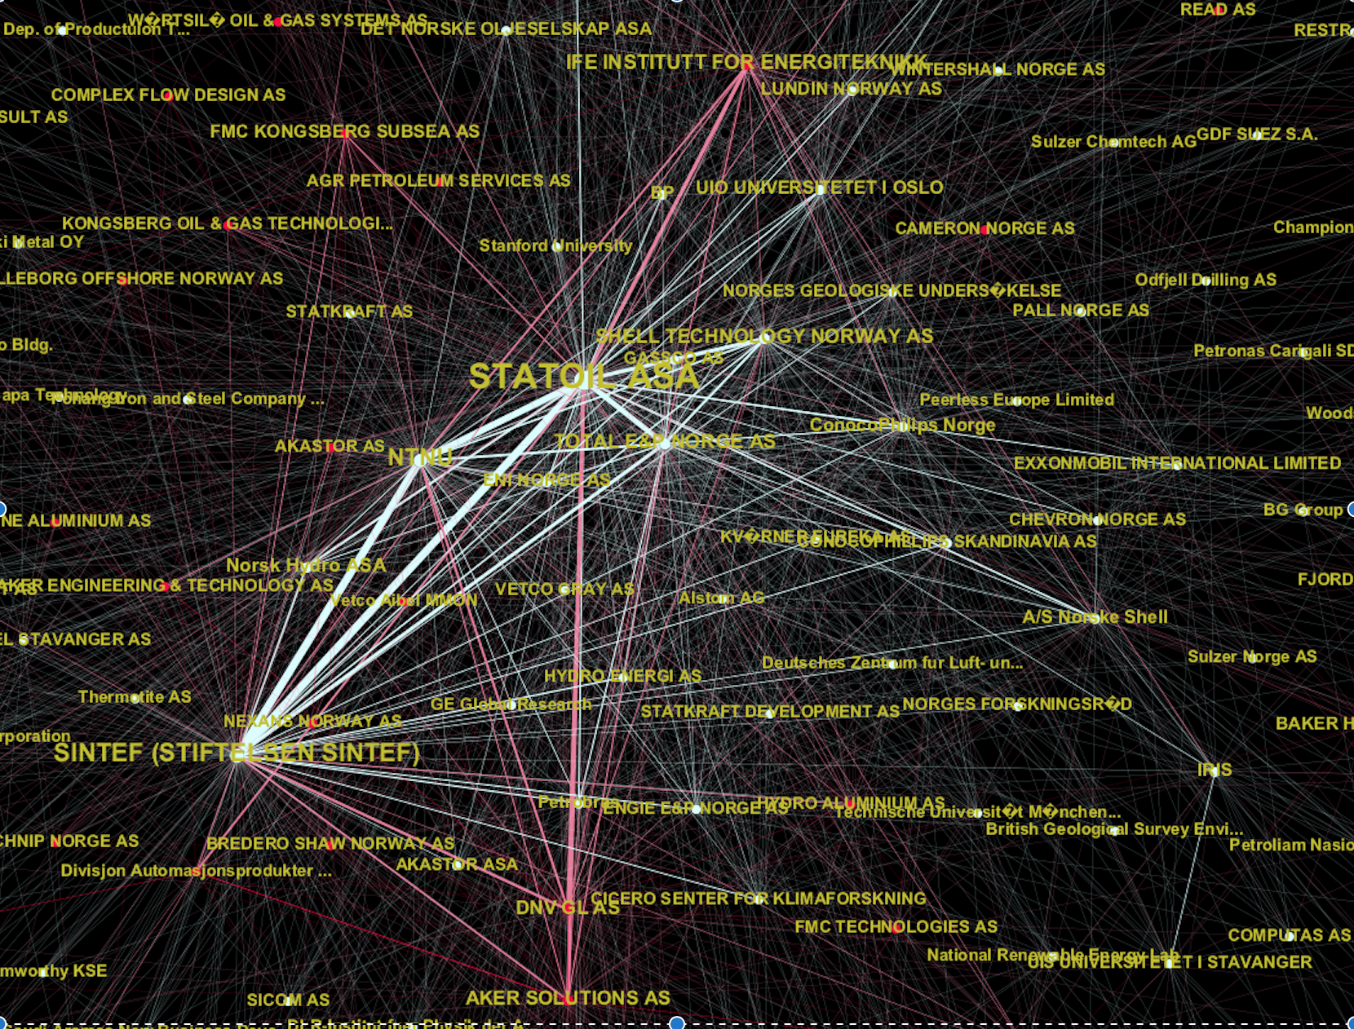
Additional slides

