Slide 1

What’s in a contract? Exploring the uses of contract research in two policy fields in Norway
Silje M. Tellmann, Magnus Gulbrandsen, Gry Cecilie L. Høiland.
TIK Centre for Technology, Culture and Innovation, University of Oslo.
Eu Spri, June 2021

Slide 2
Topic: Practices of contracting research in the public administration
Context of our interest:
We study the impact of research on public policy from the user side
Contract research plays a very important role in the public administration.
Links the supply and demand for knowledge:
  Flexible (timing, topic, knowledge producer)
  Efficient (short distance between demand and supply)
Still, a clear empirical gap concerning contract research and the practices of contracting research in the public administration

Slide 3
Research-policy relations
Some dominant perspectives:
Science and policy: two communities?
Instrumental, conceptual and symbolic uses of research in policy
Approaches to improve the impact of research on policy:
Productive interactions
Relational engagement approach
Co-production
Underlying assumption: research takes place independently of the user
Much contract research would not have happened without a planned impact from the user side
Notes:
Science and policy is often presented as two different communitites

Slide 4
Previous research on contract research/commissioned research
The academics’ perspective: On the ethics of doing commissioned research/ conflicts of interests in contract research
Case studies of commissioned research projects
  Research for policy (R4P)
  Co-creation processes in commissioned research
Yet, few broader studies into the practices of contracting research in the public administration: for what purposes do policymakers commission research, and what do they demand?

Slide 5
Contract research – a grey area with fuzzy boundaries
Grey reports:
  Not included in bibliometric analyses
  Not accounted for in research evaluations
Performed by a broader range of researchers than traditional academic research
Funded through other channels (not visible in R&D statistics)
→ Less transparent than traditional academic research?
→ Viewed with some suspicion?

Slide 6
Indistinct vocabulary
Contract research
Commissioned research
Evaluations?
Consultancy?
Sponsored research?
Applied research?
Overlapping concepts: what are we really talking about when we discuss contract research?

Slide 7
An attempt at a definition (Kaiser et al 2003):
Research financed mainly by clients as the external sources of funding;
The client determines the theme of the research to be conducted and the attendant research problems, but not the approach and the methods;
The findings are expected to benefit the client and other user groups specified by the client;
The client retains certain rights to the use of the generated research results after project completion.

Slide 8
A broader definition (Holden and Fløtten 2018)
“Research conducted for pay, where the financer want research conducted on a specific topic or problem, and where the research is not undertaken in the direct employment of the financer”
Common denominators:
Research-based
Financer/client decides on the topic/problem
External position of researchers

Slide 9
Contract research in the public administration in Norway
Long-term research is funded by ministries via the Research Council of Norway + basic funding to HEIs
Short-term research is funded and organized by each ministry
  A separate post in the state budget
  Ministries may channel funding to sub units (agencies)
Contract research in the public administration is subject to EEA tender regulations:
  Tenders above 1 MNOK (100 000 Euro) must be publicly announced at Doffin/TED
  Open competition following a transparent set of rules

Slide 10
We ask: What do policymakers demand in contracts?
Comparative study of two policy fields (ministry and agency): work inclusion and integration of minorities
Still in an exploratory phase:
The focus on policy fields reveals
  Different divisions of labour between ministries and agencies
  Different ways of procuring research
  Different knowledge producers
How shall we account for this, what is the relevant framework?

Slide 11
Data
Calls for research on Doffin (the Norwegian national notification database for public procurement) (2015-2019) + web site nav.no ​
Offer detailed descriptions of the background for calls and what
expectations policymakers have for the research (topic, methods, interactions, site of data, previous research etc). ​
Formalities: Deadlines, price of the offer, number of reports etc.​
Who was awarded the project.

Slide 12
Coding of calls/contracts (work in progress – mainly inductive)
Background of the calls (prehistory): External shocks; political demands; white papers/law revisions; routinized evaluations; etc
Declared purpose: increase knowledge base; evaluation; scaling, develop new interventions/methods;
What is the object of the study: policy instruments/programmes; user groups; professional practices; the public administration/government​
Type of research that is commissioned: research reviews; empirical mappings; evaluations; research-based development; exploring cause-effect relations; testing of interventions (incl. RCTs), other​
Involvement of the commissioner in the research process​
​

Slide 13
Some basic information
 |  | Work inclusion (2015-2019) | Integration of minorities (2015-2019)
Size of budget | Ministry | 55,1 MNOK (2019) | 36,3 MNOK (2019)
 | Agency | 54,1 MNOK (2019) | 17,5 MNOK (2019)
No. of projects | Ministry | 15 | 7
 | Agency | 43 | 32
Knowledge producer | Research institute | 35 | 19*
 | Consultancy | 14 | 18*
 | University sector** | 8 | -
Project size | Range | 0,04 – 19,7 MNOK | 0,4 - 4,5 MNOK​
*2 missing ** including university hospital (helseforetak)
Notes:
The agencies commission more projects than ministries
In the integration field, about 50% of the projects are awarded consultancies, whereas they have a more academic profile in the field of work inlusion, where only 1/3 is awarded consultancy firms. They also have more large projects.

Slide 14
Background of the calls:
Work inclusion
Integration of minorities
A pronounced need of research and
evaluations for policy development ​
NOU/White papers/law revisions​
Organizational development​
Routinized evaluations​
Extraordinary evaluations​
NOU/White papers/law revisions​
Political demands (instructions from
Parliament or Government declaration)
External shocks​
Organizational development

Slide 15
Declared purpose​
Work inclusion
Integration of minorities
Knowledge on what works and not ​
Developing interventions and services ​
Scaling up interventions and services ​
Increase knowledge base in the field ​
Evaluation of goal achievement​
Evaluation of goal achievement​
Increase knowledge base​ in the field
Developing interventions and services
Scaling up​
Knowledge about users​
Knowledge sharing (across municipalities/organization)​
Notes:
More specific purposes in the field of work inclusion

Slide 16
What kind of knowledge is commissioned?
Work inclusion
Integration of minorities
Effect evaluations and experiments ​
Research-based development​
Empirical mapping and evaluations​
Exploring cause-effect relations​
Evaluations ​
Empirical mappings​
Good practices​
Literature review​
Development work (e.g. survey tools)​
Cause-effect research

Slide 17
Some reflections
Work inclusion
Integration of minorities
Broader motivations:
To secure “relevant” research for NAV​
To develop stronger research milieus​
To legitimate funding of specific policies/ interventions​
To strengthen focus on NAV in educational programs ​
Demanding involvement:
Reference groups
Progress meetings
Workshops
Comments on report​
We observe two tracks:
Knowledge on integration​ of minorities
Knowledge about policy implementation, means and measures​

Slide 18
Further reflections:
Demands for commissioned research is linked to the policy
instruments the agencies and ministries oversee
It is often very specific, and would not have been initiated by researchers independently of the calls​
Some differences between the fields:
  Work inclusion: What works?​
  Integration of minorities: How does it work?​
Demands can be routinized, created within the organizations, or they can be ad hoc, resulting from external processes and events​​
​
​

Slide 19
How to proceed?
In what direction should we go with this?​
We consider to include other policy fields. Which?​
Are there literature on commissioned research that we are not aware of?​

Slide 21
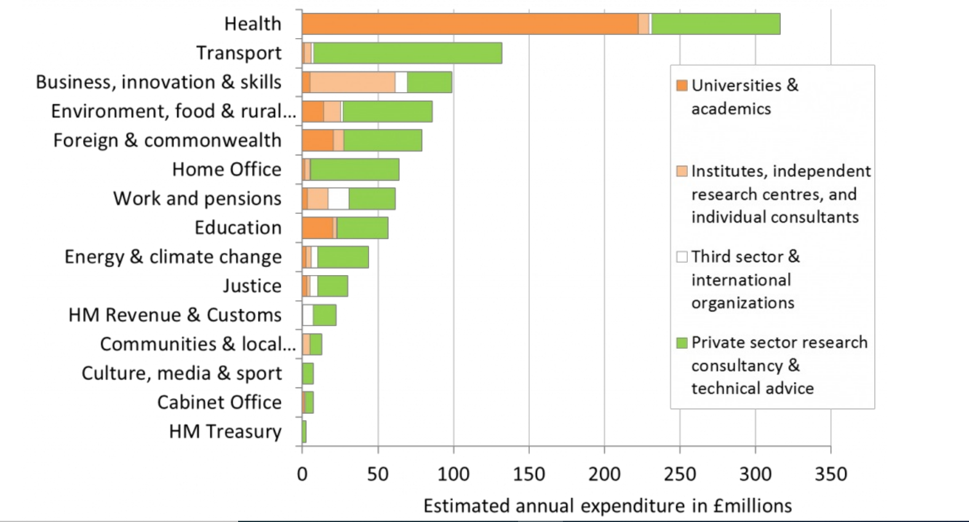
Use of contract research, UK (Bastow 2014):

