Slide 1
Grand challenges and a process perspective on research impact
Magnus Gulbrandsen, Richard Woolley and Taran Thune
EGOS Subtrack 9: Institutions, Innovation, and Impact
EGOS Annual Conference, Tallinn, 5-7 July 2018

Slide 2
Our goal: a conceptual discussion to understand and analyse research impact in light of grand challenges
We come from: science and innovation (policy) studies, where “grand challenges” and “impact” represent important priorities
The hope: lots of possible meeting places between inst./org. theory and science studies
Argument: grand challenges and the normative turn in impact requires new approaches and frameworks
Research/innovation: machines of (un)intended consequences, long time scale and 50 years of measurement experiences

Slide 3
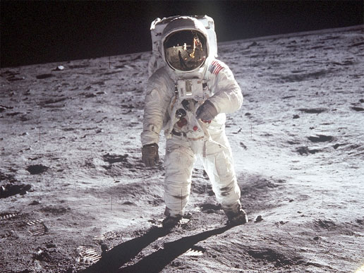
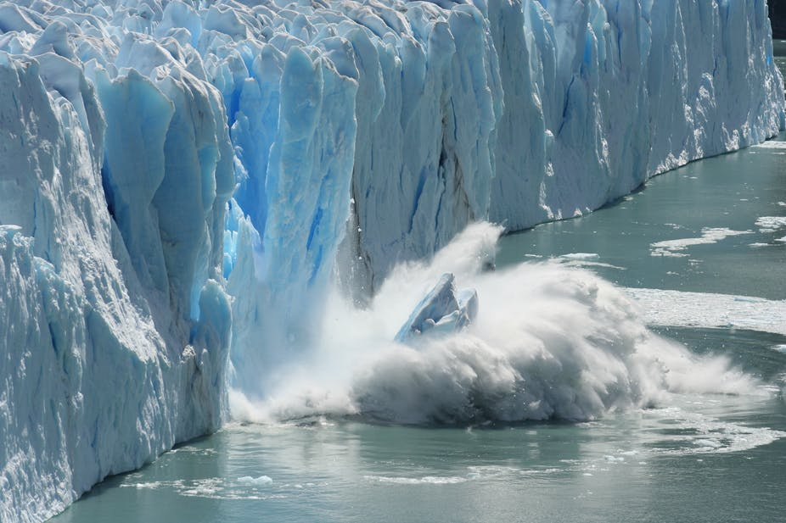
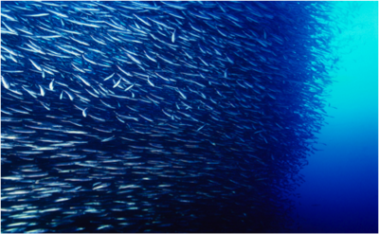
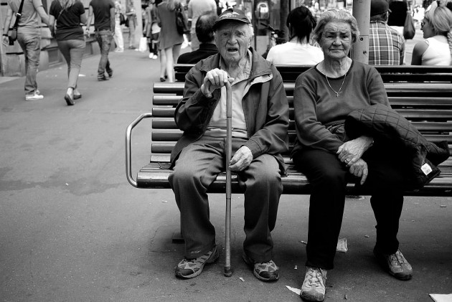
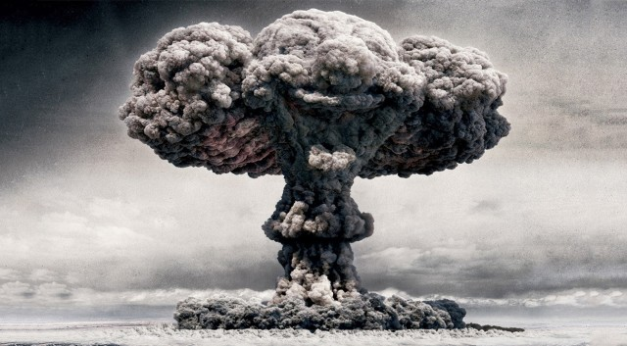
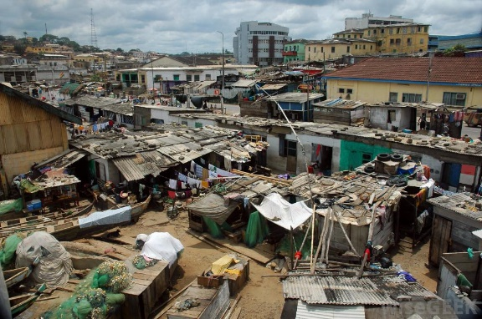
Old and new grand challenges for research
Grand challenge policies in research have been there for a long time
Early challenges were often technological in nature
Policies weakened from the 1980s: failures, diluted rationales, globalisation
Lack a good understanding of these policies
Newer grand challenges are different (“wicked” etc.)
Why has this form of policy been revitalised?

Slide 4
Changing perspectives on research
Science with and for society
New or renewed perspectives on research or knowledge production highlight usefulness, impact or end points
They also often express a new normativity with respect to who or what research should be good for
Stakeholders (should) become involved in the research process to help define relevant problems
Widened views on accountability
New mechanisms: directionality, reflexivity, experimentation, mobilization of narratives etc.
Mode 2 research
Post-normal science
Mission-oriented R&D
Responsible research and innovation (RRI)
Pasteur’s Quadrant

Slide 5
Problems with science and studies of it
Replicability crisis
Wider methodological problems (p-hacking, fMRI failures, contaminations of research material, increased retractions, datageddon)
Language problems (jargonitis, voice-of-god)
Paradigm problems (animal models, translational research, convergence towards science-for-its-own-sake or excellence)
Exponential growth
Indicators: no standards and lots of inappropriate use
Fragmentation: different communities with little contact
Linear model: naïve and instrumental perspectives on how science can and should be used
Bias: studies of “science and society” mainly become studies of science – and a general lack of investigations of defence research and industrial R&D
These criticisms raised in many of the new perspectives, asking for more combined approaches to understanding research impact

Slide 6
Combining four traditions for impact studies
Economics of R&D
Research evaluation
Mixed methods and process perspectives but mainly studies of the “research side”
Academic interaction
Nuanced and broad perspective on how research leads to impact, but research bias
Evolutionary studies
Highlight the systemic nature of impact and the often indirect nature of research and innovation
High return on investment but problems with latency and attribution

Slide 7
Starting with the impact/grand challenge
Problem area: an institutional field that is related to a (grand) challenge
User sites
Research sites
Mapping: status of knowledge, relevant science and innovation systems including users/stakeholders
Forward process tracing: study how key processual elements play out over a (preferably) long period of time
Translation | Innovation | Diffusion | Pluralisation
Learning | Legitimation | Reflexion | Alignment

Slide 8
Starting with the impact/grand challenge
Examples of problem areas we have started working on:
Rare diseases
Marine biodiversity
Employee retraining
Future public transportation
Challenges in studying research impact:
Meaningful definition and delimitation of problem areas (and grand challenges)
Keeping both the problem and the research in the same analysis
“Big” and complex perspective on temporality and causality
Process types and events that also include many forms of indirect interaction
Problem area: an institutional field that is related to a (grand) challenge
User sites
Research sites
Mapping: status of knowledge, relevant science and innovation systems including users/stakeholders
Forward process tracing: study how key processual elements play out over a (preferably) long period of time
Translation | Innovation | Diffusion | Pluralisation
Learning | Legitimation | Reflexion | Alignment

Slide 9
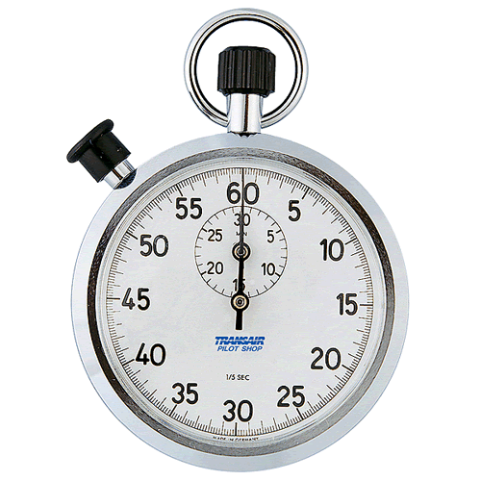
Time’s Up!
Thank you
About us:
  Magnus Gulbrandsen, Richard Woolley, Taran Thune
  University of Oslo and Polytechnic University of Valencia
  https://www.sv.uio.no/tik/english/research/projects/osiris/

