Slide 1


Slide 2
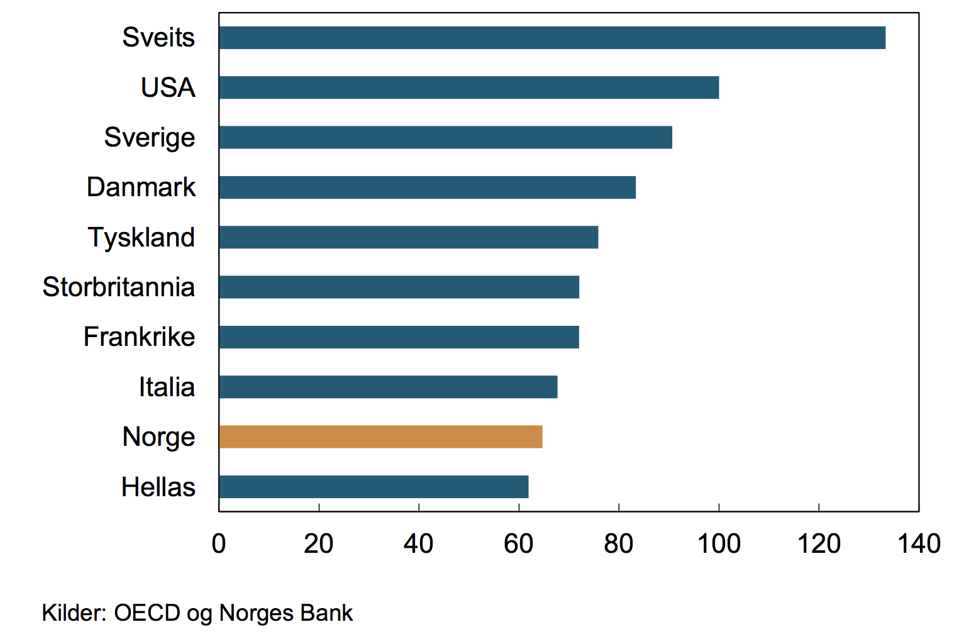
GNP per Capita in 1971
Index USA = 100

Slide 3
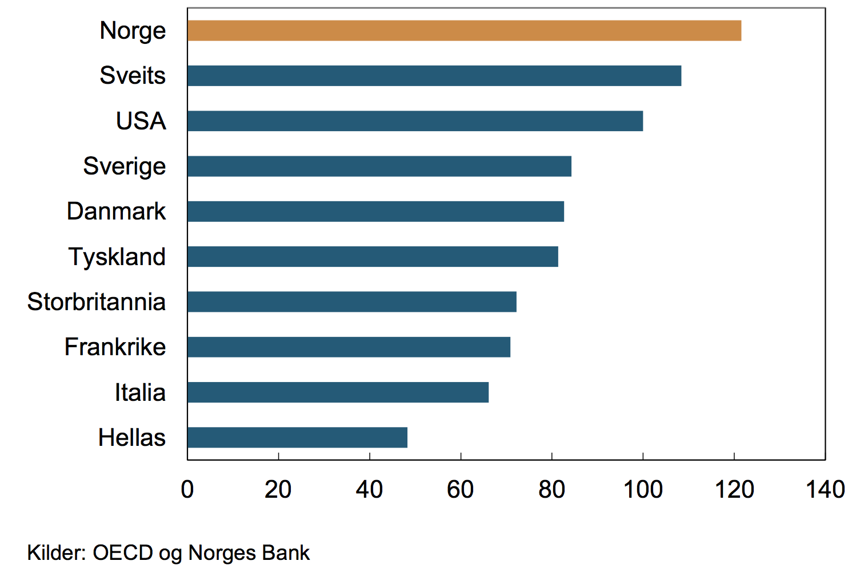
GNP per capita 2013
Index USA = 100

Slide 4
2011:
Norway imported goods and services for 508 billion NOK
Norway’s export was 889 billion NOK
Export of fish and fish products around 50 billion NOK
Traditional industries around 100 billion NOK
Export of oil and gas around 500 billion NOK
Export from the oil sector in the form of goods and services 150 billion NOK
1 Canadian dollars = 7 NOK

Slide 5
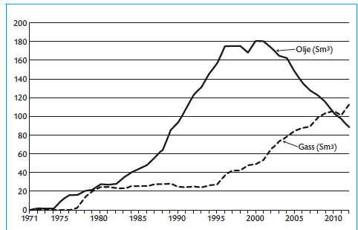

Slide 6
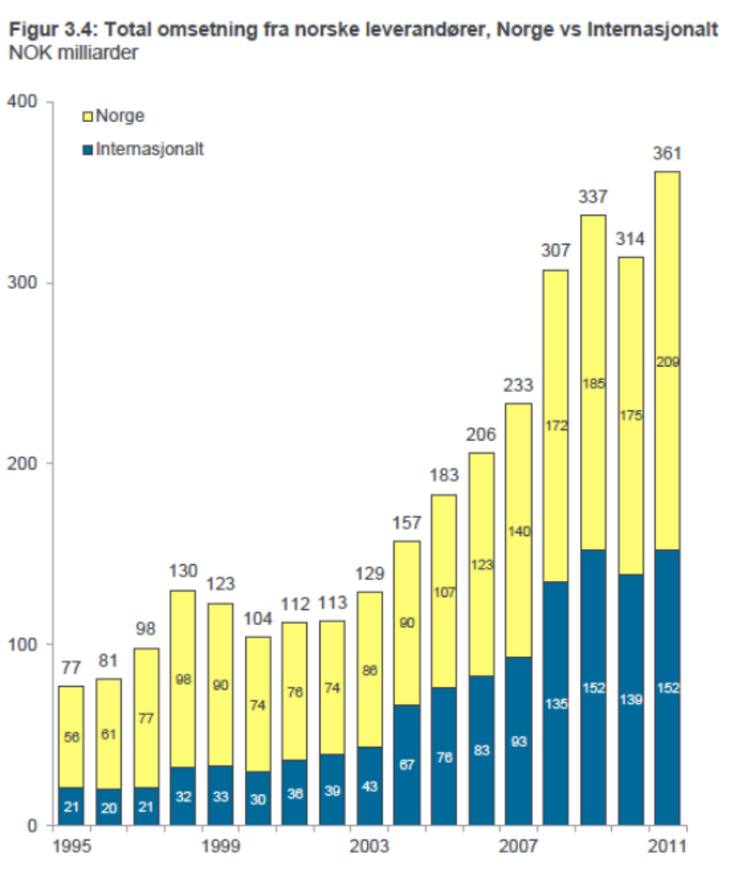

Slide 7
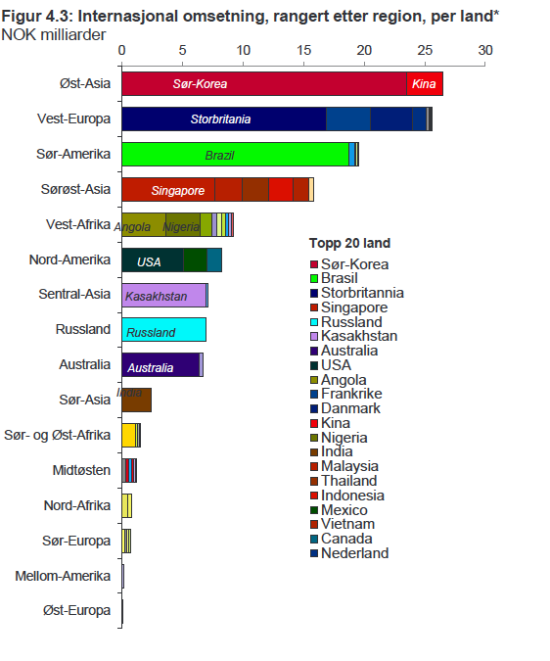

Slide 8


Slide 9
“Ultimately, if we’re going to prevent large parts of this earth from becoming not only inhospitable but uninhabitable in our lifetimes, we’re going to have to keep some fossil fuels in the ground rather than burn them and release more dangerous pollution into the sky.”
President Obama, 10. November 2015

Slide 10


Slide 11
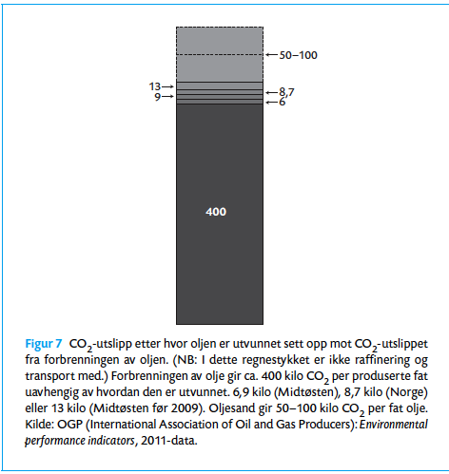

Slide 12
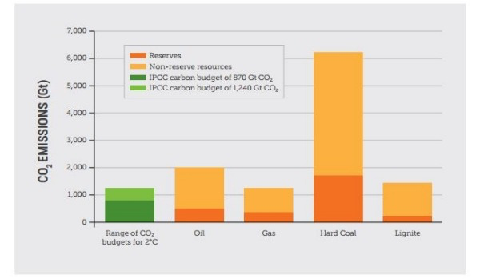

Slide 13
Våre utslipp
Olje: 0,22 Gt pr år
Gass: 0,22 Gt per år
Påviste reserver på henholdsvis 11 år olje og 15,9 år gass.
Tilsvarer 6, 1 Gt.Co2
Men opererer med reserver som er mer enn 3 ganger så stort
Tilsvarer utslipp på mer enn 20 Gt Co2.
Tilsvarer 10 % av et budsjett med 66 prosent sannsynlighet for oppvarming til 1, 5 C.
Enormt mye for en befolkning som tilsvarer 0,072 prosent av verdens befolkning.

