Slide 1
Public Health and Medicine
Topics for master thesis projects

Slide 2
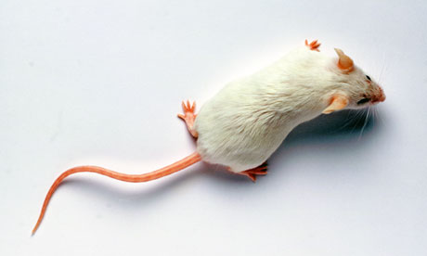
The development of laboratory animal science
Part of public health strategies
The role of animals in the work to ensure human health and welfare
The relationship between human health and
animal welfare
Care, skills, technologies and expertise
The role of law and regulations in ensuring quality in production and moral in practice

Slide 3
Technological innovations in public health and medicine
How are new technologies accepted and/or resisted socially and materially?
How are resistance to and acceptance of science and technology articulated, negotiated, and enacted in specific sites, objects and historically situated practices?
What cultural, economic and other values are enacted in negotiations of technological innovations in public health and medicine?

Slide 4
Vaccines as social controversies
1. Resistance to vaccines in society: Where and how have resistance to vaccines emerged? What alternative expertise have been mobilized? How do new social media and the Internet challenge conventional authorities on health such as policy-makers, governmental officials, and scientists?
- Relevant sites: Internet, social media, mass media, regulations and laws,
- Methods: Text analysis (historical/contemporary), interviews, field work

Slide 5
Acceptance of vaccines: How do processes of acceptance of new science and technology unfold? More specific questions:
How do vaccines work as political technologies in public health medicine and food production?
Relevant sites: The laboratory, public administration, the “farm”, NGOs
Methods: Ethnography, text analysis, archive studies, interviews

Slide 6
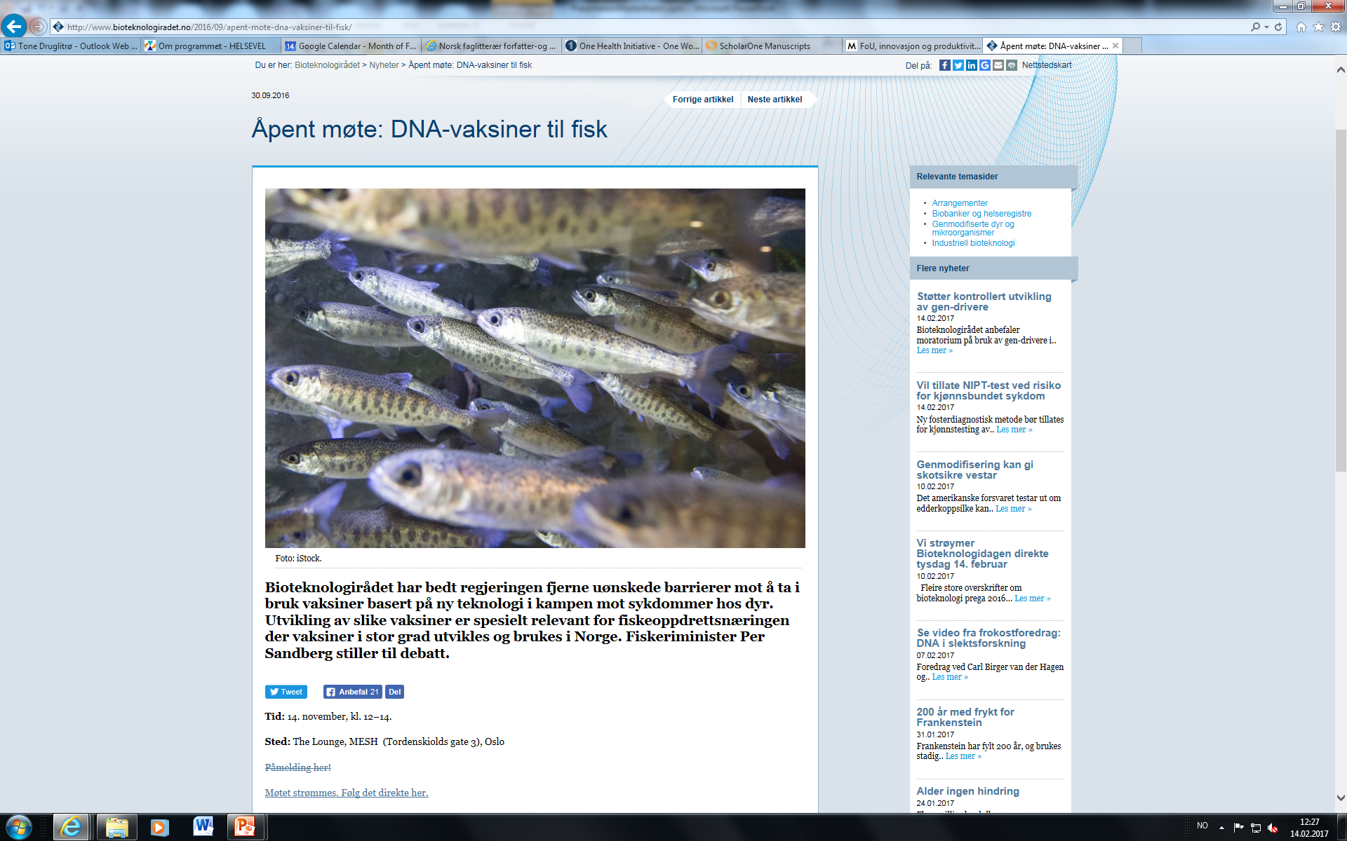
Examples of vaccine innovations and controversies in public health medicine and other bioeconomies
  Animal-based industries:
  Vaccine innovation as an important tool
  (ex. DNA vaccines), but also innovations in feed/
  fodder for domesticated livestock (which most
  often contain a combination of feed and (preventative)
  drugs)
  What is the relationship between risk (biosecurity)
  and care (welfare and quality) and how is it managed?

Slide 7
Examples of vaccine innovations and controversies in public health medicine and other bioeconomies
Public health:
Flu vaccine; swine flu epidemic, bird flu, seasonal flu
HIV vaccine; currently there is no effective vaccine, but scientists are continuously working on it
Childhood immunisation programme
Risk communication (policy-makers and scientists): How are public health advice and risk communicated?

