Slide 1

Faculty of Social Sciences

Slide 2

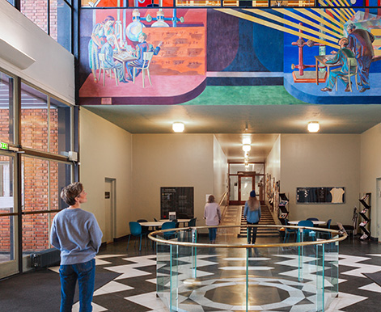


University of Oslo today
World’s 83rd best research university (Shanghai Ranking)
5 Nobel Prize winners
8 faculties
2 museums
Photo: AART Architects
Foto: Jarli & Jordan
219 study programmes
16 Centres of Excellence
107 ERC-funded projects
7 200 employees
26 500 students
Photo: Jarli & Jordan
Photo: Jarli & Jordan
Faculty of Social Science
Notes:
UiO er med i totalt 30 fremragende sentre: Sentre for fremragende forskning, sentre for fremragende utdanning, sentre for fremragende forskningsdrevet innovasjon, forskningssentre for miljøvennlig energi.
UiO er prosjekteier/vertsinstitusjon for 16 fremragende sentre.
50 aktive ERC-prosjekter per 31.12.2022. Totalt har UiO fått tildelt 92 ERC-prosjekter.
Nobelprisvinnere: https://www.uio.no/om/tall-og-fakta/nobelpriser/

Slide 3
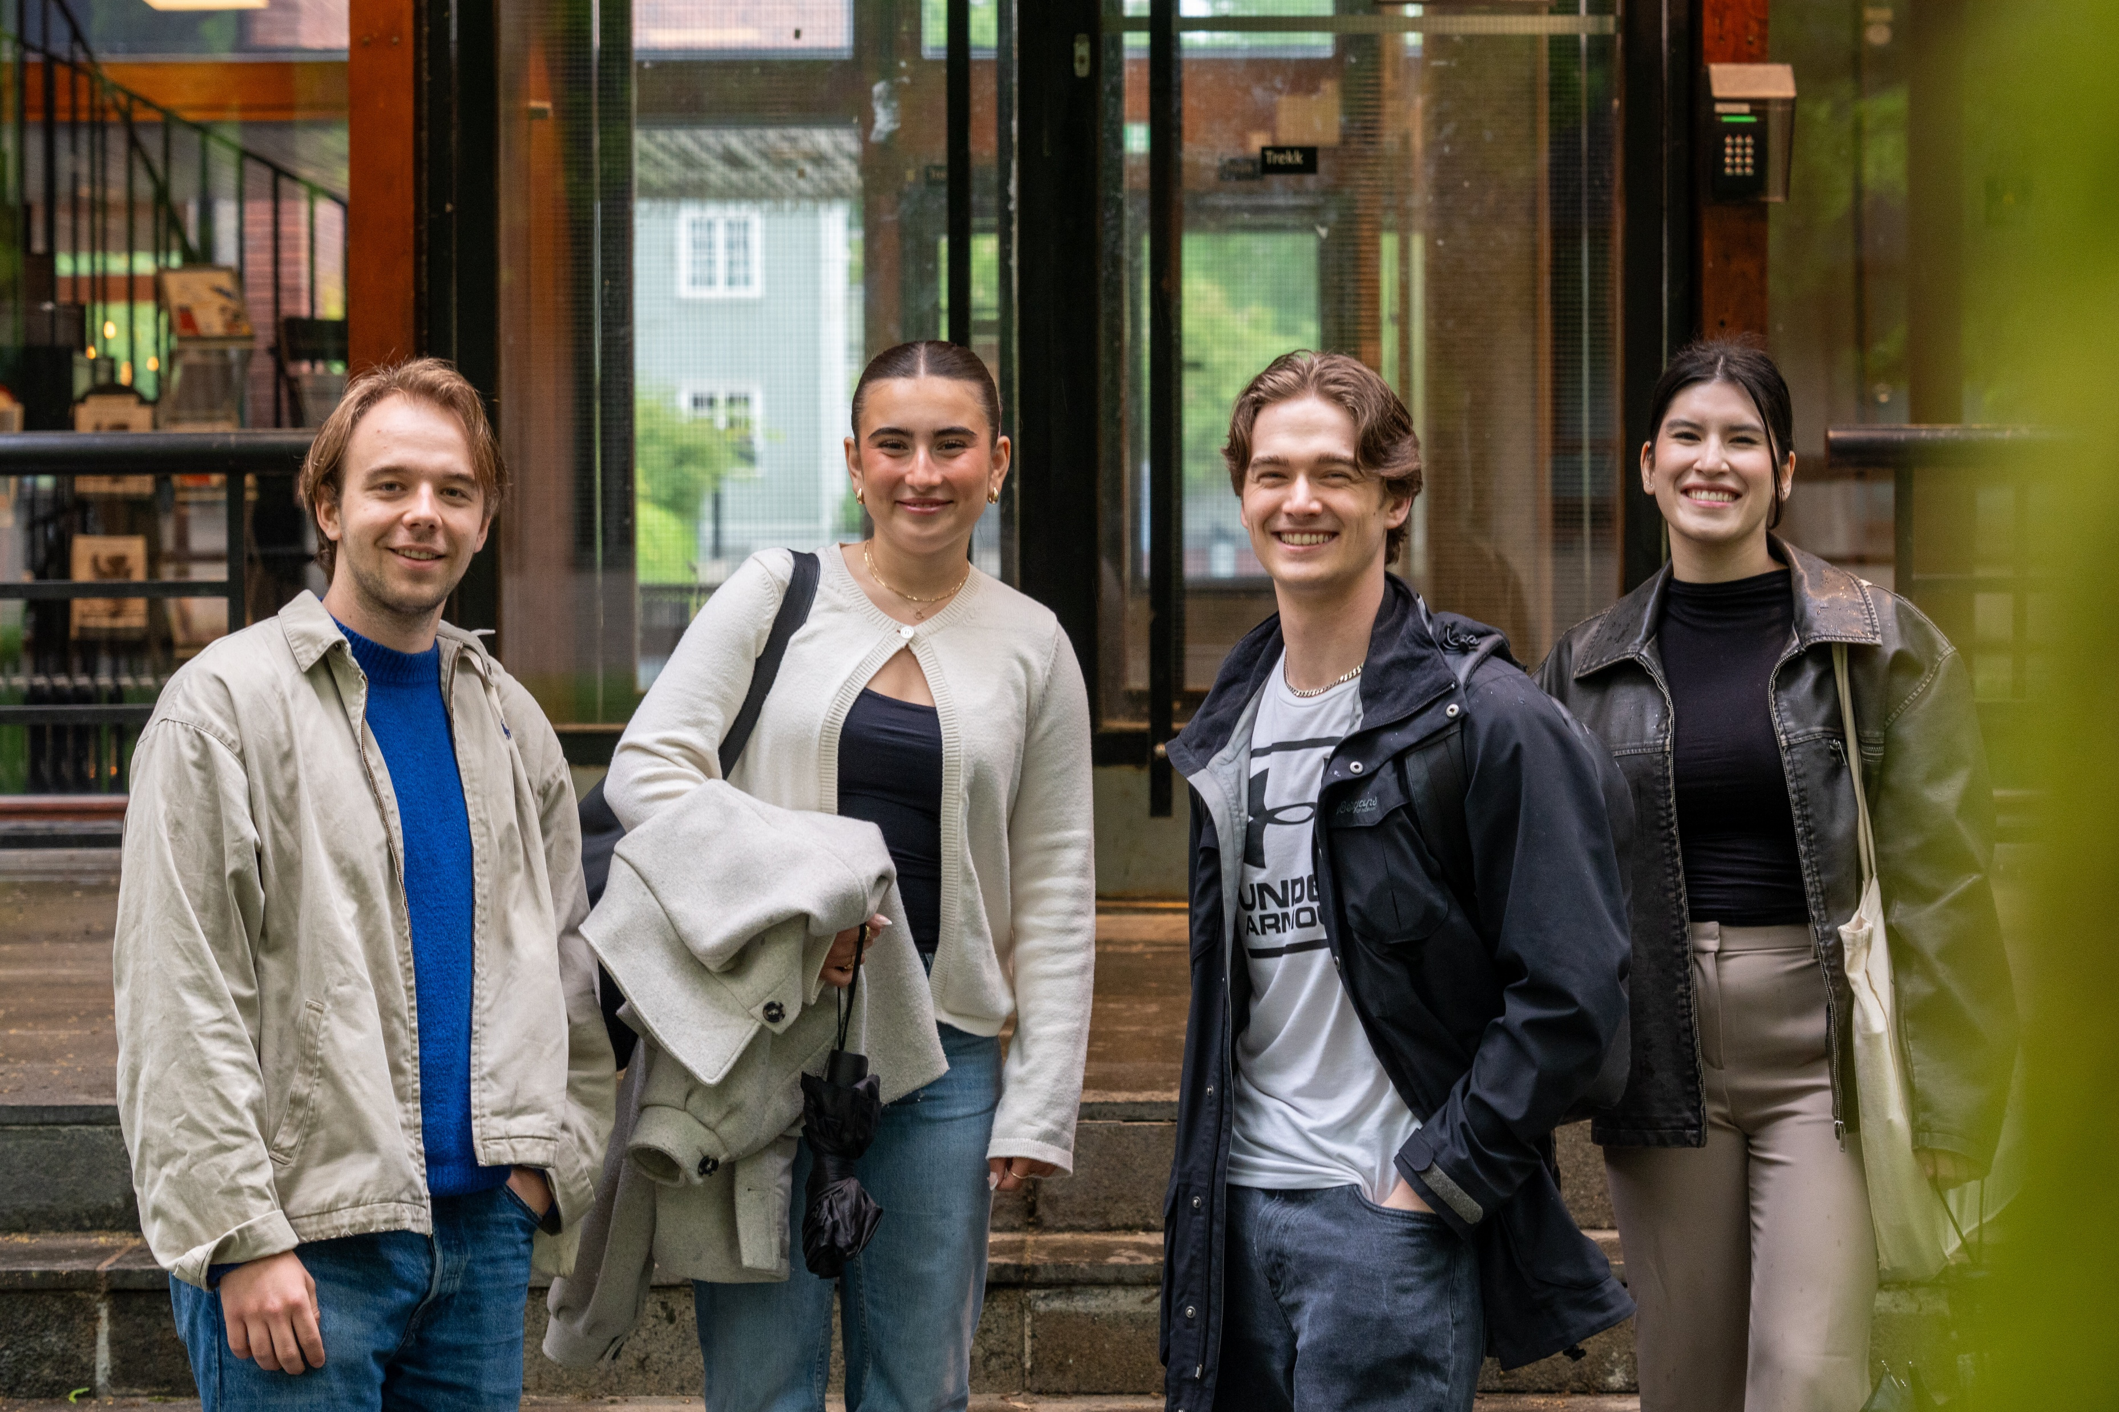

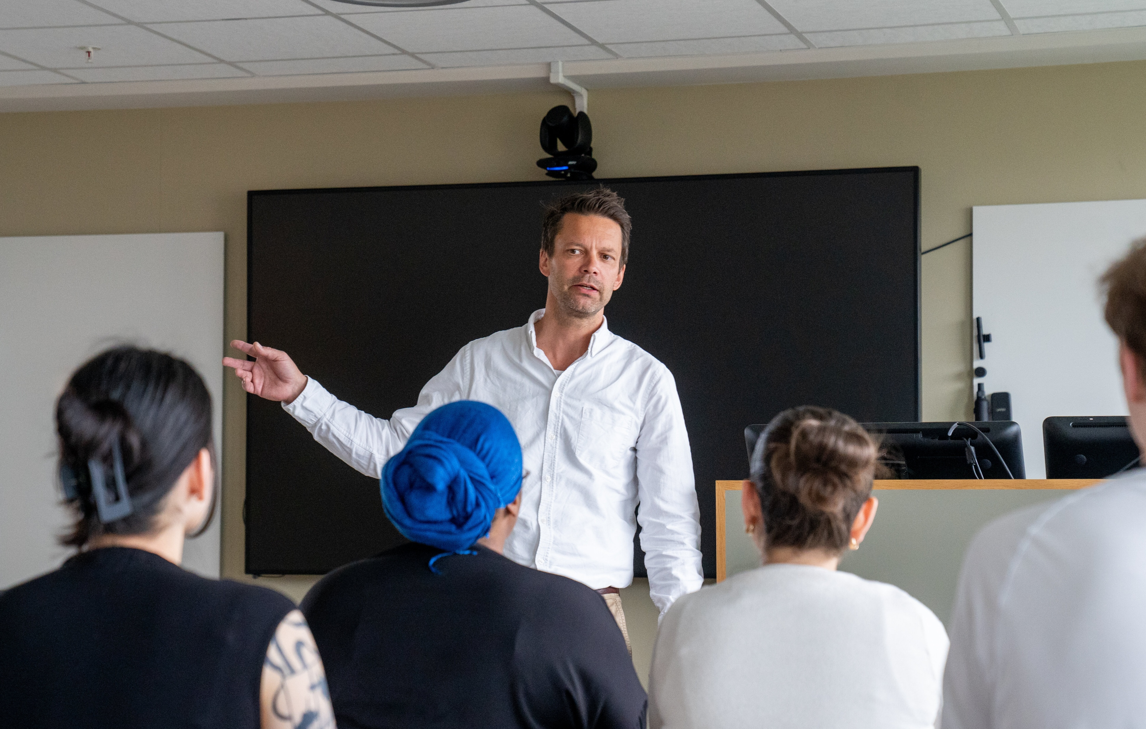
Faculty of Social Sciences – numbers and facts
Photo: Erik Engblad / UiO
Photo: Erik Engblad / UiO
Photo: Amund Aasbrenn / UiO
Students
4900 students
499 PhD candidates
Studies
1 professional program
12 master programmes
12 bachelor programmes
4 foundation years
Employees
494 academic FTEs
169 technical-administrative FTEs
Faculty of Social Science
Notes:
FTEs = full-time equivalent = årsverk

Slide 4
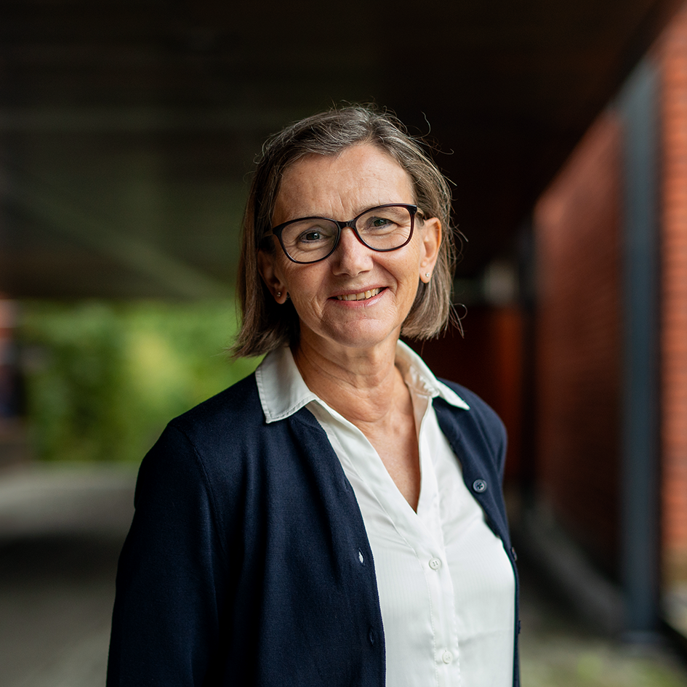
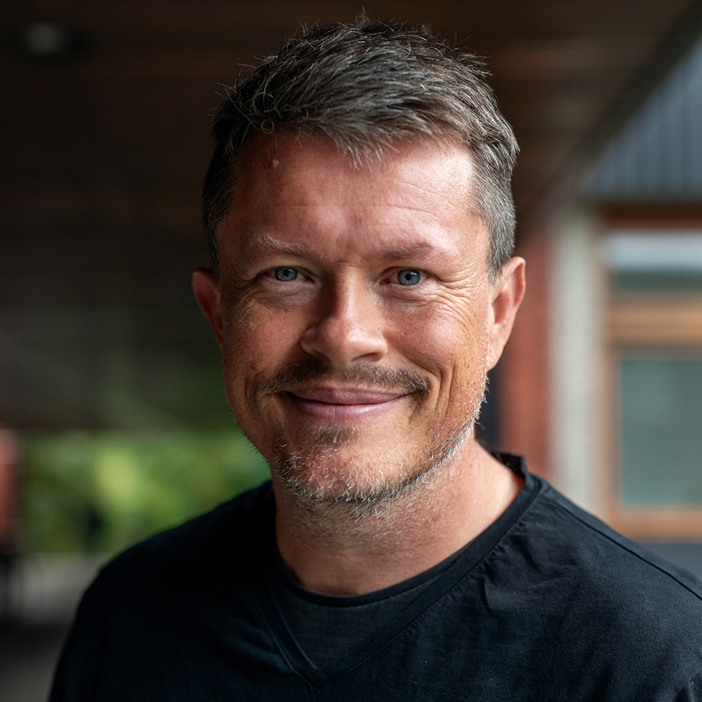
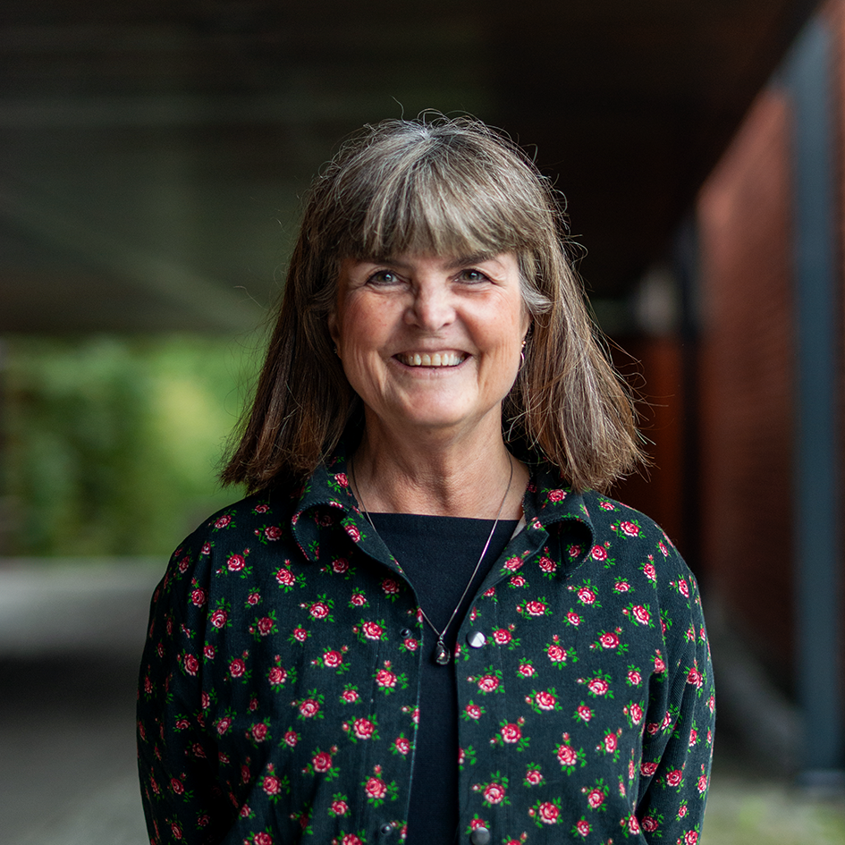
Faculty Management
Foto: Nicholas Doherty/Unsplash
Foto: Jarli & Jordan
Foto: UiO
Foto: UiO
Foto: UiO
Dean of the Faculty
Anne Julie Semb
Vice Dean (Research)
Lars Tjelta Westlye
Vice Dean (Studies)
Tora Skodvin
Faculty of Social Science

Slide 5
Organization
Faculty Board
Faculty administration
Faculty management
Finance section
Section for research and communications
HR section
Section for studies
Department of Psychology
Department of Sociology and Human Geography
Department of Economics
Department of Social Anthropology
Department of Political Science
TIK Centre for Technology, Innovation and Culture
ARENA Centre for European Studies
Faculty of Social Science

Slide 6

Study programmes and courses at the Faculty of Social Science
Photo: Erik Engblad / UiO

Slide 7
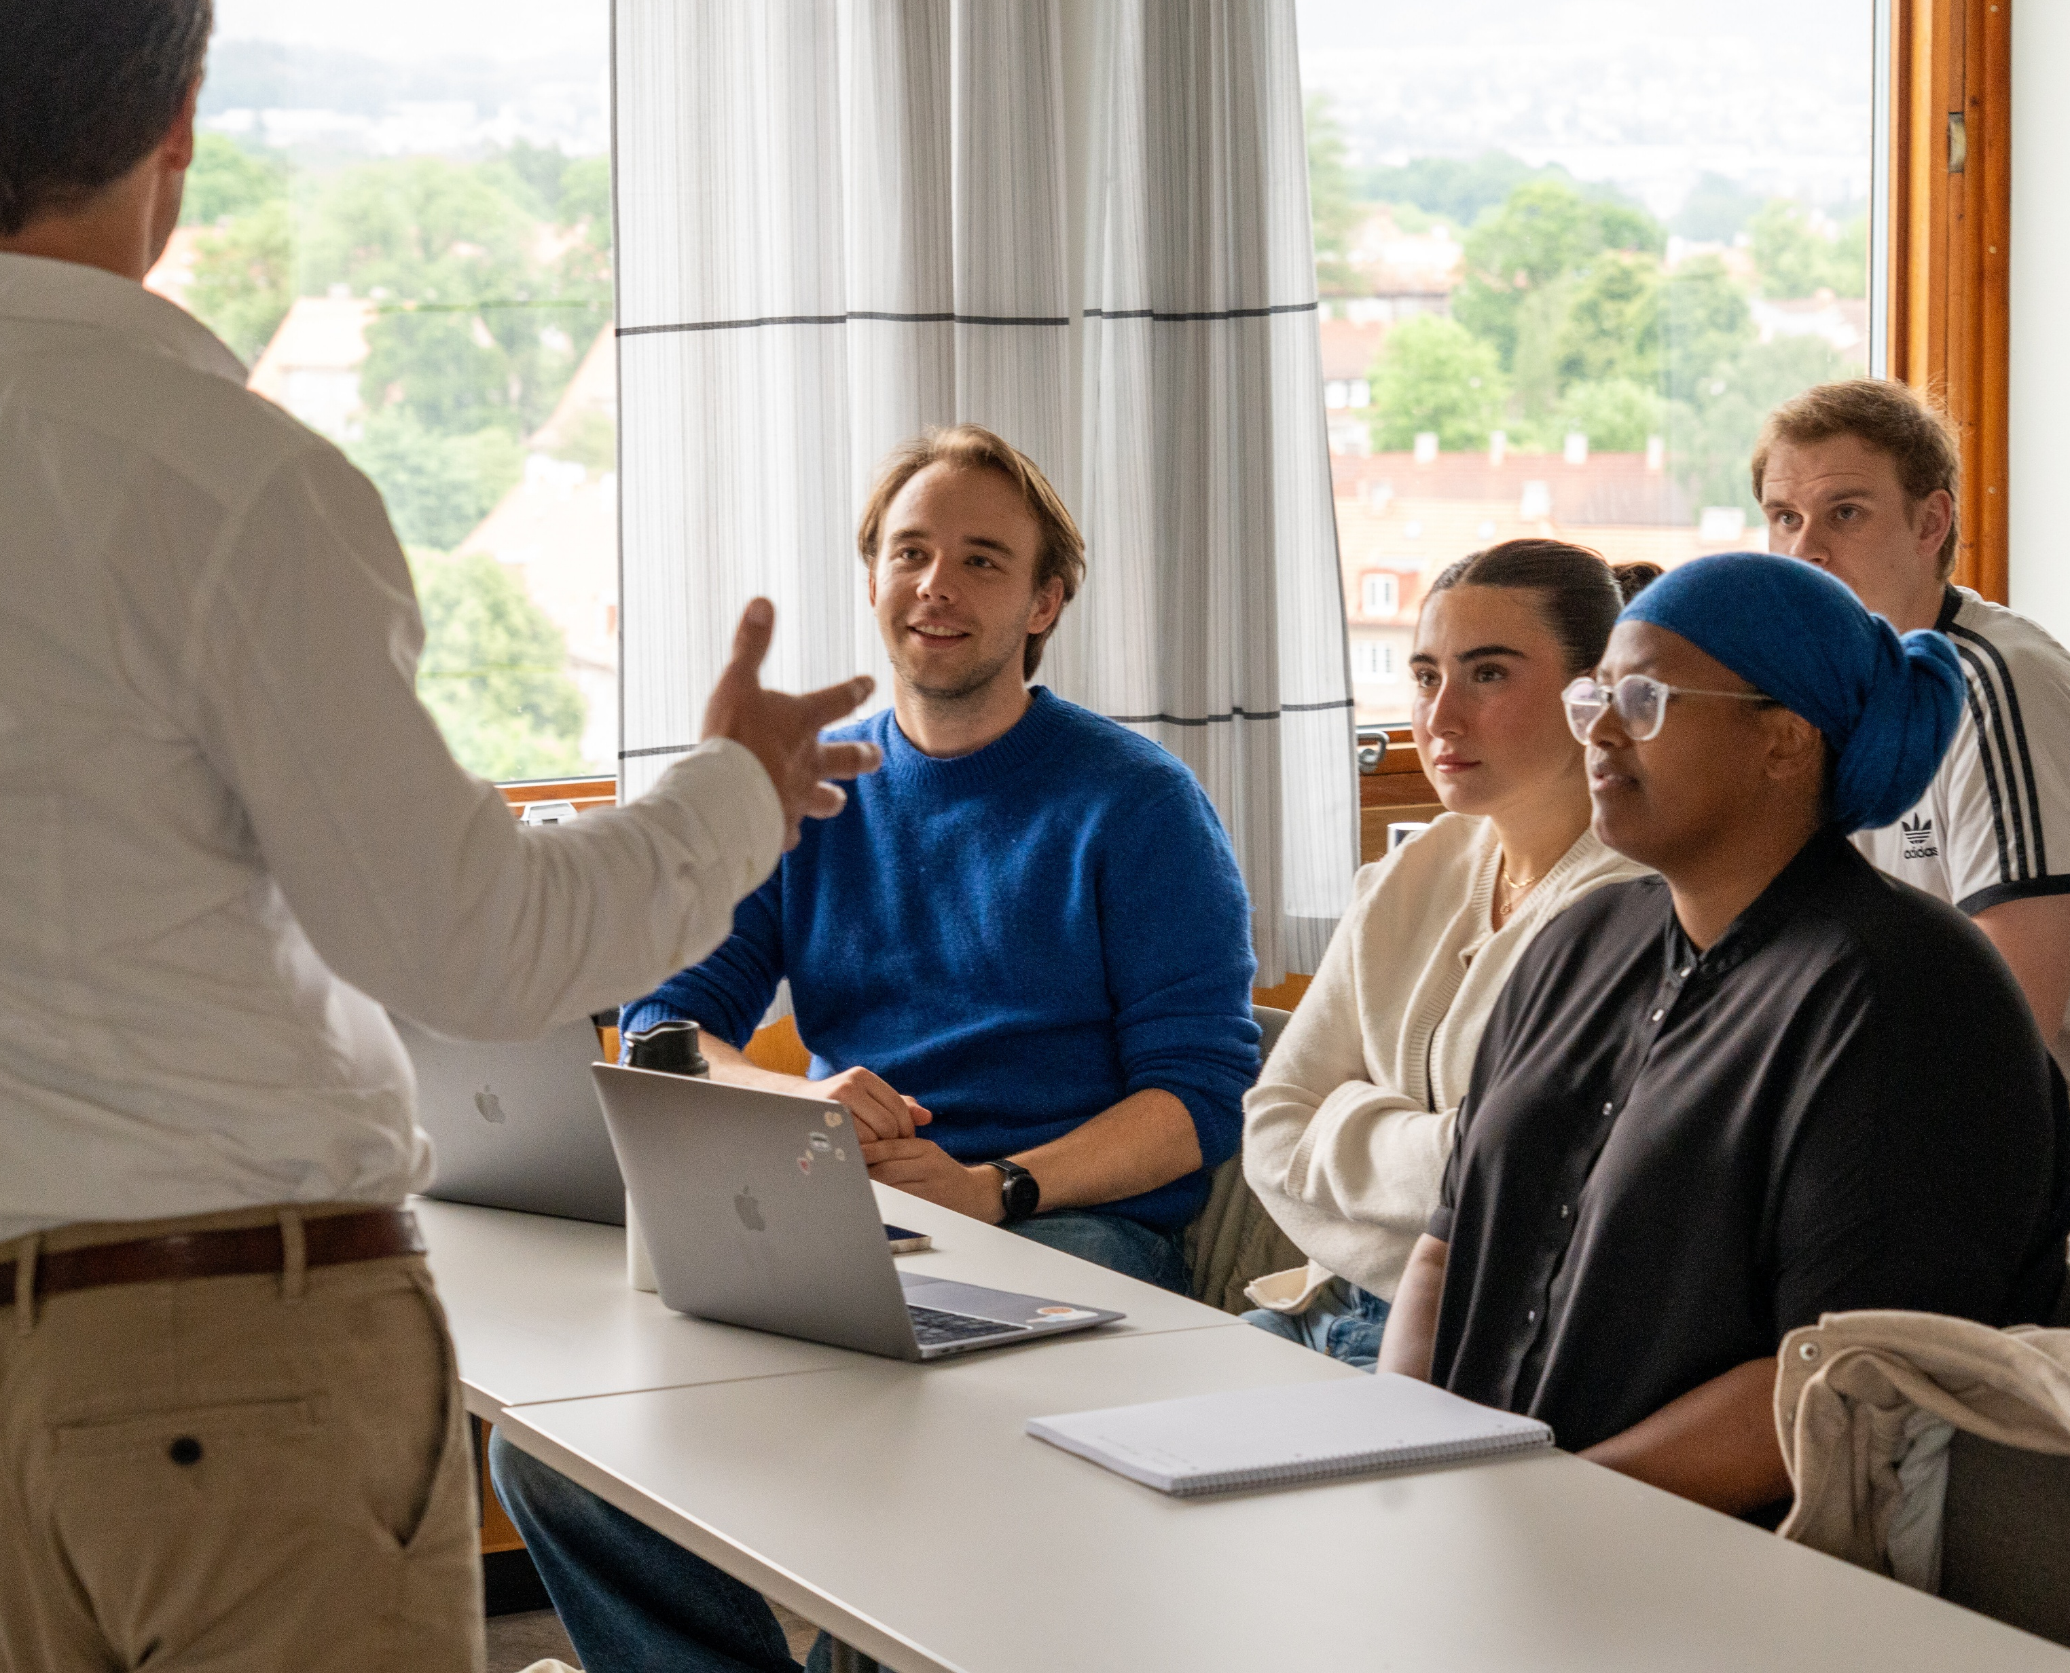



Bachelor programmes
Economics
Political Science
Sociology and Human Geography
Photo: Erik Engblad / UiO
Photo: Amund Aasbrenn / UiO
Foto: Jarli & Jordan
Foto: Jarli & Jordan
Technology, Innovation and Culture
Interdisciplinary courses
Psychology
Social Anthropology
Photo: Amund Aasbrenn / UiO
Photo: Erik Engblad / UiO
Foto: Jarli & Jordan
Faculty of Social Science
Notes:
Seks disiplinære og fire tverrfaglige programmer.

Slide 8




Master's degree programmes offered in English
Economics
Human Geography
Photo: Amund Aasbrenn / UiO
Photo: Amund Aasbrenn / UiO
Foto: Jarli & Jordan
Foto: Jarli & Jordan
Peace and Conflict Studies
Psychology
Social Anthropolgy
Photo: Erik Engblad / UiO
Photo: Erik Engblad / UiO
Foto: Jarli & Jordan
Faculty of Social Science
Notes:
Seks disiplinære og fire tverrfaglige programmer.

Slide 9
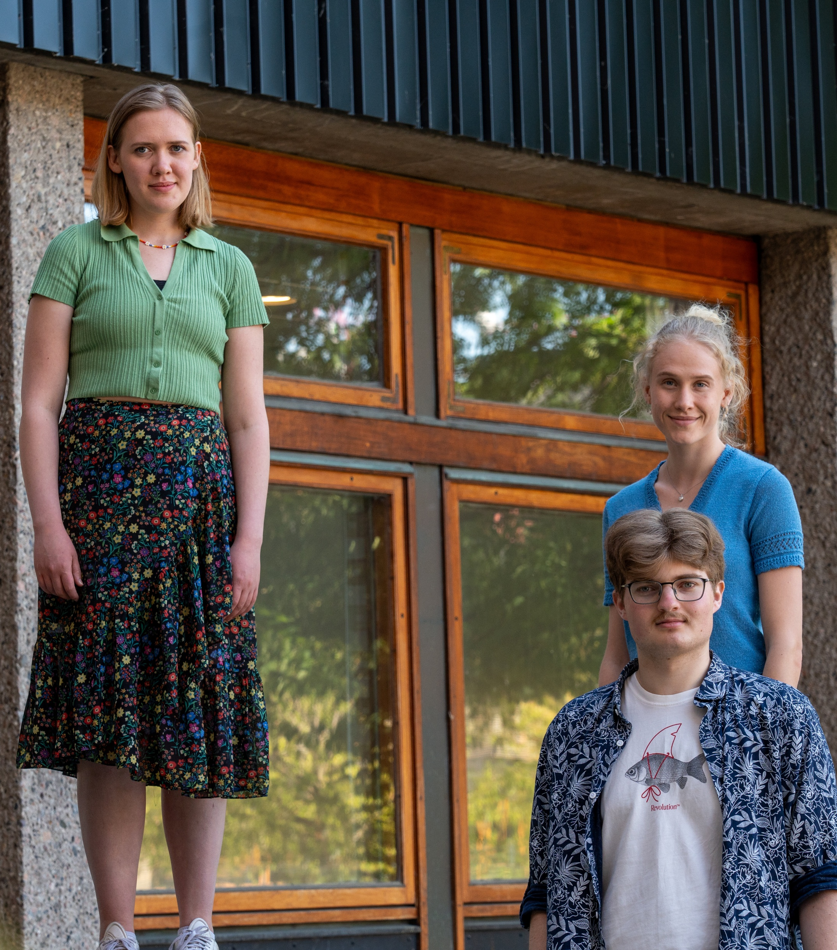
Professional education
Psychology
  Provides the student with the competence to work as an authorized psychologist
  6 years of education
  360 credits
Economics
  Socioeconomic analysis
  5 year master's program
  300 credits
Faculty of Social Science
Foto: Maylinn Hovengen Byrknes
Foto: Erik Engblad / UiO

Slide 10
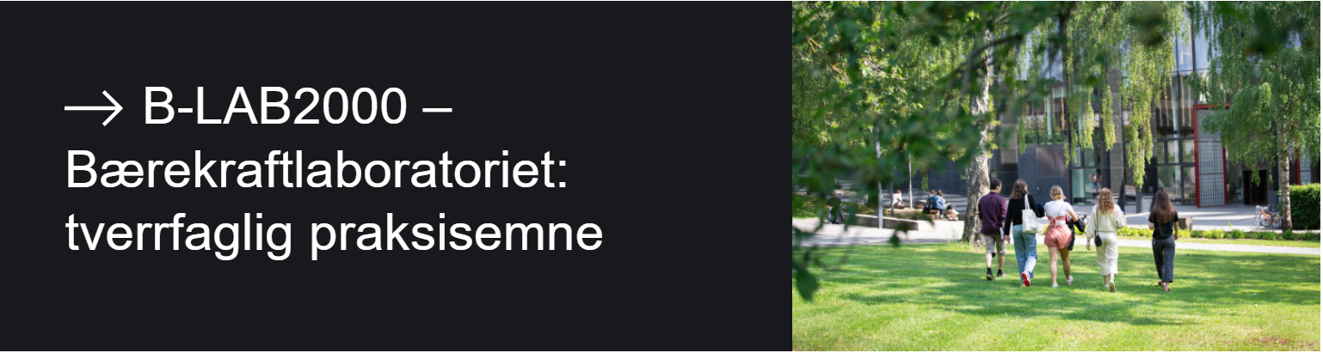


Interdisciplinarity and sustainability
Examples:
SAMKLIMA: Environment, society and sustainability (40 group)
Faculty of Social Science

Slide 11

Center for Interdiciplinary Education: INTED
Brings together students from:
The Faculty of Humanities
The Faculty of Social Sciences
The Faculty of Mathematics and Natural Sciences
Goal: Develop students’ interdiciplinary competence
Faculty of Social Science

Slide 12
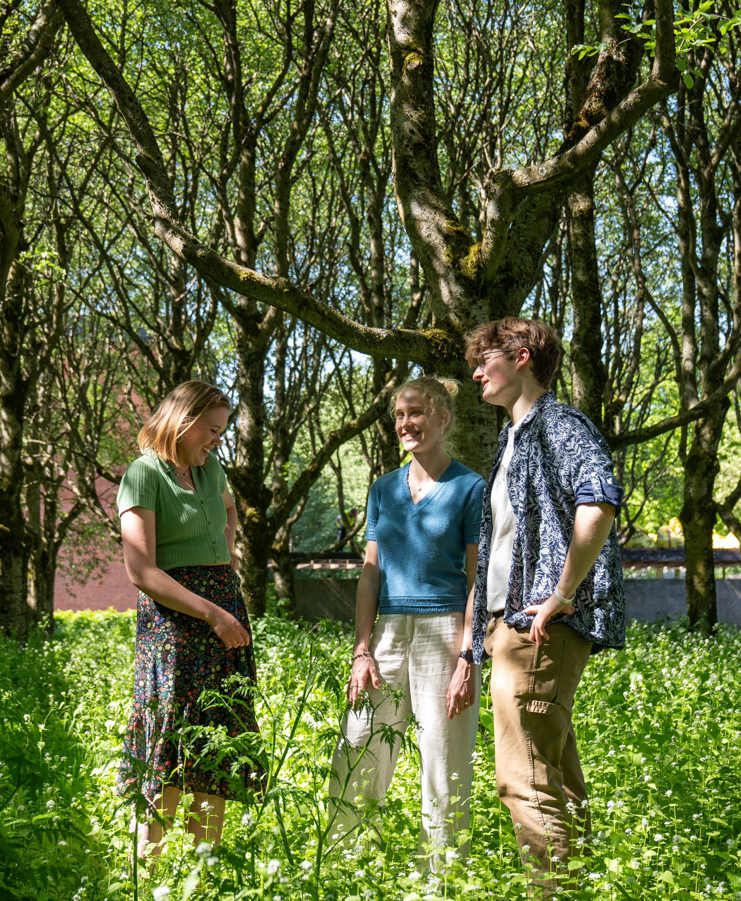
Exchange programmes
115 student exchange agreements with higher education institutions
The Faculty of Social Science offers 331 English-language courses
Entries in 2024: 335
Departures in 2024: 225
Faculty of Social Science
Photo: Amund Aasbrenn / UiO
Notes:
Oppdatert 15.08.25

Slide 13
Working life relevance
Internship
- work life experience
- resources
- network
Active
learning
- learn to learn
- relevance to
working life
Career competence
- Knowledge of and communicate own competencies
- transission from studies to work
Alumni
- ambassadors
- job profiles
- network
Society
and working life
- relevance
- point of contact
and frequency
- network
5 focus areas aimed at strengthening the content of education and the student's learning experience and perceived working life relevance
Foto: Getty stock image
Foto:Audum Braastad/NTB
Foto: Jarli & Jordan
Foto: Jarli & Jordan
Ensure the relevance of students' competencies for the workforce after completing their education
Increase students' own understanding and ability to articulate their competencies
Ensure employers' understanding of and knowledge about students' competencies after completing their education
Det samfunnsvitenskapelige fakultet
Referanse: Sluttrapport Samfunns- og arbeidslivsrelevante studier, 2021, SV, UIO

Slide 14
EILIN - Network for Learning and Teaching
Photo: Erik Engblad / UiO
Photo: Erik Engblad / UiO
Photo: Erik Engblad / UiO
Digital Tools
Student active learning methods
Varied assessment methods
Teaching support
Development projects
Support and assistance for IT in education
First-line support
Subject-specific services
Sharing of experiences
Competence development
Pedagogical development work
Faculty of Social Science

Slide 15
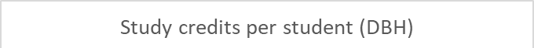
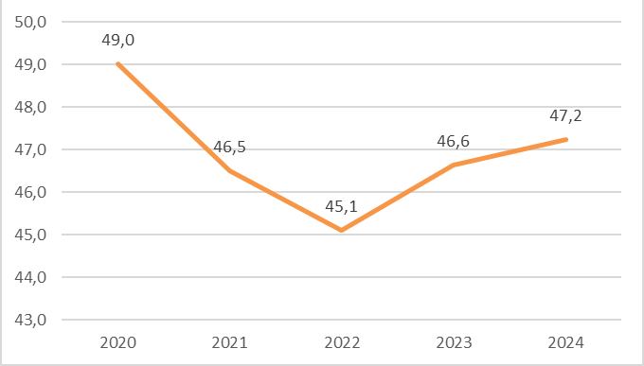
Focus on teaching quality
Positive trend
Good results – even with a large scope
607 high-quality courses
Preventive measures against dropout
High student-to-teacher ratio: 9,2
Faculty of Social Science
Notes:
Oppdatert 15.08.25

Slide 16



Circle U.
European university alliance consisting of 9 universities
Will facilitate students and staff to study and collaborate across borders
Photo: Circle U.
Photo: Circle U.
Faculty of Social Science
Notes:
Målet er å etablere et inkluderende, forskningsintensivt og tverrfaglig europeisk universitet.
Samarbeid på tvers av institusjoner, mellom ansatte, mellom studenter, og mellom studenter og ansatte.
Etablering av forskningsprosjekter og nye studietilbud.
Medlemmer: Universitetet i Oslo, Aarhus Universitet, Humboldt-Universität zu Berlin, King’s College London, Univerzitet u Beogradu, Université catholique de Louvain, Université Paris Cité, Università di Pisa, Universität Wien.

Slide 17
Research at the Faculty of Social Science
Photo: Erik Engblad / UiO

Slide 18

Funding allocations from the Research Council of Norway 2015 - 2024
21 FRIPRO research projects
21 FRIPRO young research talents
2 big interdisciplinary research projects
28 researcher/collaborative projects
Photo: Jarli & Jordan
4 research centres
Center of Excellence (SFF)
Photo: Unsplash
Photo: Unsplash
Faculty of Social Science

Slide 19

EUs Framework Programme
Total number of projects
ERC
9 Advanced Grants
9 Consolidator Grants
16 Starting Grants
Thematic (2014-2024)
4 coordinator projects
18 partner projects
Marie Skłodowska-Curie Actions
7 doctoral networks (1 coordinator)
7 postdoctoral projects
Total funding 2019-2024: 32,8 millions euros
Faculty of Social Science
Foto: Unsplash
Photo: Wikipedia
Photo: Wikipedia

Slide 20

Targeted initiative
ERC
  The first two in 2012, a total of 34 approved
  Several researchers have recieved multiple ERC grants
Thematic
  Great potential
  Aiming at Horizon Europa
Marie Skłodowska-Curie Actions
  Recruit young, excellent researchers
Faculty of Social Science
Photo: Unsplash

Slide 21
The Guild of European Research-Intensive Universities
23 research-intensive universities from 17 European countries
Working on research and education policies, as well as contributions to EU programmes
Faculty of Social Science
Photo: imageBROKER/Wilfried Wirth
Notes:
For UiO er påvirkning på den europeiske arenaen viktig, gitt norske universiteters avhengighet av innretningen på EUs politikk, programmer og utlysninger, i tillegg til at forsknings- og utdanningspolitikken som utformes i Brussel i stor grad påvirker nasjonal politikk og nasjonale virkemidler.
Om The Guild-samarbeidet: https://www.uio.no/om/internasjonalt/the-guild/

Slide 22



Ranking of social science at UiO
Shanghai ranking
QS 2023
Times Higher Education
Sociology 30th place
Political science
34th place
Public administration
36th place
Social Anthropology:
44th place
Sociology: 45th place
59th place
Det samfunnsvitenskapelige fakultet
Notes:
Oppdatert 15.08.25

Slide 23
Funding
Income over time (2019-2024)
Share of external funding 2024
Det samfunnsvitenskapelige fakultet

Slide 24
Research support
Strategies, consultations, processes
Information and guidance on the Research Council of Norway and Horizon Europe
Guidance in grant writing
Research infrastructure
Research ethics and GDPR
Research support
Faculty of Social Science
Photo: Hilde Vik Dale / UiO
Notes:
For UiO er påvirkning på den europeiske arenaen viktig, gitt norske universiteters avhengighet av innretningen på EUs politikk, programmer og utlysninger, i tillegg til at forsknings- og utdanningspolitikken som utformes i Brussel i stor grad påvirker nasjonal politikk og nasjonale virkemidler.

Slide 25
The PhD programme
51 doctoral dissertations in 2024
Increased admissions as a result of success in external funding.
Faculty of Social Science
Photo: Amund Aasbrenn / UiO

Slide 26
Strategic objectives
Development in gender balance
EQUALITY

Slide 27

Gender distribution
Faculty of Social Science

Slide 28
Social innovation – applied knowledge
Public Commissions
Changes in policy, regulations and systems
SPARK Social innovation
Knowledge dissemination
Participation in the Innovation Council
ERC – Proof of concept
Faculty of Social Science

Slide 29
We contribute to a knowledge-based public debate
Faculty of Social Science

Slide 30
The road ahead
Continued focus on excellent research and education
Equality and diversity among students and staff
Social innovation
Investing in research infrastructure and research ethics.
Sett inn bilde her
Faculty of Social Science
Foto: Jarli & Jordan
Foto: Colourbox

