Slide 1
The virtue of Innovation Systems Analysis for policy makers and other stakeholders in the Energy Transition Prof. Marko Hekkert

Slide 2
Who is talking?
Prof of Dynamics of Innovation Systems
Head of Innovation Studies (35 fte)
Part of Copernicus Institute (120 (fte)
Part of Utrecht University

Slide 3
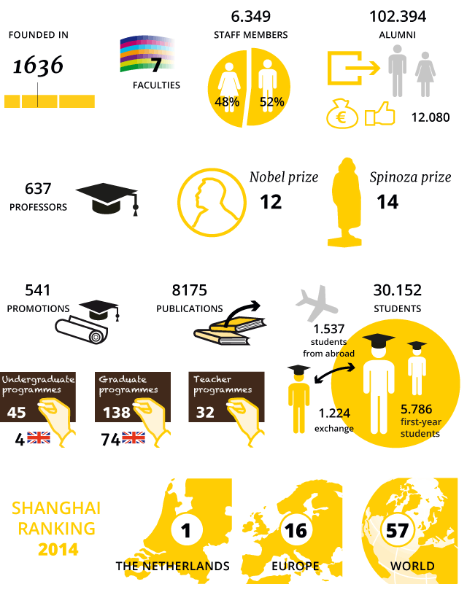

Slide 4
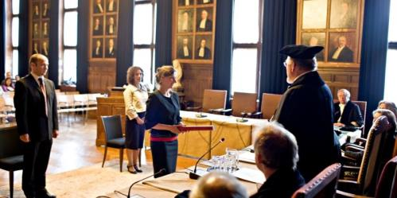
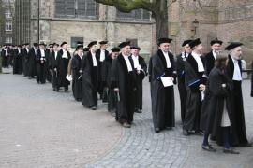
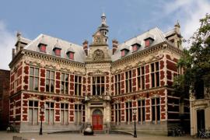

Slide 5
This talk
Overview of what we have been doing in this field
Focus on science – policy interaction using the TIS approach

Slide 6
Long history in TIS research
Why?
Interested in emergence of new technologies
Innovation is a collective activity
Technology characteristics, actors + institutional settings all matter (structure)
Technological fields differ
Leads to policy relevant outcomes – problem oriented
Shift from structure to processes

Slide 7
Quick tour through a Technological Innovation System analysis PV as casus

Slide 8
Government, policy, institutions
Research
education
industry
market
Supportive infrastructure (banks, innovation support offices, lobby organizations)

Slide 9
Diffusion→
Wafer based
Stabilisation
Thin Film
accelleration
Pre-development
Development
Take-off
Functioning prototype?
Commercial
application?
Fast
Market growth?
Market saturation?

Slide 13
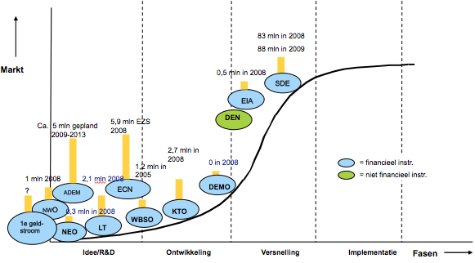

Slide 14
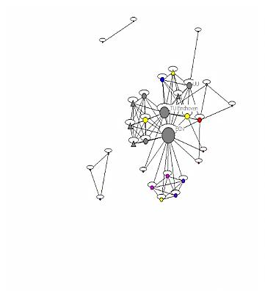
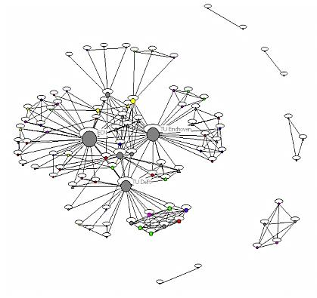
Network 2006 vs 2010

Slide 15
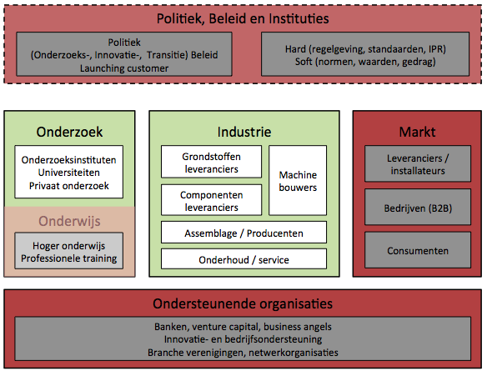

Slide 16
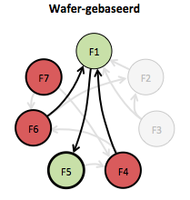
Key processes / functions of TIS
F1 entrepreurial experimentation
F2 knowledge development
F3 knowledge exchange
F4 Guidance of the search
F5 Market formation
F6 resources mobilisation
F7 legitimacy creation

Slide 18
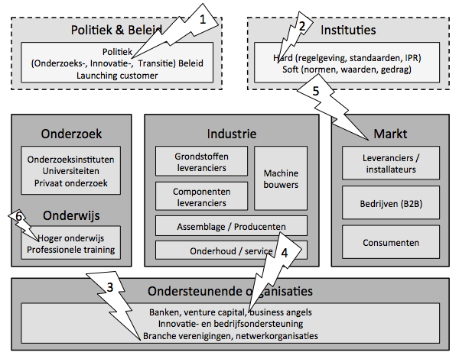

Slide 19
What have we done so far?
7 PhD students
Mapping of the emergence and growth of many TIS
E.g. Biofuels, wind, PV, CHP, gasification
Framework article + testing of framework
Review article: why does renewable energy diffuse so slowly?
Developed process methodology
Developed theory on dynamics of TIS: motors of innovation

Slide 20
recently
Study of actors strategies within TIS: system building, institutional theory
Role of incumbent actors in blocking TIS
Developed scheme of analysis for policy advice
Wieczorek, A.J., Hekkert, M.P. (2012). Systemic instruments for systemic innovation problems: A framework for policy makers and innovation scholars. Science and Public Policy, 39(1), pp. 74-87

Slide 21
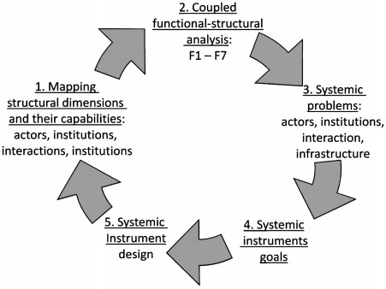
Scheme of analysis

Slide 22
Policy discourse
Neo-liberal innovation policies
Generic innovation subsidies
Help to overcome market failure
Innovation department of Economic Affairs
Innovation policies in specific domains
Energy, Transport, Water
Goal oriented
Much more specific policy intervention
Specific R&D programs, launching customer, demonstration projects

Slide 23
Goal oriented policies
Were in need of a guiding framework
Many different stakeholders
What is good policy when effects show up much later?
They stumbled upon the TIS framework

Slide 24
Why do they like TIS?
Innovation process is complex but framework is simple
Right language: system failure, motors not running, fixing, intervention
Backed up by science – legitimate

Slide 25
2008 First TIS policy project
Quick scan of 20 TIS related to the energy transition
Based on stakeholder workshops
Close cooperation with NEA
What factors are blocking the development of the TIS to the next phase?
product life cycle perspective
500 million euro + 3,5 billion in matching from industry

Slide 26
2010 End of energy transition
New government
More liberal policy
Transition policy had to go
Focus on national strengths
Top sector policy
Energy as top sector
No more interest in TIS

Slide 27
TIS survived
NEA had to monitor the energy transition program
The decided to collect data based on TIS framework
All projects
All actors
Actor networks
Goals of the projects
Project results

Slide 28
Training of NEA
Help by designing structure of database
Train employees to understand the concepts and the usefulness
Increase legitimacy in top of organization by giving presentations, attending strategy meetings etc

Slide 29
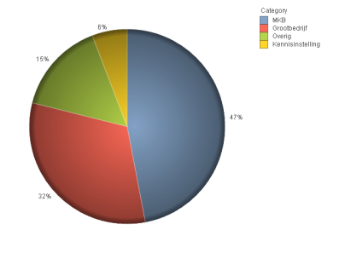
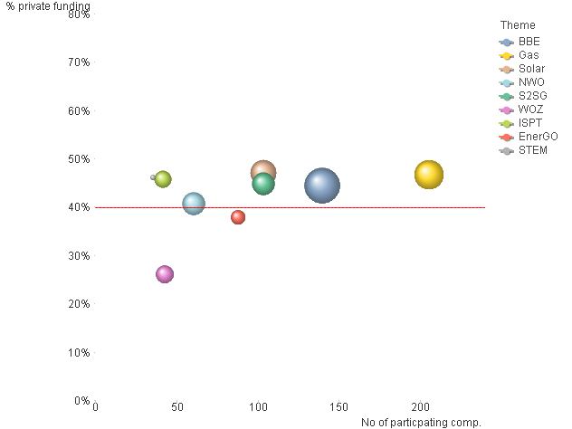
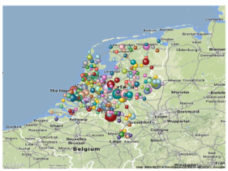
Functioning of the Dutch Energy System - Actors
The right actors?
International reputation?
Role in value chain?
Regional clusters?
Enough Private Resources?
% SME?
Source: Public-Private financed project plans of RVO.NL, NOW and Knowledge Institutions

Slide 30
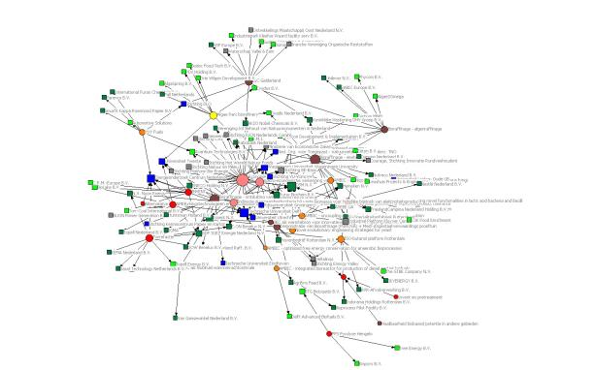
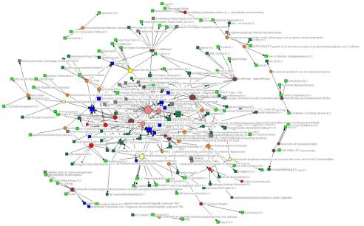
Functioning of the Dutch Energy System – Collaboration
Building up an innovation system?
Do we see changes in network characteristics?
For example: Network of BBE in 2012 and 2013
Source: Public-Private financed project plans of RVO.NL, NOW and Knowledge Institutions

Slide 31
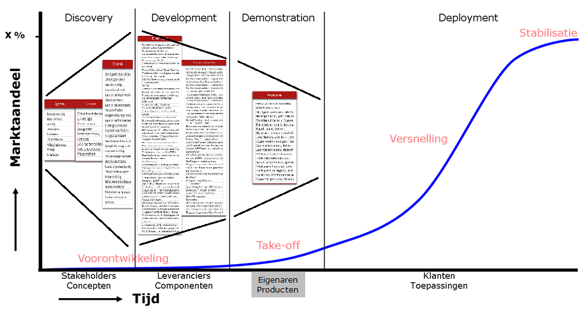
Functioning of the Dutch Energy System - Technology
Enough variation?
Increase in Technology Readiness?
Stabilisation
Accumulation in products?
Marketshare
Acceleration
Business case?
Take-off
Pre-development
Stakeholders Suppliers Owners Customers
Concepts Components Products Applience
Time
Source: Public-Private financed project plans of RVO.NL

Slide 32
Innovation Sensor
A Dashboard for Portfolio Management
Helping the TopTeam to decide on….
Doing the right things?
Based on expectations of plan Bureaus and experts
Doing the things right?
Based on facts and figures from projects
1
Review the functioning of the structure
Identify potential value networks
2
3
Prioritize the most actractive value networks
4
2
Decide on less/more
Resources for Programs
Analyze the functioning
1
6
5
Map the innovation structure
Execute and monitor the Programs
3
Staf the Programs
Optimize the portfolio of Innovation Programs
6
Execute the Programs
5
Staf the Programs
4
Select the Innovation Prrograms
….institutional change to empower the new economy

Slide 33
Final result
TIS is now firmly embedded in Dutch energy policy domain…..
…. as monitoring tool / framework
Tool to make sense of a lot of data
Not only energy: also water, transport, agriculture
Policy makers may not understand the framework but work with the outcome
International expansion

